Slide 1
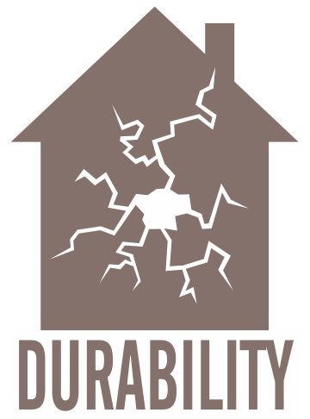
WATER-RESISTANT MATERIAL (WATER-MANAGED FOUNDATION)
WHAT?
Water threats can come in the form of:
Rainwater/stormwater runoff
Groundwater intrusion
Movement of moist air
Water vapor movement
Bulk water leaks from inside the basement.
Notes:
Water threats can come in the form of rain/stormwater runoff, groundwater intrusion, movement of moist air, water vapor movement, or bulk water leaks from inside the basement (e.g., plumbing leaks).

Slide 2
WHY?
Water management is critical in addressing overall foundation durability and creating healthy basement conditions. Mold and insect/pest issues, decreased IAQ, etc. can result from water damage. Using water-resistant materials around the foundation and basement is part of a comprehensive set of measures that minimize the risk of water damage to these areas.
Notes:
Water management is critical in addressing overall foundation durability and creating healthy basement conditions. Mold and insect/pest issues, decreased IAQ, etc. can result from water damage. Using water-resistant materials around the foundation and basement is part of a comprehensive set of measures that minimize the risk of water damage to these areas.

Slide 3
Insulating basement walls without properly addressing moisture management can mask future problems, so before installing insulation:
Use a vapor barrier under slabs and on crawlspace floors
Damp-proof the exterior of foundation walls.
HOW?
Notes:
Insulating basement walls without properly addressing moisture management can mask future problems, so before installing insulation, use a vapor barrier under slabs and on crawlspace floors, and damp-proof the exterior of foundation walls. Before insulating the basement, be sure to evaluate these additional critical matters:
Combustion and appliance safety
Radon and carbon monoxide safety
Insect/pest considerations

