Slide 1
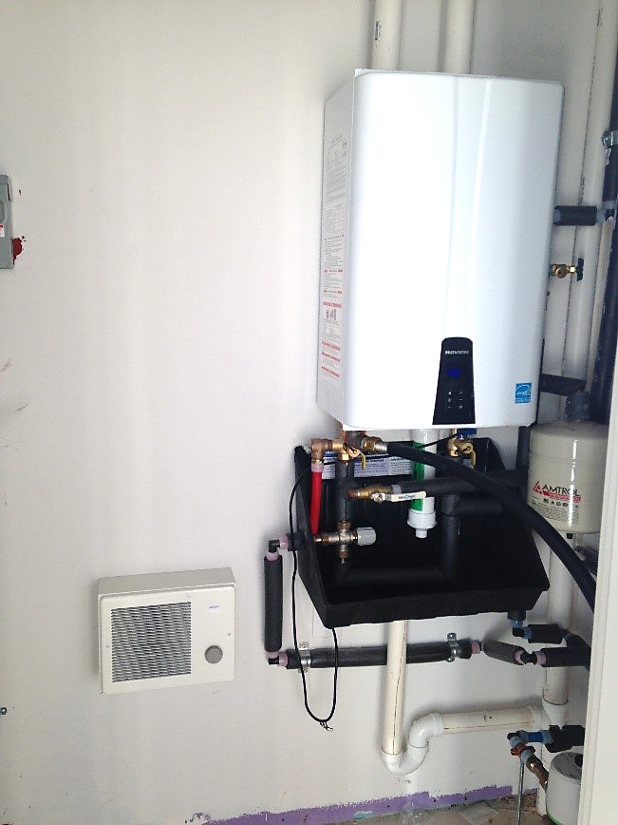
WATER HEATERS USE VARIOUS MEANS FOR FUEL: SOLAR WATER HEATERS
WHAT?
A tankless water heater can help significantly reduce water heating energy because:
It provides on-demand heated domestic water—without the standby losses associated with tank storage water heaters.
Its tank allows a considerably large volume of water to be used in a very short time.
Notes:
Another way to significantly reduce water heating energy is through installation of a tankless water heater. It provides on-demand heated domestic water—without the standby losses associated with tank storage water heaters. Here, the tank allows a considerably large volume of water to be used in a very short time.

Slide 2
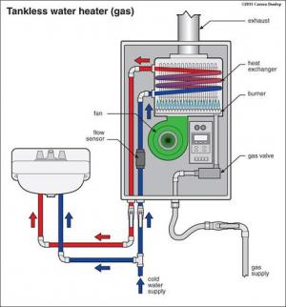
WHY?
High-efficiency endless hot water heaters offer:
2 to 5 gallons of hot water per minute
Compact size
Longer life expectancy
Minimal wasted energy
Lower-cost, endless hot water
Notes:
Often, high-efficiency endless hot water heaters can provide hot water at a rate of 2 to 5 gallons per minute. Other benefits include small size and longer life expectancy. These water heaters minimize wasted energy, producing lower-cost hot water that never runs out.

Slide 3
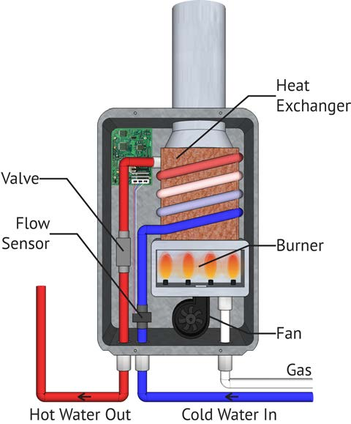
When a hot water tap is turned on, cold water enters the unit from the cold water supply and heating is activated.
Heating stops when water flow from the fixture stops, so energy is only consumed when a fixture is on.
When installing a tankless water heater, the unit should be level and rust- and corrosion-proof hardware should be used.
HOW?
Notes:
A gas tankless water heater’s basic components include a high-powered burner, fan, and heat exchanger. When a hot water tap is turned on, cold water enters the unit from the cold water supply and a sensor detects the water flow; then it activates a heating device, which raises the water temperature to a preset level. The heating element shuts off when the water flow from the fixture stops. These water heaters only consume energy when they are on.
When installing a tankless water heater, the unit should be level and rust-and corrosion-proof hardware should be used.

