Slide 1
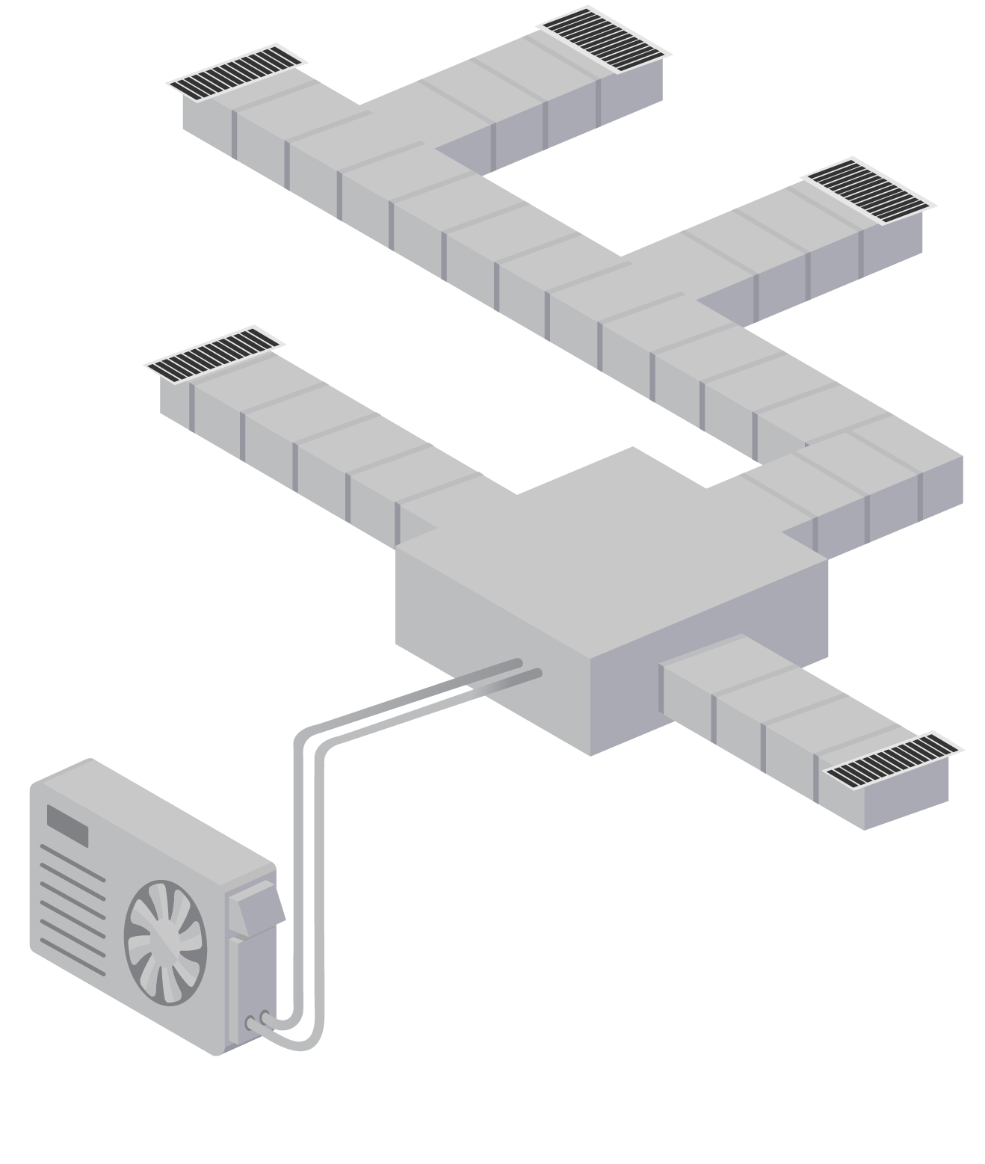
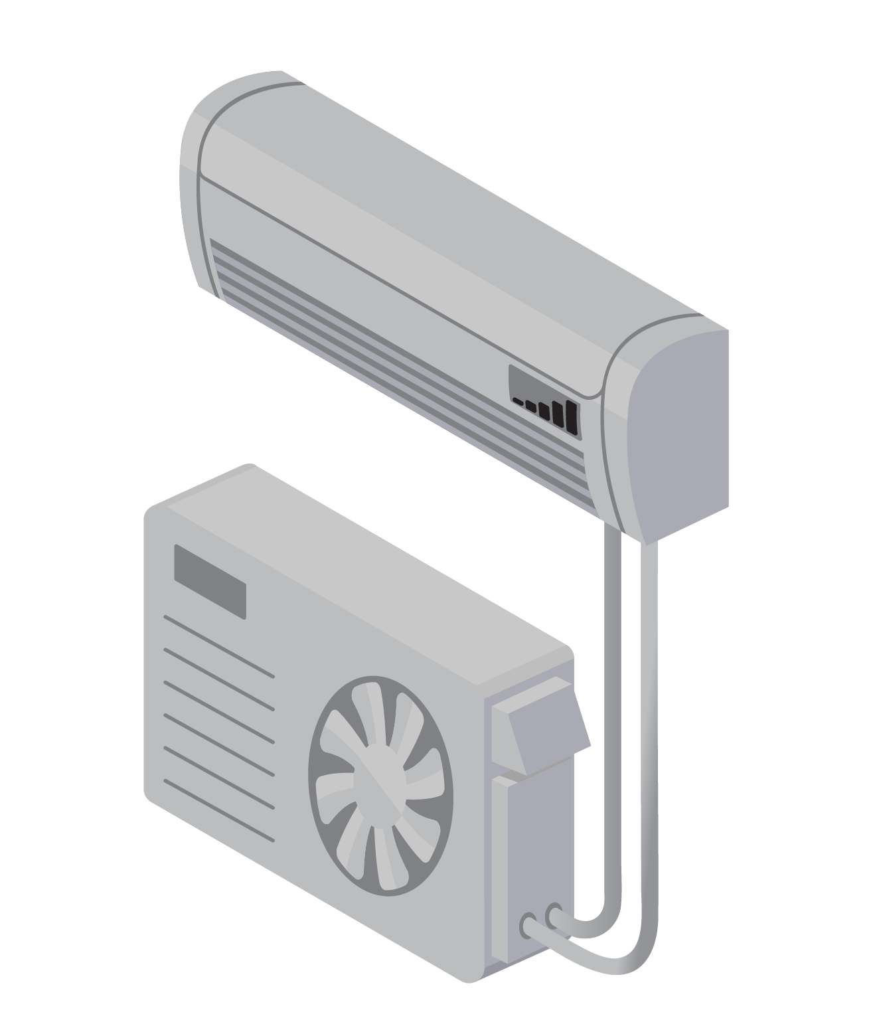
Thermostats and Controls
Taken from
Cold Climate Air Source Heat Pump Sizing and Design Training
by NYSERDA
Notes:
From NYSERDA Training. Used with permission.

Slide 2
Thermostats and Controls Learning Outcomes
Understand common ASHP control types
Learn about integrated control strategies for back up or supplemental heat
Understand control principles
Learn about temperature setback nuances specific to ccASHPs
Notes:
Discuss why this is important to the audience. Cater to the specific audience’s roll and pre-knowledge.
Homeowner’s perspective
Contractor’s perspective
The best system only functions as intended if properly controlled.

Slide 3
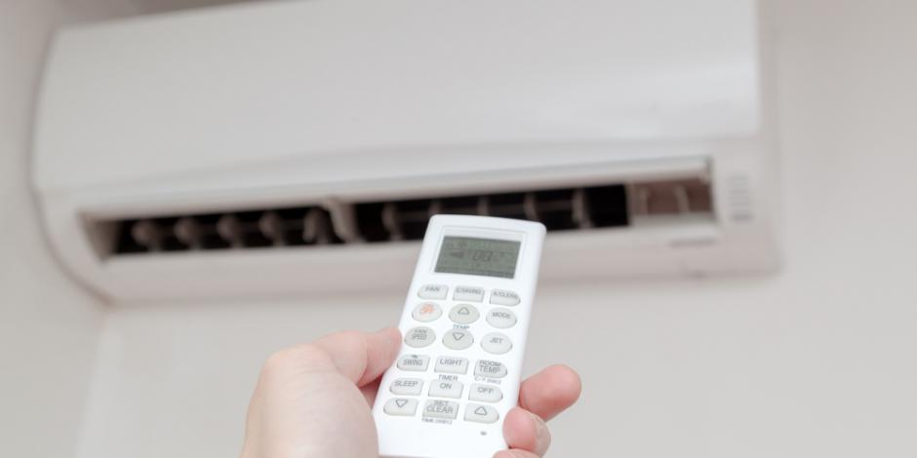
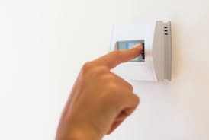
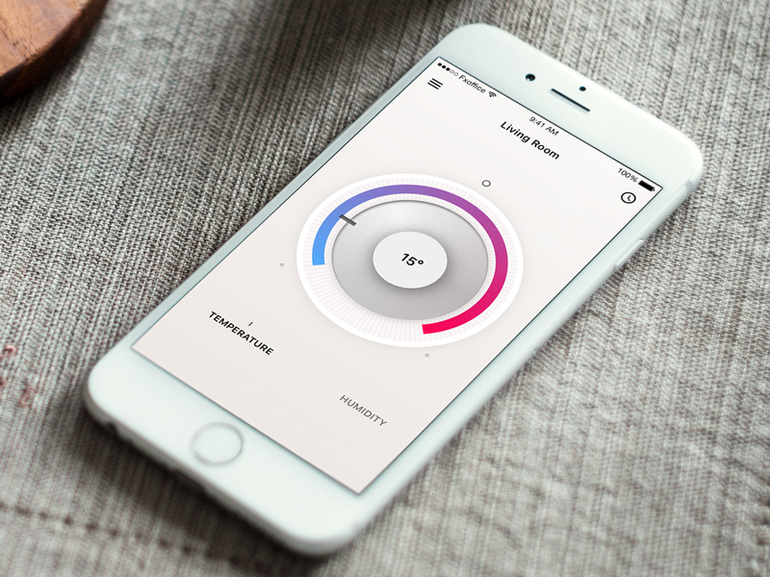
Controlling the Heat Pump
Ductless Wand/Remote
Wall Thermostat
Mobile App
Smart Wall Thermostat
Notes:
Typically, most DHPs will come with a “wand” style controller that almost looks like a remote control. This is only a controller, the thermostat itself is typically a part of the wall or ceiling indoor unit.
Many manufacturers also sell wall mounted thermostat style controllers. Depending on the brand, you may need additional components, or to simply understand the control settings in the thermostat in order to get the wall unit to also act as the thermostat – temperature detectors.
In addition, some of the top manufacturers also have Apps that can be used to control systems, providing flexibility for homeowners. Be sure to check with your manufacturer or distributor rep to learn if additional components, optional features/specific models are needed for these apps to work.
Finally, a few DHP manufacturers also have their own “smart thermostats” that work similar to Nest and Ecobee, but may not apply to all product lines that they offer.

Slide 4
Controlling the Backup Heat
Integrated controls
One thermostat controls both the heat pump and the backup
Gives primacy to the heat pump when economical
Balance point programmed for automatic changeover at 5°F to 35°F depending on system capabilities
Simultaneous operation (aka droop method) —backup system’s heating setpoint 3°F colder
Separate controls
Backup thermostat location similar to heat pump’s
Droop method—backup system’s heating setpoint 3°F colder
Notes:
Many systems offer control over balance-point and backup activation though thermostat control or from programing the unit “board” (i.e., using menus or dip switches). Clear guidance should be provided to installers regarding thermostat and unit configurations and a commissioning checklist should be developed for each thermostat / equipment combination. The most careful equipment selection and design can be undone

Slide 5
Determining the Balance Point
Balance Point set at 15°F
Notes:
The load line is determined during the load calculations
The heat pump capacity is determined from NEEP ccASHP database data or manufacturer’s extended performance data
Where they cross over, the heat pump can no longer provide enough heat to maintain comfort. This is the balance point

Slide 6
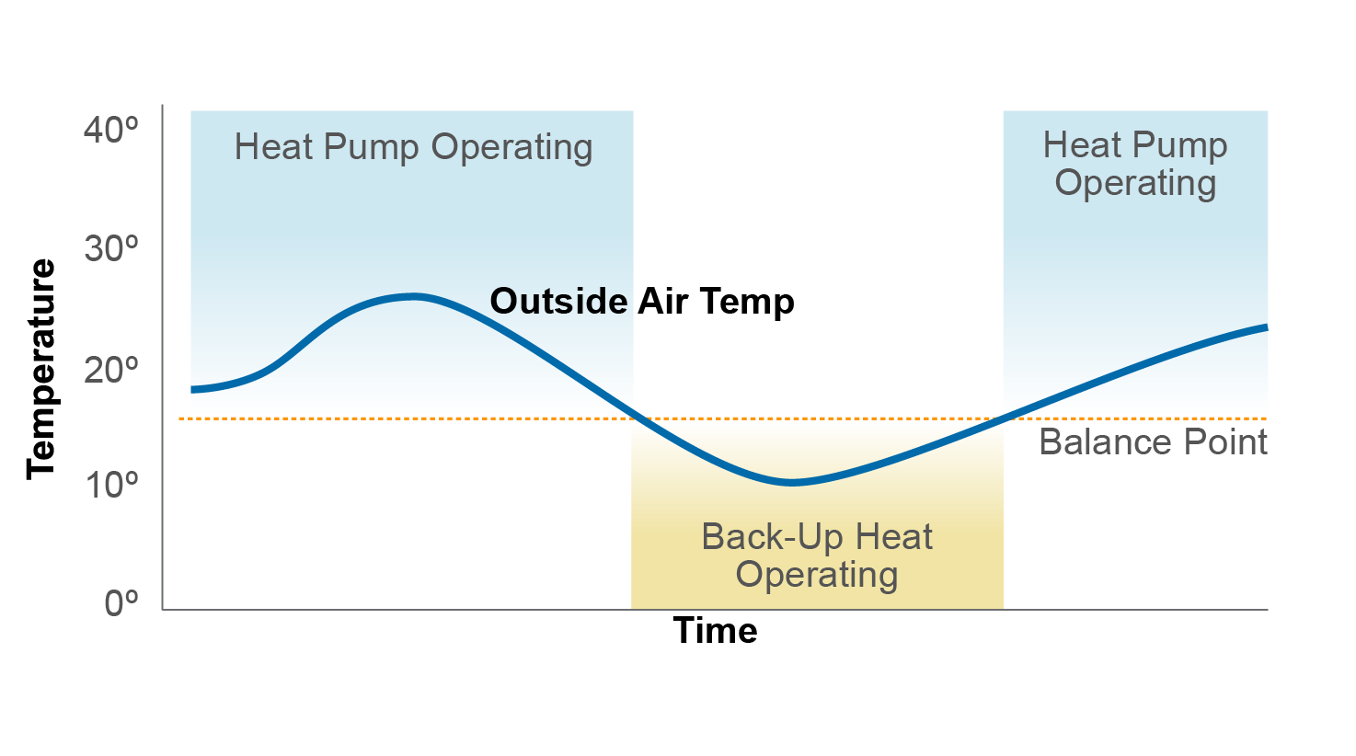
Balance Point Method
Notes:
The heat pump operates on its own, until the outdoor air temperature drops below the balance point. Then the thermostat switches and heats via the backup system instead of the heat pump. Only one system is ever on at a time, and the thermostat toggles between them based on the outdoor air temperature. On systems with outdoor temperature sensors (recommended) this cut-over is controlled by programing an appropriate compressor lockout temperature based on the balance point.

Slide 7
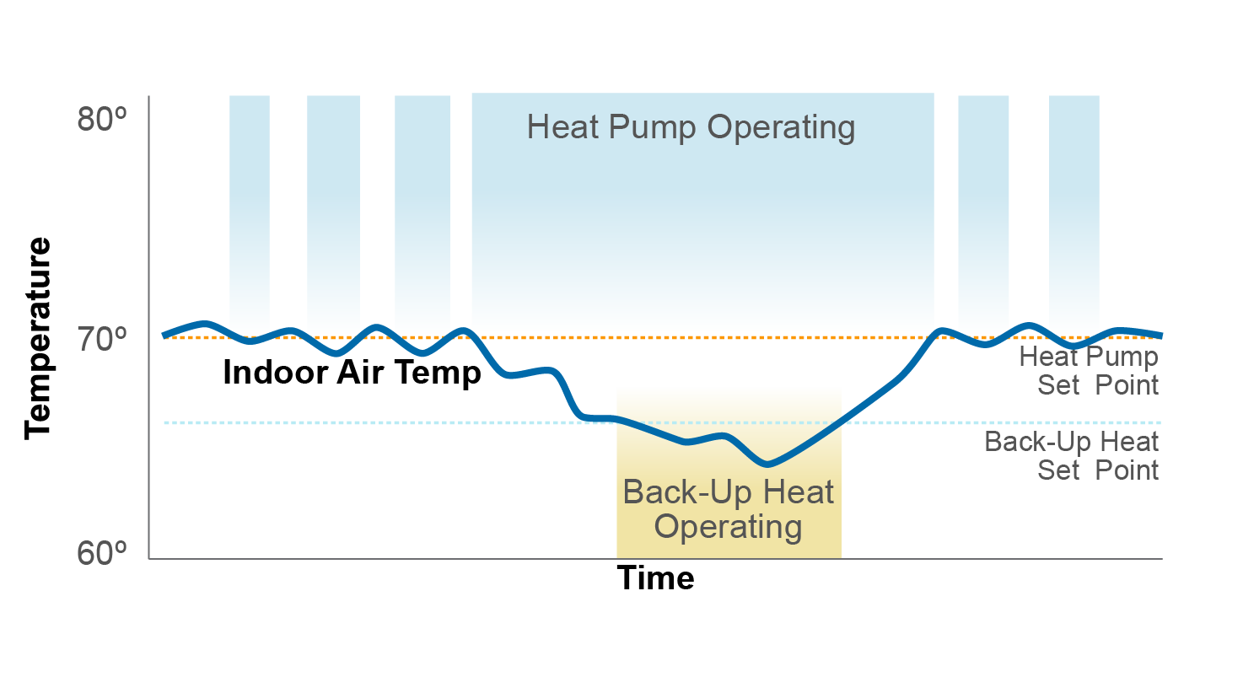
Simultaneous or Droop Method
Notes:
For the droop method, both systems are “on,” and the heat pump essentially never stops supporting space heating. This is accomplished with a two-stage thermostat or sometimes with two separate thermostats. When the indoor air temperature starts to droop, because the heat pump can no longer maintain the indoor air temperature, the backup system triggers, and runs simultaneous to the heat pump until the back-up systems' thermostat is satisfied. This should occur at about the same outdoor condition that defined the balance point, when the heat pump can no longer keep up with the load.

Slide 8
Controlling the Supplemental Heat
Separate controls
Supplemental thermostat located in the supplemental zone
May be viable for a small droop—2°F—to maximize heat pump use on mild days

Slide 9
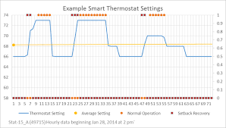
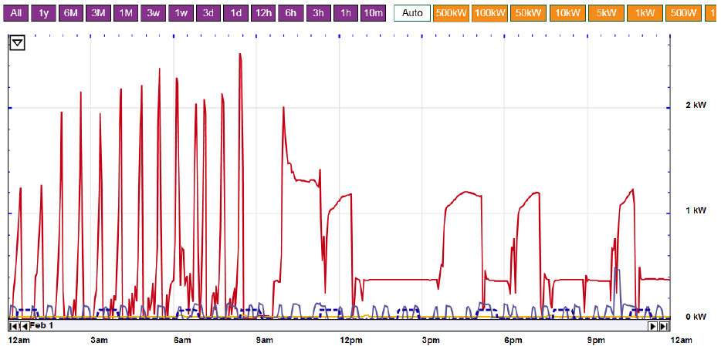
Control Principles
Different than traditional heating
Avoid deep-daily setbacks—(max 3°F at any time-step)
Reduce reversion to catch-up mode
Deep setbacks for vacation are fine
Be careful when pairing with 3rd party thermostats (Nest, ecobee, etc.)
The heat pump’s control algorithms can conflict with the 3rd party tool.
Use the Efficiency operating mode (different manufacturers use different terms)
But beware of reversion to factory default after a power-outage
Monitor the energy use for unexpected patterns or behaviors
Notes:
During catch up mode, the heat pump uses a high-gear for high-output, but at significant cost to efficiency during that mode. Often it can use up more energy during catchup than it saved during a setback period. See next slide.

Slide 10
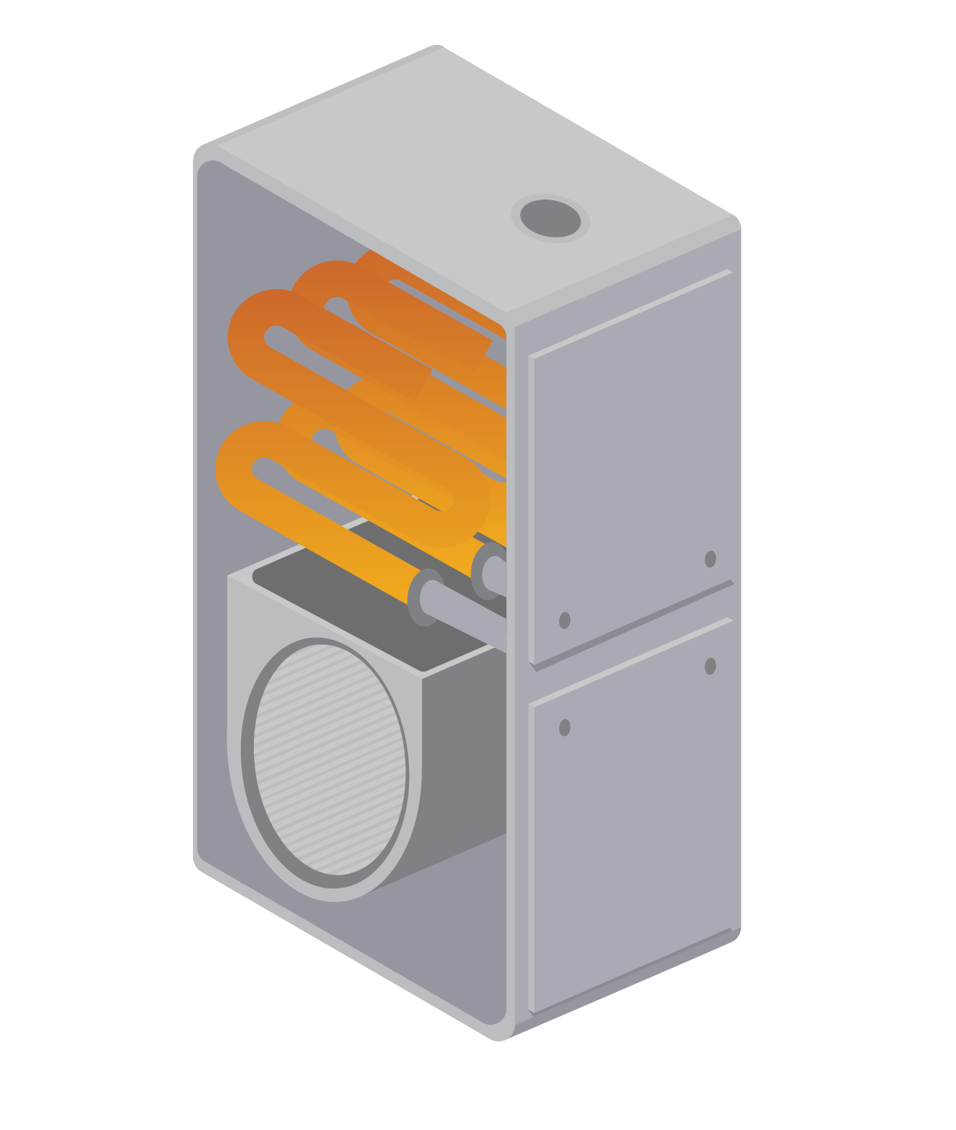
Setback Norms Difference
Daily setback 4 – 7°F
Vacation setback 7 – 15°
High heat comes on to recover
Great savings from reduced heating during the setback
Daily set back 1 – 3°F
Vacation setback 7 – 15°
Compressor operates at steady speed to recover
Recovery can take longer than with traditional systems
Good savings from reduced heating during the setback, without recovery penalty
Gas/Oil
Heat Pumps
Notes:
When a VCHP tries to catch up to a large temperature difference, it will either operate at aggressive, inefficient speeds, or it will trigger electric resistance back up heat (also inefficient). Any savings accrued during the setback can easily be eaten up during inefficient recovery period. For long periods of time (>1 day), a deep setback still saves energy.
Upon return, the home will take longer to catch up than what a gas/oil system would provide. Consider triggering the start of recovery by a timer, or a mobile app ~6-10 hours early if viable.

Slide 11
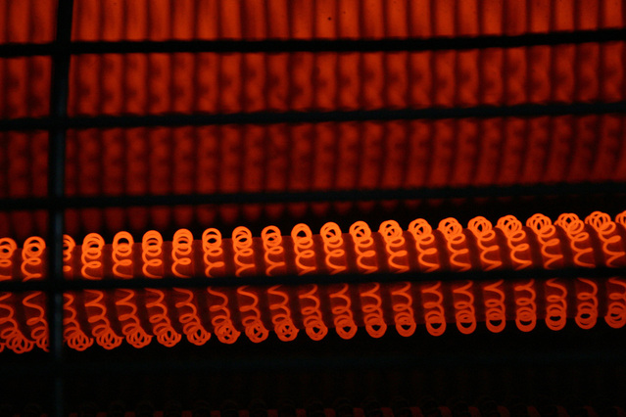
Auxiliary Strip Heat Lockouts
Definition:
Temperature above at which the auxiliary electric resistance strip heat will not operate
Typically set in the range of 25°F – 35°F
Outdoor temperature sensor or weather station
Alternative method – set lockout based on minimum heat pump supply air temperature
Typically set at 85°F
Benefits:
Prevents use of electric resistance for recovery when not necessary
Notes:
Only applicable for ducted systems with integrated auxiliary electric resistance strip heat. Check for local code requirements regarding lockout temperatures and requirements.

Slide 12
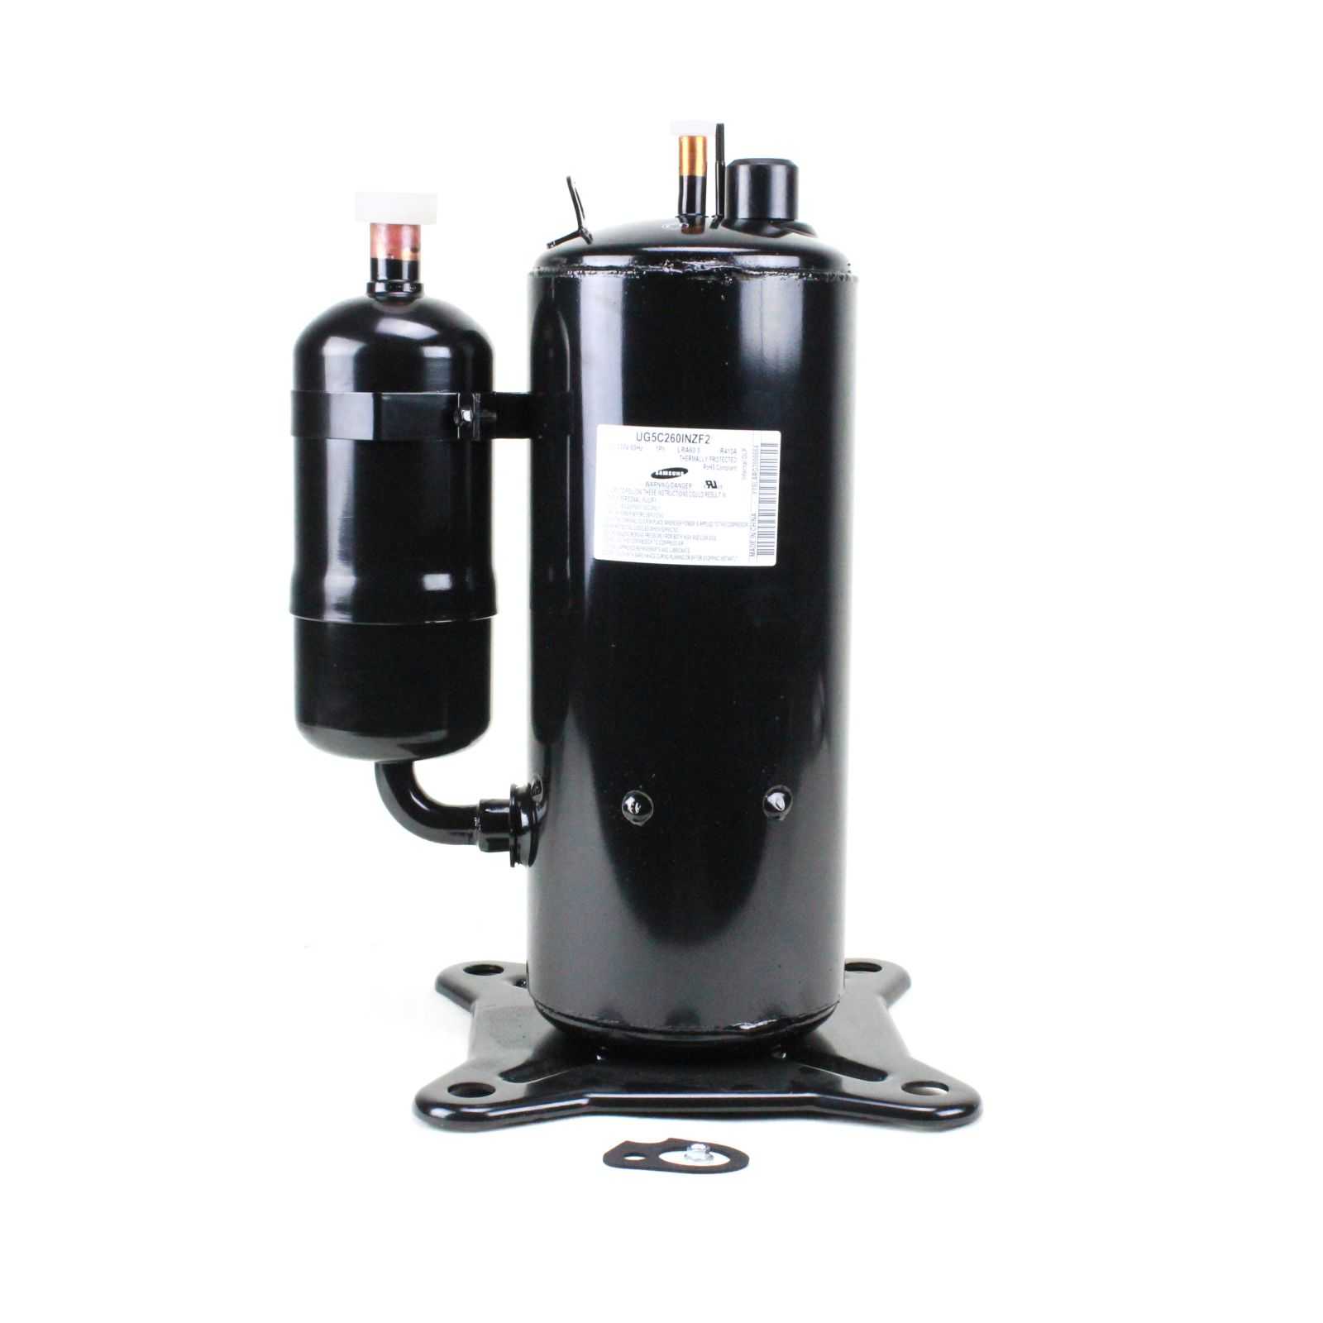
Compressor Lockouts
Definition:
Temperature below at which the heat pump’s compressor will not operate
Follow manufacturer guidelines
Disable for most cold climate heat pumps
If used, 5°F or lower

