Slide 1
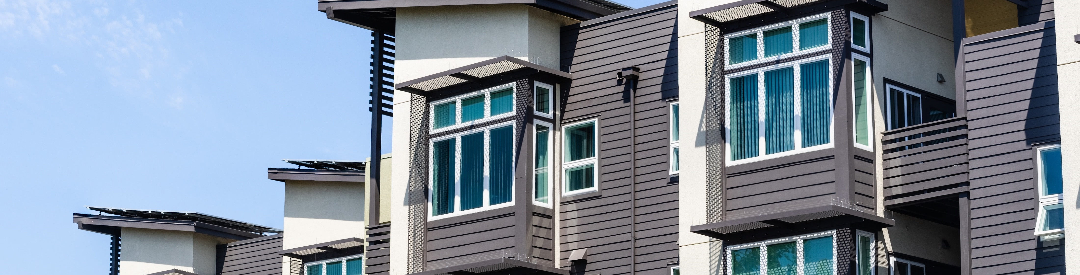
THE IMPORTANCE OF DRAFTSTOPPING AND FIREBLOCKING PARTY WALLS
WHAT?
A common wall, also known as a party wall, fire wall, fire separation wall, townhouse separation wall, or tenant separation wall, can be described as a fire-resistance rated wall that extends continuously from the foundation to the underside of fire protected roof sheathing. These are most common in multi-family units.
Notes:
A common wall, also known as a party wall, fire wall, fire separation wall, townhouse separation wall, or tenant separation wall, can be described as a fire-resistance rated wall that extends continuously from the foundation to the underside of fire protected roof sheathing.

Slide 2
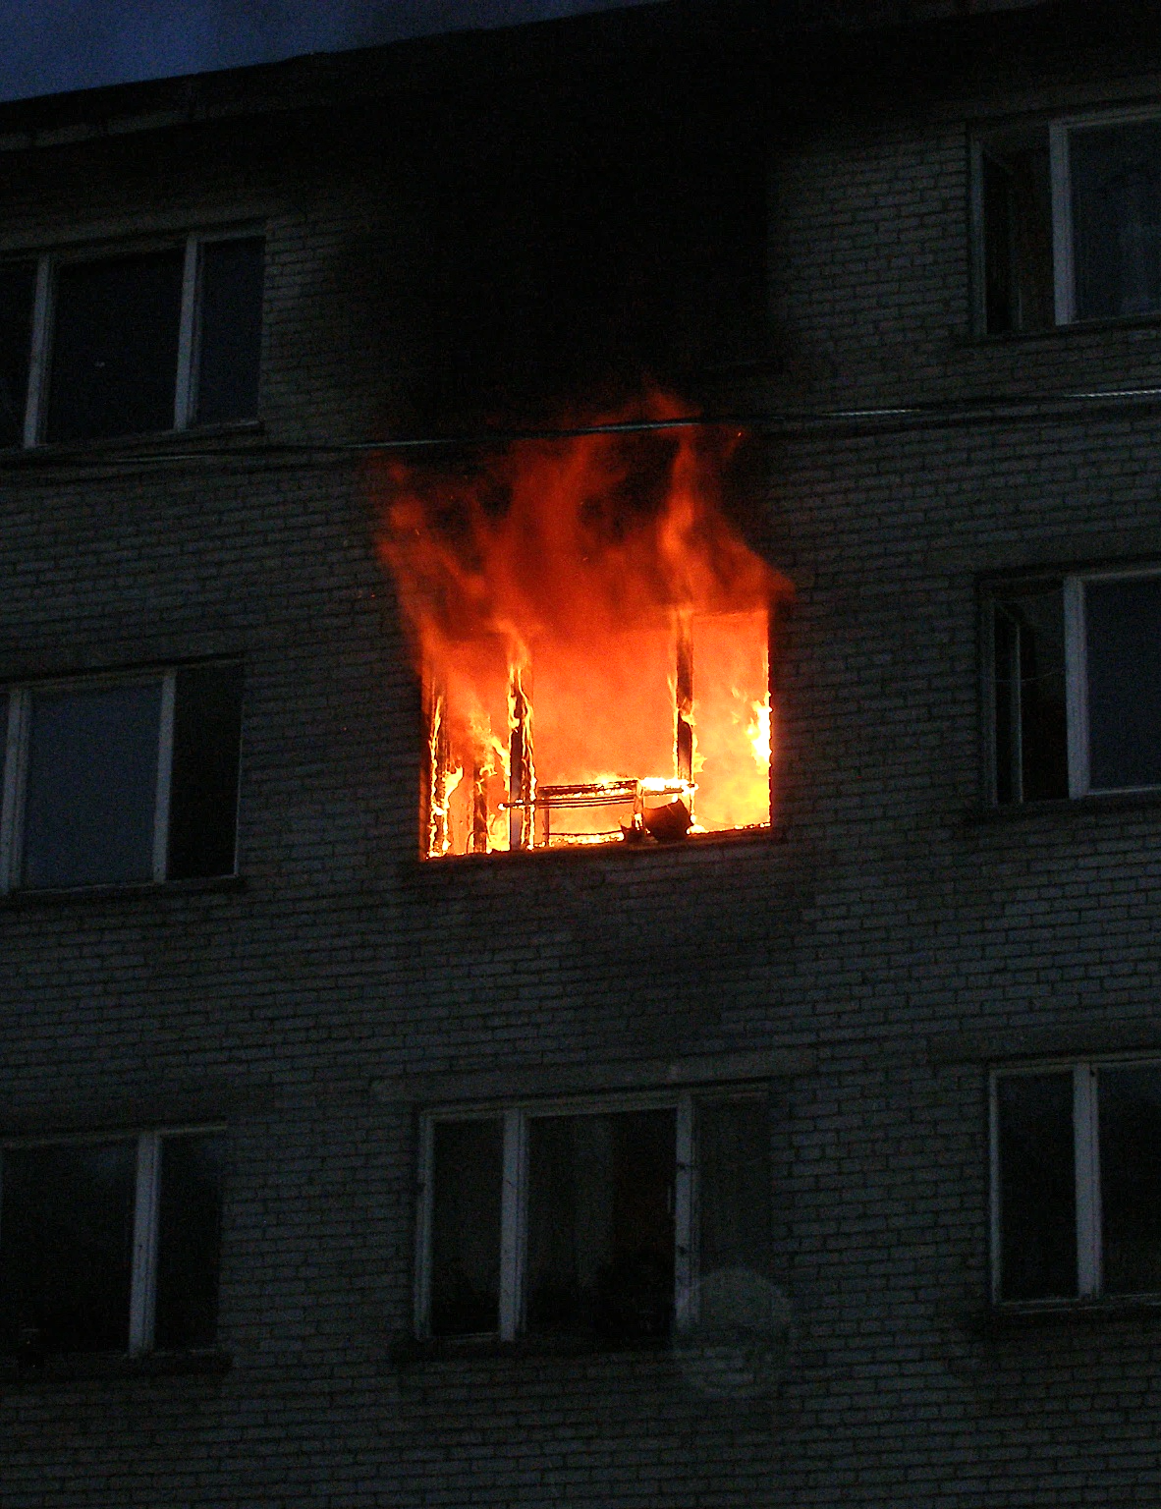
WHY?
The purpose of a common wall is to prevent the spread of fire from one unit to another, and to allow the collapse of a unit that is on fire without structurally impacting the adjacent unit.
Proper air sealing this common wall is critical in a fire situation because it allows less transfer of smoke and hot gas in one direction, and less oxygen to feed the fire in the other direction.
Notes:
The purpose of a common wall is to prevent the spread of fire from one unit to another, and to allow the collapse of a unit that is on fire without structurally impacting the adjacent unit.
Proper air sealing this common wall is critical in a fire situation because it allows less transfer of smoke and hot gas in one direction, and less oxygen to feed the fire in the other direction.

Slide 3
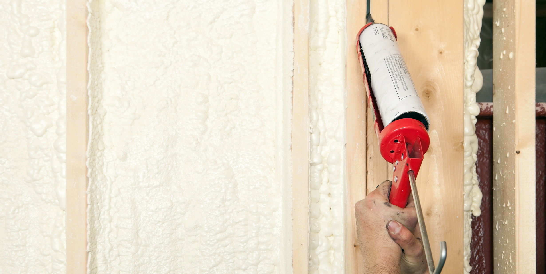
Other benefits to a well-sealed party wall:
Energy efficiency and comfort is improved by reducing infiltration and the energy required to condition that air.
IAQ is improved by reducing odor and contaminated air transfer from adjacent units or common areas.
Reduced sound transfer between units.
If lobby doors or unit windows are left open, air-sealing greatly reduces or eliminates the chimney or stack effect upward through the building.
HOW?
Notes:
Other benefits to a well-sealed party wall:
Energy efficiency and comfort is improved by reducing infiltration and the energy required to condition that air.
IAQ is improved by reducing odor and contaminated air transfer from adjacent units or common areas.
Reduced sound transfer between units.
If lobby doors or unit windows are left open, air-sealing greatly reduces or eliminates the chimney or stack effect upward through the building.

