Slide 1
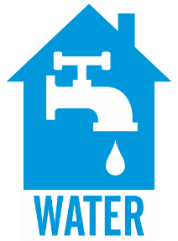
WATER CONVEYANCE: CORE AND MANIFOLD PLUMBING
WHAT?
A compact plumbing distribution system can use:
A core plumbing strategy where all hot water fixtures positioned near and directly piped to a centrally located water heater to shorten plumbing runs and minimize water use in the home. OR
A central manifold plumbing design where PEX piping runs go from a manifold near a centrally located water heater directly to each hot water use.
Notes:
A compact plumbing distribution system can use:
A core plumbing strategy where all hot water fixtures positioned near and directly piped to a centrally located water heater to shorten plumbing runs and minimize water use in the home. OR
A central manifold plumbing design where PEX piping runs go from a manifold near a centrally located water heater directly to each hot water use.

Slide 2
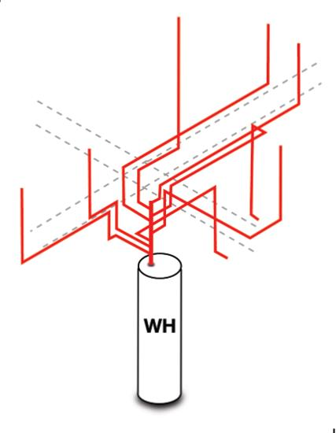
WHY?
CORE PLUMBING
MANIFOLD PLUMBING
With a core plumbing option, hot water is piped to each fixture and appliance in as direct a path as possible.
Manifold plumbing uses plastic piping to route all hot water lines directly to each fixture or appliance from a central manifold, which is connected to the water heater.
Both of these are time- and water-saving choices when designing or updating plumbing in a home.
Notes:
With a core plumbing option, hot water is pipes to each fixture and appliance in as direct a path as possible. There may be more than one plumbing core, each with its own water heater supplying nearby plumbing fixtures and appliances. Manifold plumbing uses plastic piping to route all hot water lines directly to each fixture or appliance from a central manifold, which is connected to the water heater. Each appliance or fixture has its own circuit of pipework and is conveniently located and can simply be turned off isolated in the event of a problem. Both of these are time- and water-saving choices when designing or updating plumbing in a home.

Slide 3
Assign a proposed location for all hot water plumbing fixtures and appliances; hot water fixtures be as close to the water heater as possible to minimize heat loss in pipes.
Avoid placing water pipes in exterior walls. Design plumbing trunks and branches to store as little water as possible by running the smallest-diameter code-permitted pipe between the hot water source and each fixture. Install and insulate the plumbing according to the applicable codes.
Calculate the stored volume between each water source and water use point to make sure that no more than 0.5 gallons of water is stored between the water source and the use point.
Document all plumbing design features on a plumbing diagram.
HOW?
Notes:
Assign a proposed location for all hot water plumbing fixtures and appliances; hot water fixtures be as close to the water heater as possible to minimize heat loss in pipes.
Avoid placing water pipes in exterior walls. Design plumbing trunks and branches to store as little water as possible by running the smallest-diameter code-permitted pipe between the hot water source and each fixture. Install and insulate the plumbing according to the applicable codes.
Calculate the stored volume between each water source and water use point to make sure that no more than 0.5 gallons of water is stored between the water source and the use point.
Document all plumbing design features on a plumbing diagram.
Applicable codes and standards include DOE Zero Energy Ready Home (Rev. 07), Environmental Protection Agency (EPA) WaterSense New Home Specification, 2021 IECC, 2021 IRC, and 2021 Uniform Plumbing Code (UPC).

