Slide 1
Introduction to Heat Pumps
Taken from
Cold Climate Air Source Heat Pump Sizing and Design Training
by NYSERDA

Slide 2
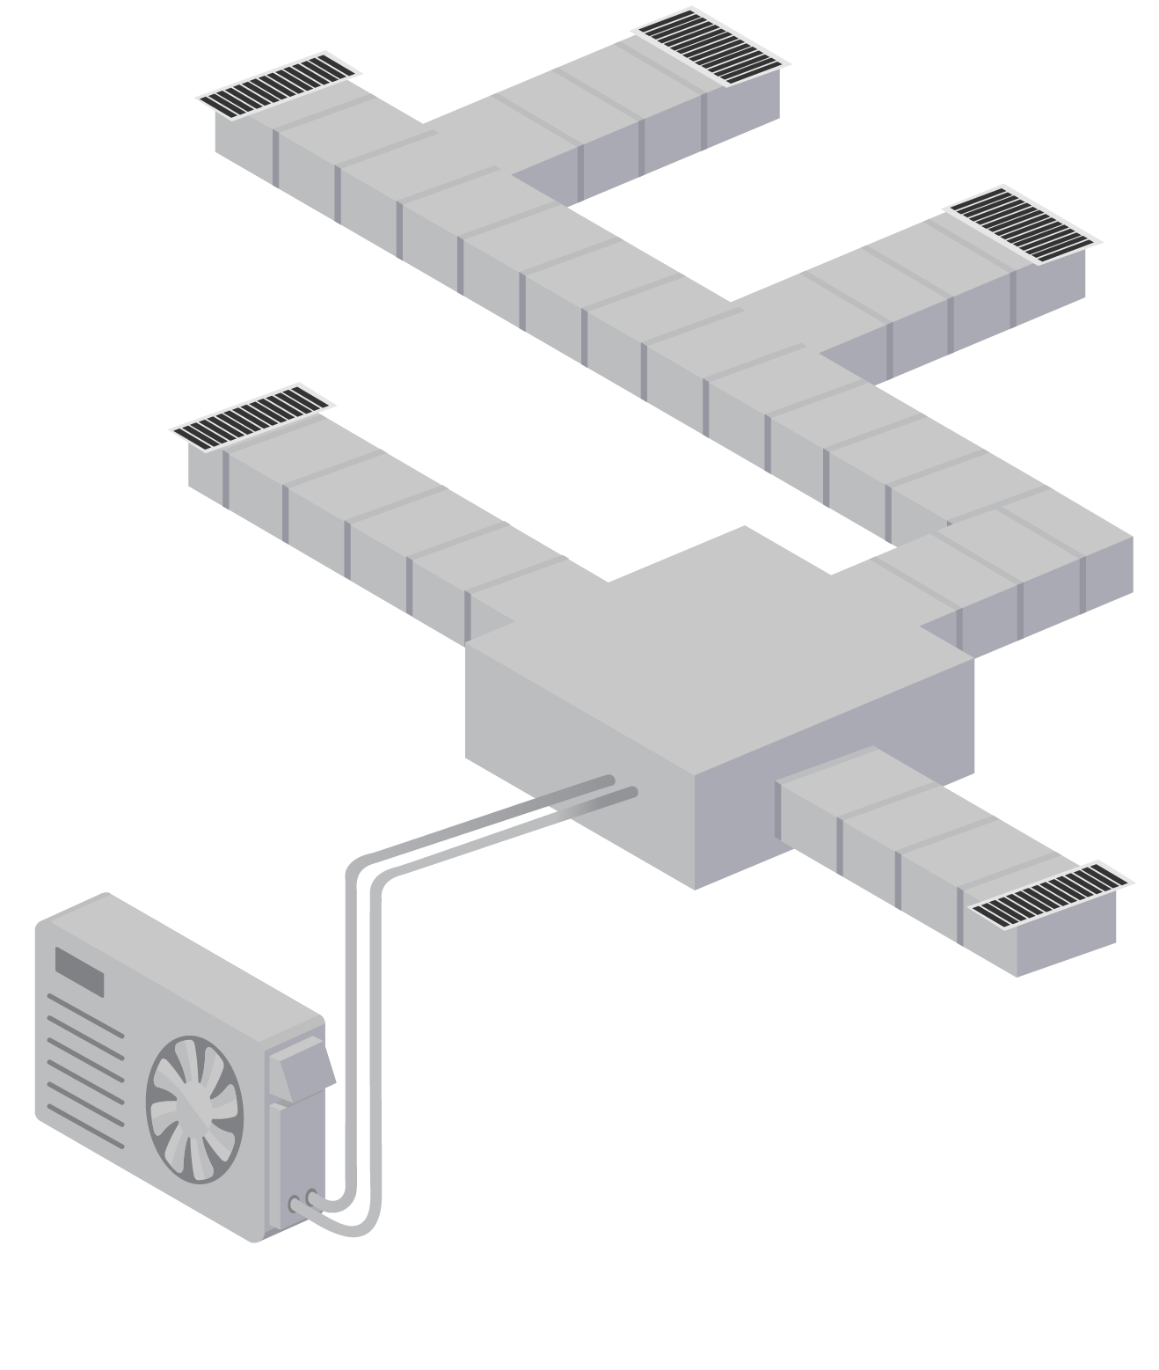
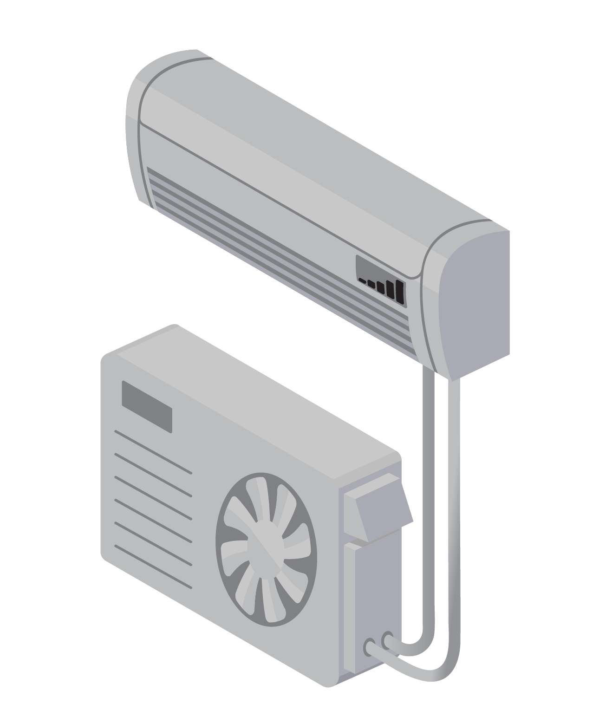
Basic Principles of Heat Pump Operations

Slide 3
Heat Pump Basics Learning Outcomes
Understand the basic operation of a heat pump
Learn what defines a cold climate air source heat pump
Understand the advantages of variable capacity
Notes:
Discuss why this is important to the audience. Cater to the specific audience’s roll and pre-knowledge by asking questions about familiarity with HP installs (i.e., Possibly characterize as a refresher, or review, so as not to insult the audience by presenting too basic of information).
Homeowner’s perspective
Contractor’s perspective
Heat pump technology has improved over the last 15 years. New heat pumps are more capable of being the primary or sole heating source in cold climates. Understanding how they function can improve sizing and design decisions, as well as to add confidence in using them for primary heating.

Slide 4
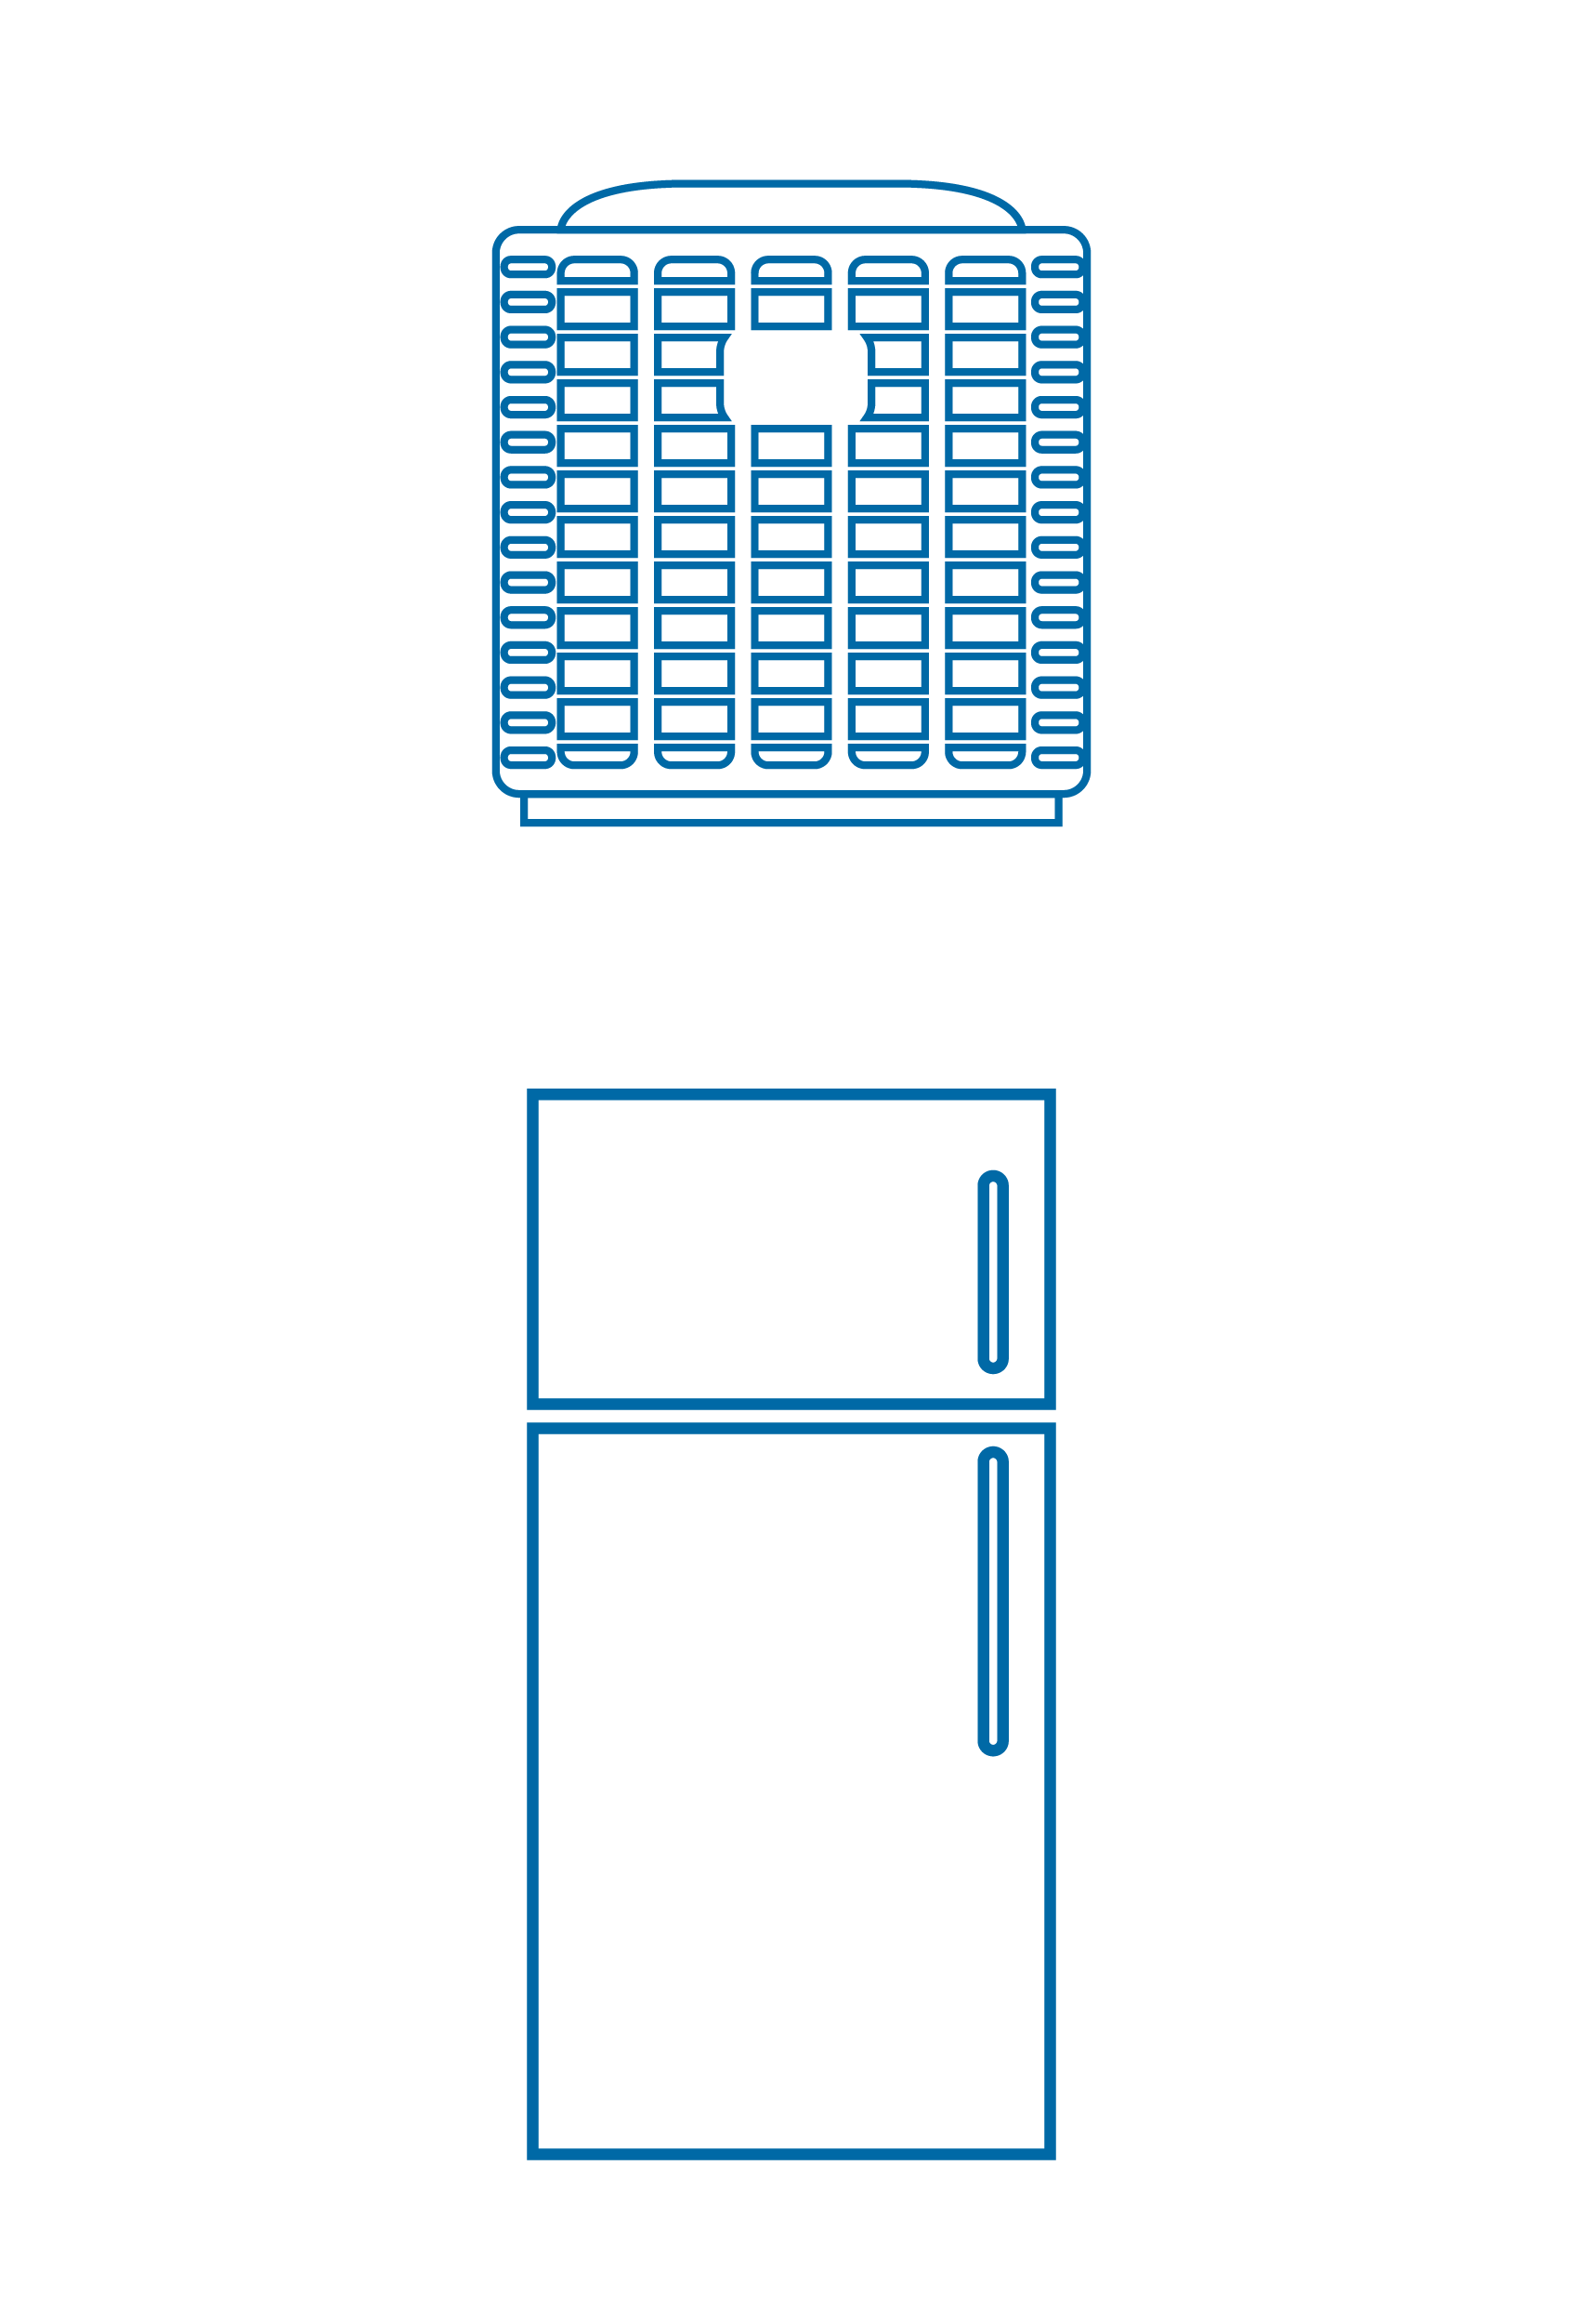
What is a heat pump?
Summer: Pumps heat from
the inside to the outside
Same technology as:
Air-conditioner
Winter: Pumps heat from the outside to the inside
Refrigerator
Notes:
Unlike all other heating systems, the heat pump doesn’t create the heat. It just helps move it. This is how it can achieve efficiencies greater than 100%.
Same technology as a refrigerator, freezer, or an air-conditioner. It adds the ability to switch the direction its pumping heat.

Slide 5
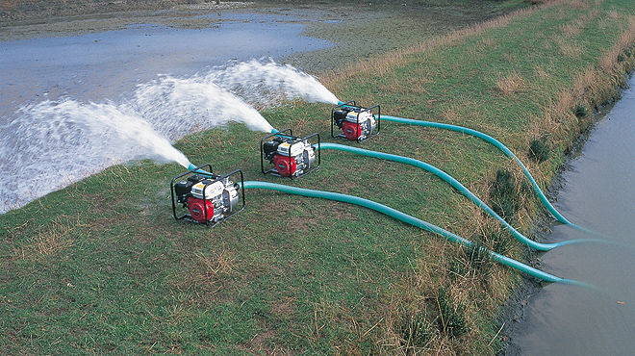
Heat Pumps Do Not Generate Heat, They Move It
Notes:
Just like the energy needed (gasoline) to pump the water shown here, heat pumps use energy to pump heat.

Slide 6
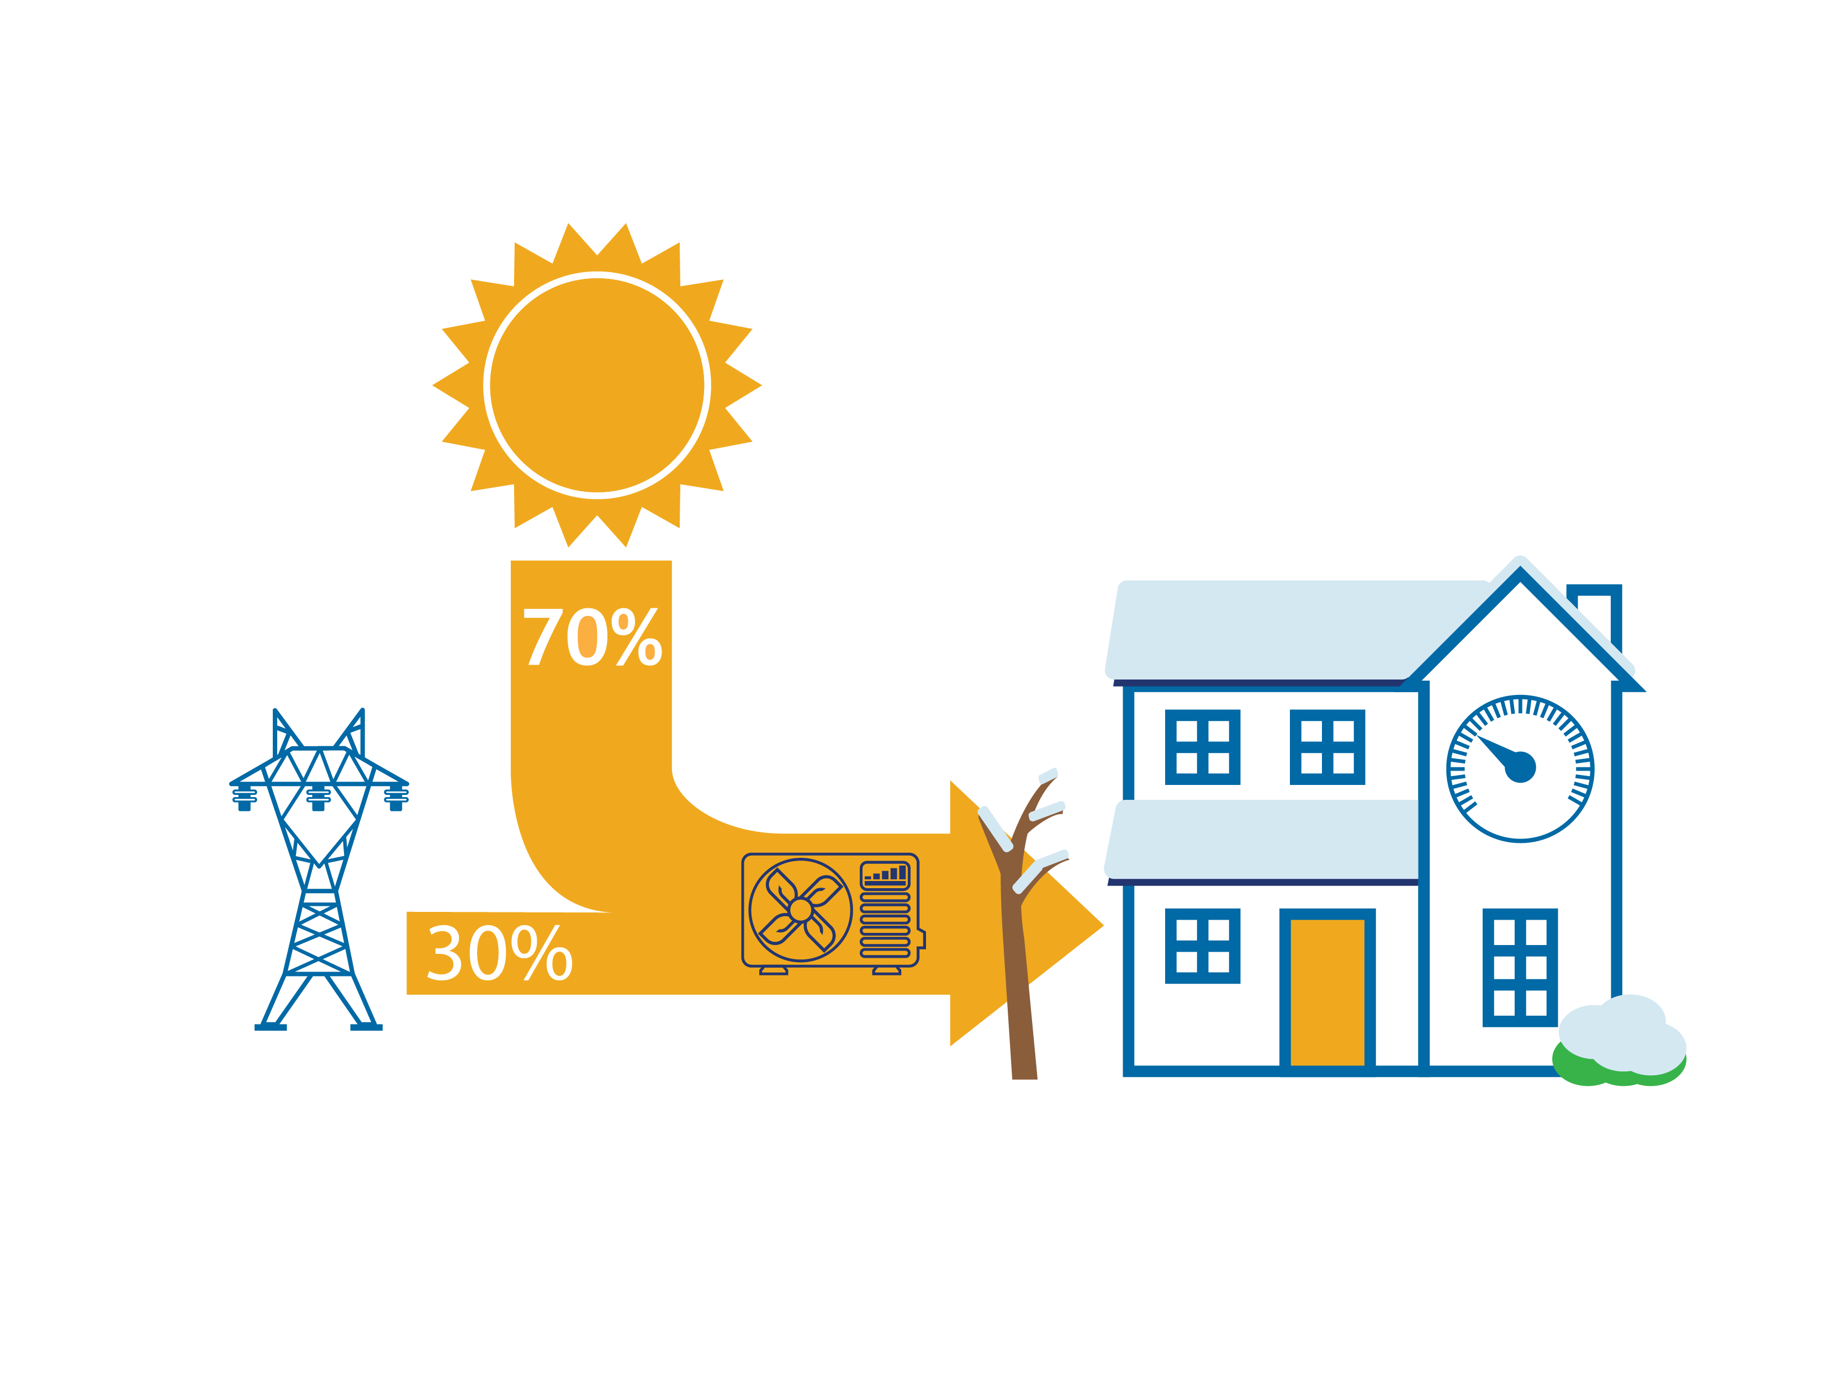
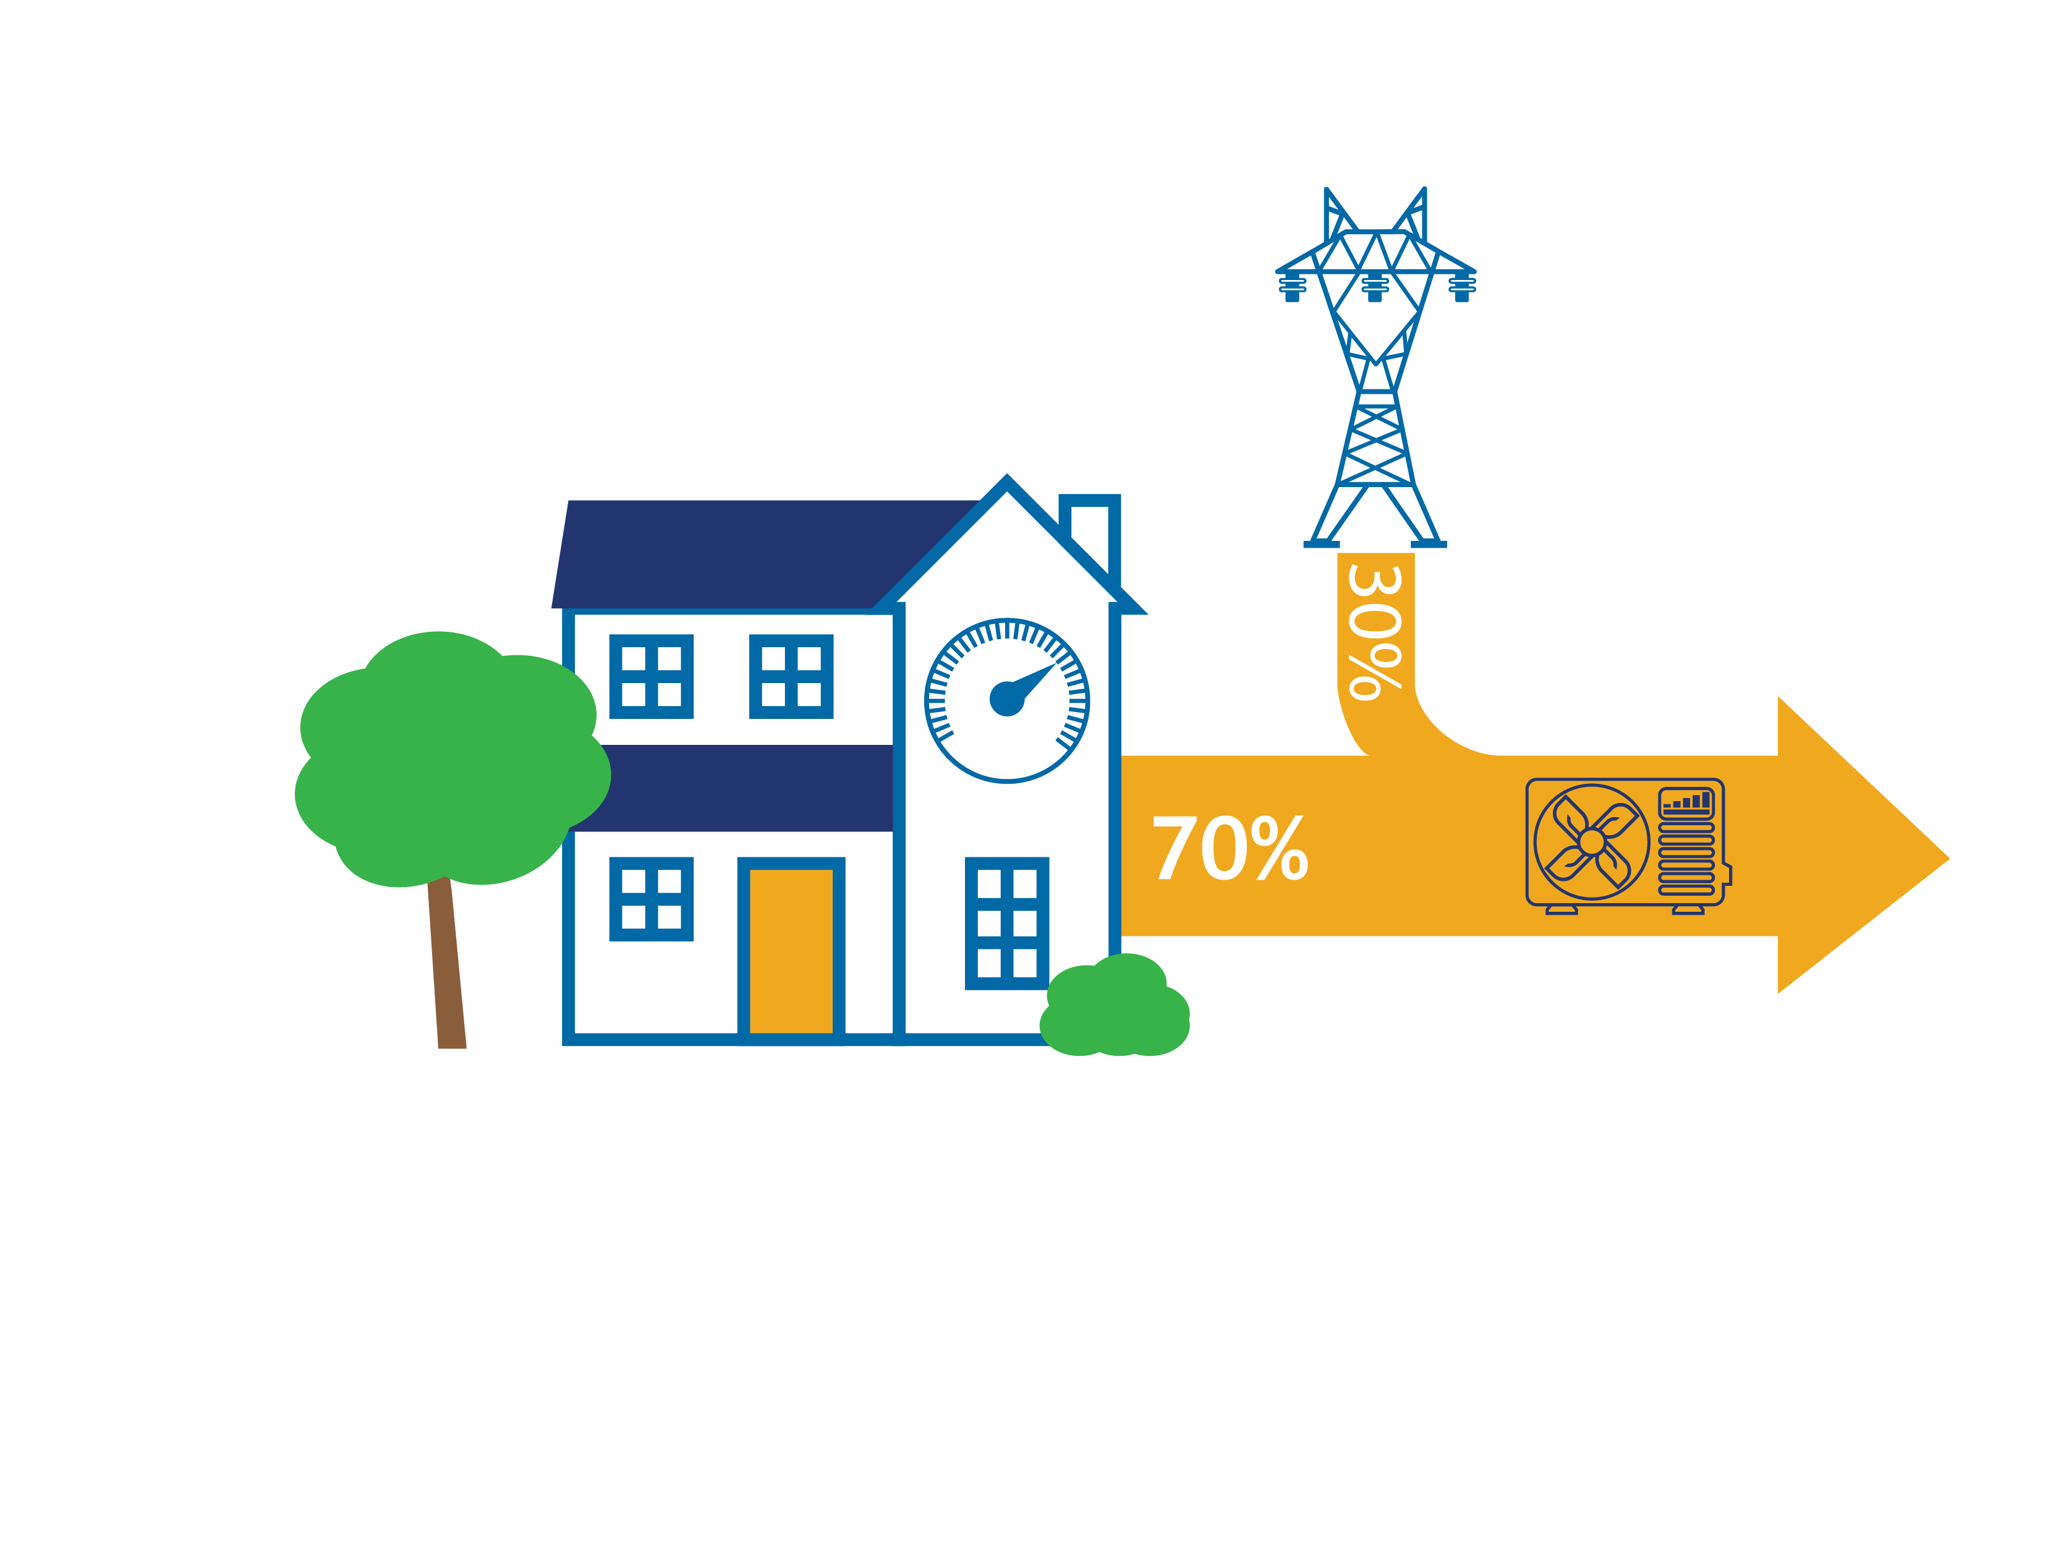
Where does the heat come from?
Heating mode: From the outside air, heated by the sun. Even when it is cold outside, heat energy can be extracted from the air and pumped inside.
Cooling mode: From the inside air. It is not bringing in cold, it is pumping heat out of the building.

Slide 7
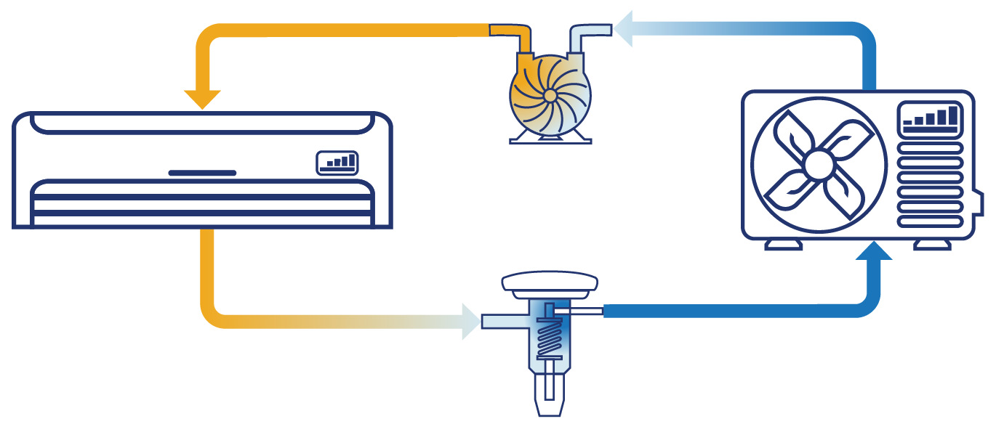
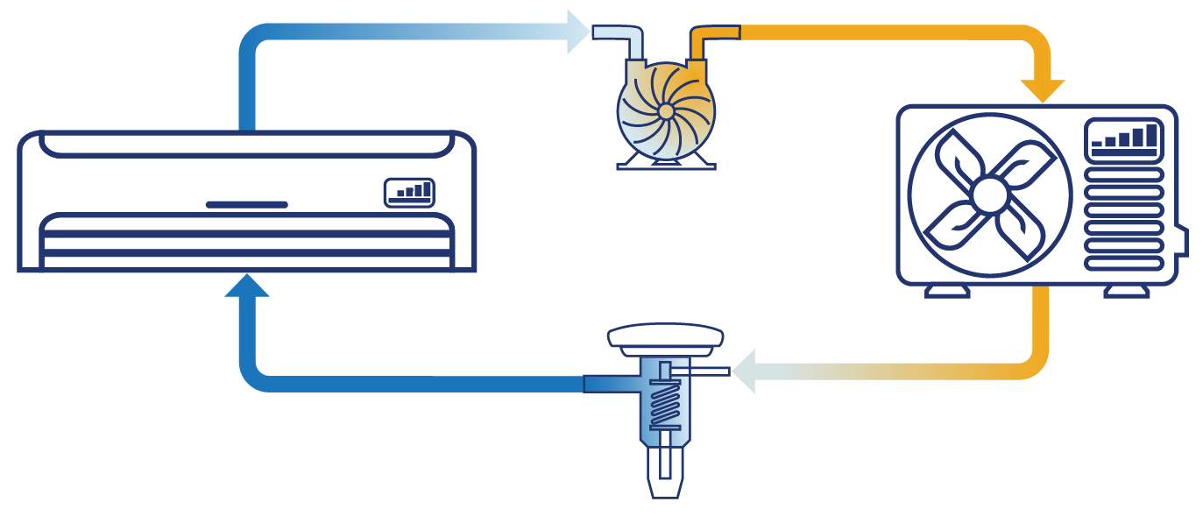
How do heat pumps work?
Vapor Compression Cycle
Pumped refrigerant
Pressurized (liquid) delivers heat
Depressurized (gas) collects heat
Indoors
Outdoors
Cooling Mode
Heating Mode
Notes:
Uses a vapor compression cycle – it moves refrigerant between an outdoor, and an indoor unit. It is able to toggle between heating and cooling mode, simply reversing the flow of refrigerant.
In each location, air flows over refrigerant-filled coils, either adding heat (when the air is hotter) or removing heat (when the air is cooler).
A compressor squeezes (pressurizes) the refrigerant, making it hotter as it goes to the heating end, then an expansion valve lets it depressurize causing it to cool off for the cooling end. (Relatable Example: A compressed air duster (e.g., Dust-ff) becomes cold as its used because the compressed gas in the can is being depressurized. HPs continuously depressurize and repressurize refrigerant gas, which is known as the refrigerant cycle).
Inside the home, the conditioned air (hot or cold depending on the season) is distributed by a fan – either through ducts, or directly at an indoor head.
The ability to change between heating and cooling is what makes a heat pump special and differentiates it from an air-conditioner which can only pump heat in one direction.

Slide 8
The many names of a heat pump
Air Source Heat Pump
(ASHP)
Variable Capacity Heat Pump
(VCHP)
Cold Climate Air Source Heat Pump
(ccASHP)
Cold Climate Ductless Heat Pump
(ccDHP)
Also Known As:
Inverter driven
Extended capacity
Extra performance
Extreme climate
Various branded trade-names:
Hyper heat®, Aurora ®, Halcyon XLTH ®, Max-Heat ®
Notes:
All heat pumps operate using the basic principle just described. However, some heat pumps are designed to optimize their performance for increased comfort, energy efficient operation, or when operating in cold climates. Additionally, Heat Pump manufacturers have various trade-marked names associated with their products to describe their enhanced performance equipment in comparison to “standard” Heat Pumps. However, very nature of heat pumps make standardizing the definition of a “cold climate” heat pump challenging. That’s why organizations like NEEP and NEEA have worked to establish standard definitions that are applicable across manufactures.

Slide 9
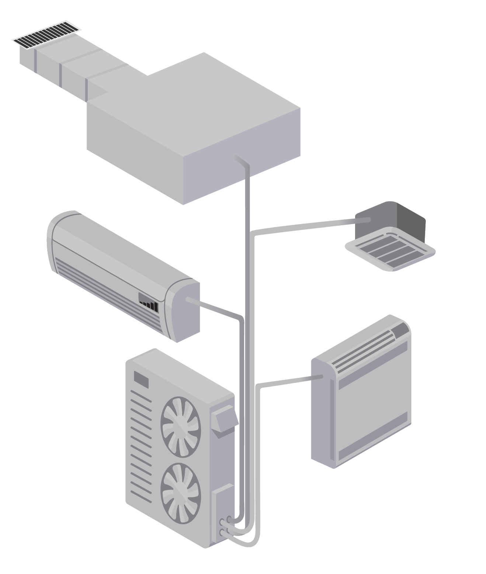
Heat Pump Taxonomy
Residential air source heat pumps
Inverter driven
Cold-Climate listed?
Distribution
Mini-split
Multi-split
Centrally ducted
Short duct
Packaged terminal heat pump
Cold-climate listed
Conventional (single or double speed)
Not listed
Compressor
Ducted
Mini-split
Multi-split
Notes:
Not exhaustive. There are also air-to-water heat pumps. Ground Source heat pumps.
This training focusses on systems in blue, not Package Terminal units or conventional systems.

Slide 10
Heat Pump Efficiency Ratings Defined
Acronym | Name | Description | Range
HSPF | Heating Seasonal Performance Factor | Overall heating efficiency; Heating output (Btu) during a typical heating season divided by total electric energy (watt-hours) used during the same period | 7 – 18+
SEER | Seasonal Energy Efficiency Ratio | Overall cooling efficiency; Cooling output (Btu) during a typical cooling-season divided by the total electric energy (Watt-hours) used during the same period | 14 – 25
COP | Coefficient of Performance | Instantaneous efficiency (heating or cooling); Units of energy IN divided by energy OUT | 2 – 5
Notes:
An HSPF rating allows for comparisons between the efficiency of equipment on an annualized basis, the rating may include operation of supplementary electric heat (more on that later). Currently 8.2 is the minimum HSPF allowed to be sold by law. In 2023, the HSPF minimum will increase to 8.8
A Coefficient of Performance rating indicates how efficiently the HP can pump heat. For every single kW of electricity provided to a HP with a COP 2 provides 2 kW of heat. (Question for Participants: What’s the COP of electric resistance supplemental “strip” heat?
SEER is similar to HSPF, but a for cooling.

Slide 11
Heat Pump Terms Defined
Term | Description
Rated Heating Capacity | Nominal output of heat pump at 47°F (Btu/hr) as tested
Design Heating Capacity | Heat pump’s output at the winter design temperature (Btu/hr)
Minimum Capacity | Lowest possible output at a given temperature. Minimum capacity at 47°F is a valuable reference when sizing for heating
Heating Capacity @ 5°F | Maximum heating capacity when the outdoor temperature is 5°F
Design Heating Load | Heating need at the target minimum winter temperature (Btu/hr)
Displacement Heating | A design strategy where the heat pump is only intended to cover part of the home’s annual load, displacing heat that would otherwise come from another heating system
Refrigerant | A chemical compound that readily absorbs and releases heat using a phase change. Common heat pump refrigerants include R410a, R32, R134a, R744 (CO2), R22 (phased out)
Multi, Mini, Package, Split | System type descriptions
Notes:
The first five terms on this list are important for system sizing and design. Review with participants (optional: Ask participants to identify the terms they use when designing a system)

Slide 12
Customer Benefits from Heat Pumps
Cost savings or fuel cost stabilization
Adding cooling to spaces with heating only
Provide increased capacity or control with supplemental equipment
Avoiding risks from combustion heating
Interest in slowing climate change through electrification and efficiency improvements

Slide 13
Heat Pump Market Trends
National trend toward electrification
The electric grid is getting cleaner.
Switching from fossil fuels to electricity allows homes to lower climate and pollution impacts.
Efficiency
Heat pumps are significantly more efficient than fossil fuel systems.
Addition of air conditioning in cooler climates
Availability of cold climate heat pumps

Slide 14
Adding Heat Pumps to an HVAC Business Offering
Increased sales and maintenance opportunities for customers with heat pumps
Some customers will use dual systems or replace early, meaning more systems to install/maintain
Cold climate heat pumps make heat pump installation more feasible in the northern U.S.

Slide 15
Job Opportunities
Increased demand for heat pumps results in more HVAC jobs:
Sales
Design
Installation
Maintenance
Manufacturing

Slide 16
Heat Pump Certifications
Different levels of proficiency, based on NATE Certification:
HVAC Ready-to-Work
HVAC Support Technician
HVAC Core and Specialty
HVAC Senior Level Efficiency Analyst
Other organizations offer training or certification, including:
PHCC
NCCER
NYSERDA
BPI
AHRI
NEEP
Notes:
NATE: https://www.natex.org/site/1/Home
NEEP: https://neep.org/high-performance-air-source-heat-pumps/air-source-heat-pump-installer-and-consumer-resources
NYSERDA: https://www.nyserda.ny.gov/All-Programs/Clean-Energy-Workforce-Development/Clean-Energy-Training-Resources
AHRI: https://www.ahrinet.org/certification/ahri-certification-programs
BPI: https://dev-bpidev.pantheonsite.io/sites/default/files/Technical%20Standards%20for%20the%20Air%20Conditioning%20and%20Heat%20Pump%20Professional.pdf
PHCC: https://www.phccweb.org/wp-content/uploads/2021/08/HVAC-Courses-Syllabi.pdf

Slide 17
ASHP Operating Costs
Current Annual Heating Energy
Bill reports therms:
$$Annual Heating Energy Requirement \left(Btu/yr\right)$$
$=Annual Heating Fuel Use \left(therms/yr\right) x\frac{100,000 Btu}{1 therm} x efficiency$
Bill reports gallons of fuel oil:
$$Annual Heating Energy Requirement \left(Btu/yr\right)$$
$=Annual Fuel Oil Use \left(gallons/yr\right) x\frac{138,500 Btu}{1 gallon} x efficiency$

Slide 18
ASHP Operating Costs
Example:
700 therms/yr
80% AFUE (efficiency) furnace
$$Annual Heating Energy Requirement \left(Btu/yr\right)$$
$=Annual Natural Gas Use \left(therms/yr\right) x\frac{100,000 Btu}{1 therm} x efficiency$
$=700\frac{therms}{yr}x\frac{100,000 Btu}{1 therm} x 80\%=56,000,000\frac{Btu}{yr}$
56 million Btu/yr heating energy

Slide 19
ASHP Operating Costs
Proposed Annual Heating Costs with Heat Pump
$$HSPF=\frac{Heating Energy Requirement (Btu/yr)}{Electric Energy Used (Wh/yr)}$$
$$Electric Energy Used \left(kWh/yr\right)$$
$= \frac{Heating Energy Requirement \left(Btu/yr\right)}{HSPF}x \frac{1 kWh}{1,000 Wh}$

Slide 20
ASHP Operating Costs
Proposed Annual Heating Costs with Heat Pump
56,000,000 Btu/yr heating load
HSPF = 10.5
$$Electric Energy Used \left(kWh/yr\right)$$
$= \frac{Heating Energy Requirement \left(Btu/yr\right)}{HSPF}x \frac{1 kWh}{1,000 Wh}$
$= \frac{56,000,000\frac{Btu}{yr}}{10.5}x\frac{1 }{1,000}=5,333 kWh/yr$

Slide 21
ASHP Operating Costs
Proposed Annual Heating Costs with Heat Pump
$$Operating Cost=Fuel Use x Utility Rate$$
$$Gas Furnace Operating Costs=700 therms x \$0.82 per therm=\$574$$
$$Heat Pump Operating Costs=5,333 kWh x \$0.09 per kWh=\$479$$
The gas furnace costs $574 per year and the heat pump costs $479 per year.
Heat pump saves nearly $100 per year

Slide 22
ASHP Operating Costs
Cost effectiveness varies with:
Climate: the HSPF value is for a standardized set of heating conditions. The actual heating efficiency will vary from region to region
Utility costs

Slide 23
ccASHPs
Specially tuned to do well in cold climates
Meets efficiency and capacity criteria set forth by the Northeast Energy Efficiency Partnership (NEEP)
Improved components combine to provide variable speeds
Standard heat pumps are single-speed or two-speed only
Akin to a fixed speed bike vs. a 21-gear bike
Notes:
The term ccASHP refers to products listed on the NEEP ccASHP products and specification list
ccASHPs are a subset of what are also called variable capacity heat pumps, extended capacity heat pumps, or inverter driven heat pumps. The key is multiple operating speeds that can be fine tuned to match the indoor heating and cooling needs during a range of outdoor temperature conditions, rather than just on vs. off.
The same added capabilities that allow for improved heating performance on the coldest days extend its cooling performance on the hottest days.

Slide 24
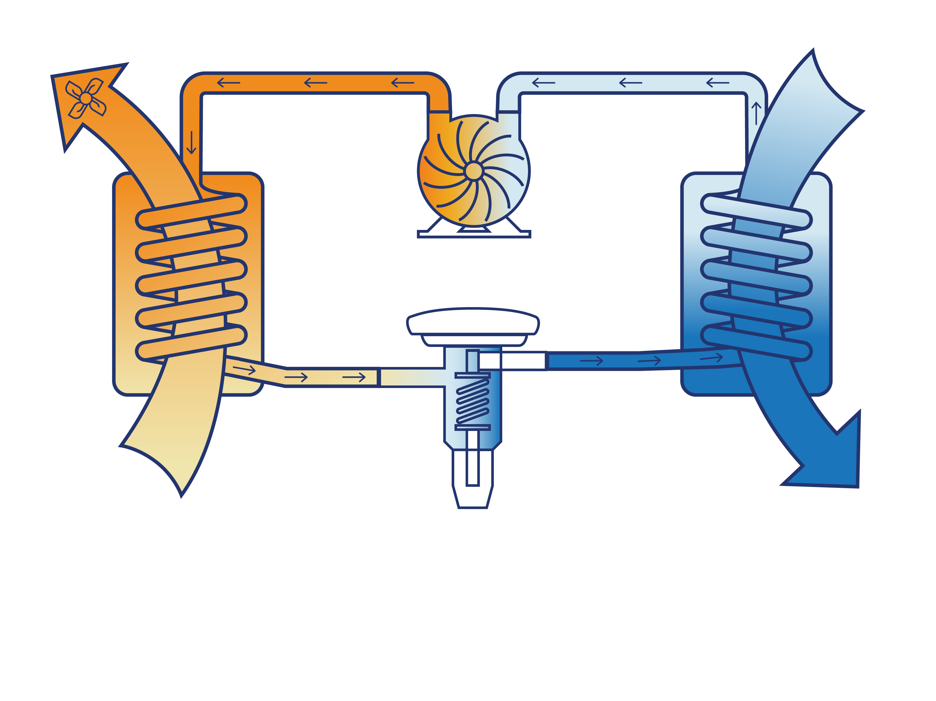
Heat Pump Components
2
1
Compressor
Fan
Indoor Unit:
Condenser
Outdoor unit: Evaporator
Useful Heat
Heat Source
Indoors
Outdoors
3
Electronic Expansion Valve (EXV)
Heating Mode
Notes:
Reiterate the explanation of the Vapor Compression Cycle introduced on the prior slide
Pumped refrigerant
Pressurized (liquid) delivers heat
Depressurized (gas) collects heat
Restate that this is showing heating mode only. When the system is in cooling mode, the cycle essentially goes in the opposite direction, and the roles of the indoor and outdoor units (condenser and evaporator) swap. Systems change refrigerant direction using a “reversing valve” or by routing refrigerant through a manifold using, which is not shown.
The evaporator: in heating mode this is the outdoor unit, where cool liquid refrigerant evaporates into warm gaseous refrigerant, pulling heat out of the air. In the summer, the indoor unit is the evaporator. Another way to think about it is that the evaporator is where the liquid refrigerant is expanded into a gas.
The compressor: this compresses warm gaseous refrigerant into hot-gaseous refrigerant, to send to the condenser for release
The condenser: in heating mode this is the indoor unit, where hot-gaseous refrigerant condenses into warm liquid refrigerant inside the coil, releasing its heat in the process. In the summer, the outdoor unit is the condenser, releasing heat.
The fan: this blows air across the indoor unit’s heating coil, helping to release the heat (in winter) or pull the cool air (in summer). It’s how the energy is transferred from the unit itself into the house. The speed of airflow impacts that rate of energy transfer. There is also a fan on the outdoor unit (not shown).
The expansion valve: Control logic electronically adjusts this valve to regulate the amount of refrigerant flowing through the loop overall. As warm-liquid refrigerant passes through it, it turns to cool-liquid due to lower pressures on the other side of the valve, and is now ready again to collect heat in the evaporator. EXVs offer more precise control than Thermal Expansion Valves found in older equipment.
Of all these items, 3 can be controlled dynamically to adjust heat transfer and energy use: Compressor, Fan, Expansion Valve (described on the next slide)

Slide 25
VCHP Component Differences
Compressor motor is inverter driven for multi-stage variance
Compressor
Fan is controlled by an electronically commutated motor for variable speeds
Fan
EXV controlled by an electromagnetic piston to vary the firing rate
Expansion Valve
Notes:
These three components are controlled by finely tuned control algorithms to adjust the flow of refrigerant and air to deliver the optimal amount of heat for the current need based on the current conditions. Depending on the manufacture several different sensor and control strategies are used to inform the algorithms (e.g., outdoor temp, return air temp, coil temp, etc.), but they all serve the same purpose.

Slide 26
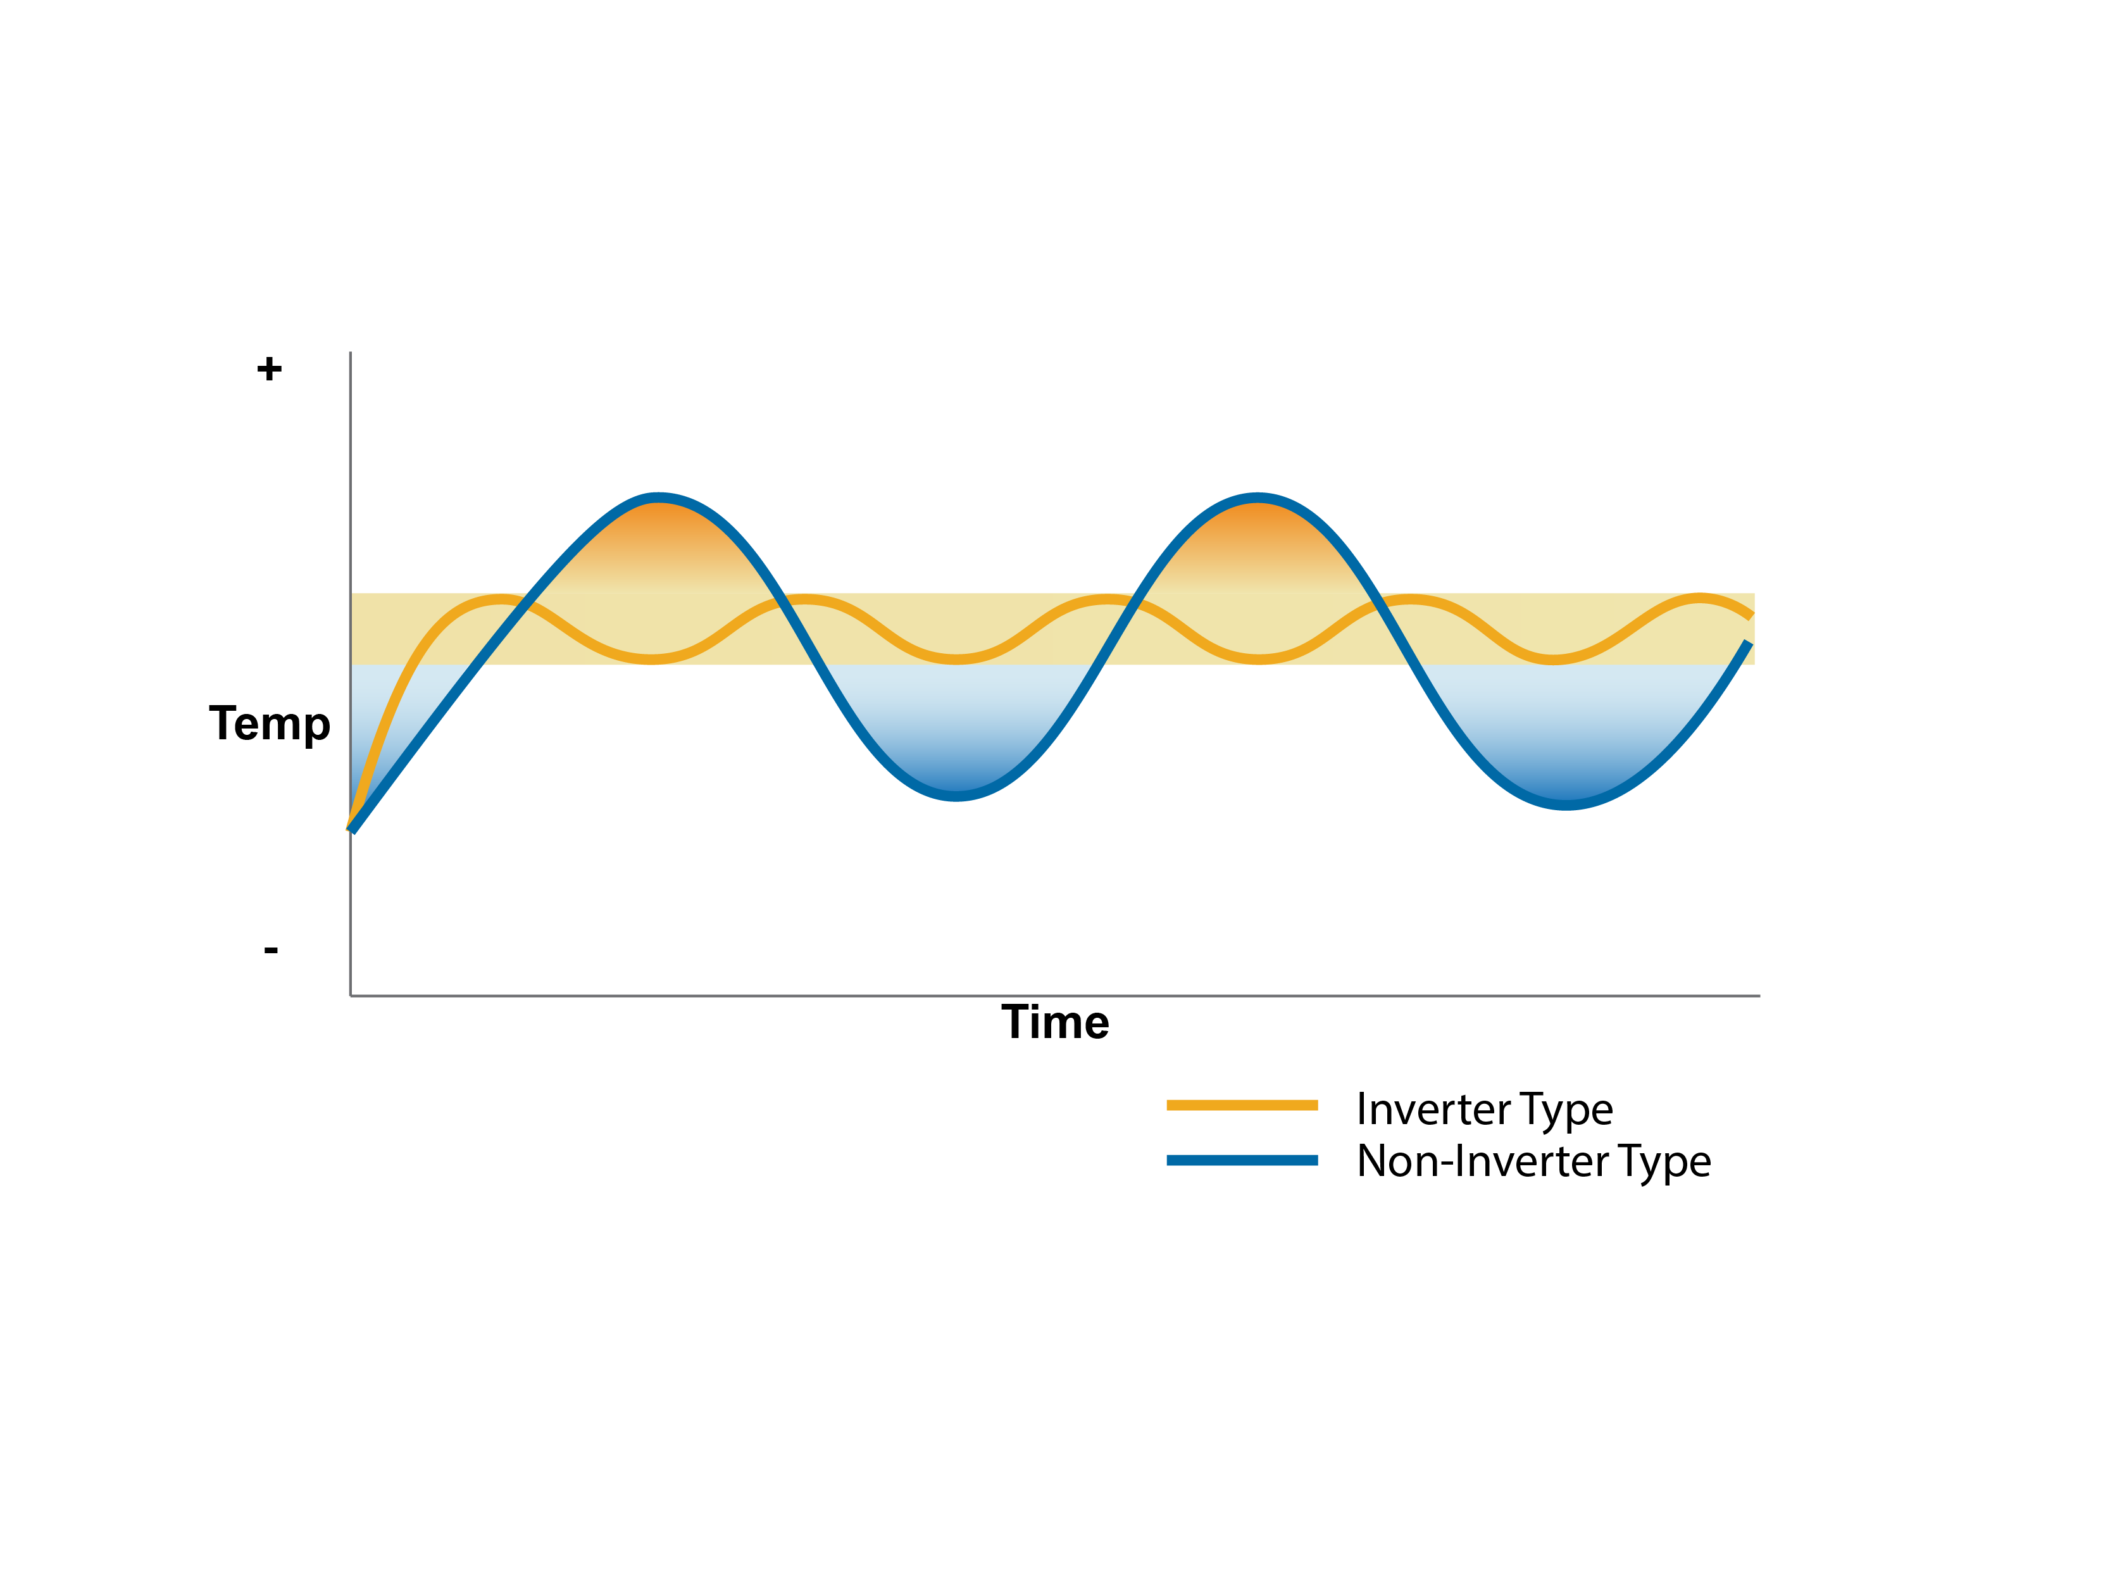
How Modulation Helps - Control
Recovery Speed
More control
Less waste
Improved comfort
Notes:
Inverter type – quicker recovery, tighter control
Non-inverter type, one-mode of on. Slower recovery, and overshooting t-stat normal
From admin version:
Variable capacity heat pumps have multiple speeds and can modulate. They have a high-gear for faster recovery speed (though frequent use of that speed is inefficient), and lower gears for steady operation and tighter control.
Non-VCHPs typically have only 1 or 2 speeds. This means slower recovery, and often overshooting the thermostat signal. It is like a teenager learning to drive and toggling between slamming the gas pedal and slamming the breaks.

Slide 27
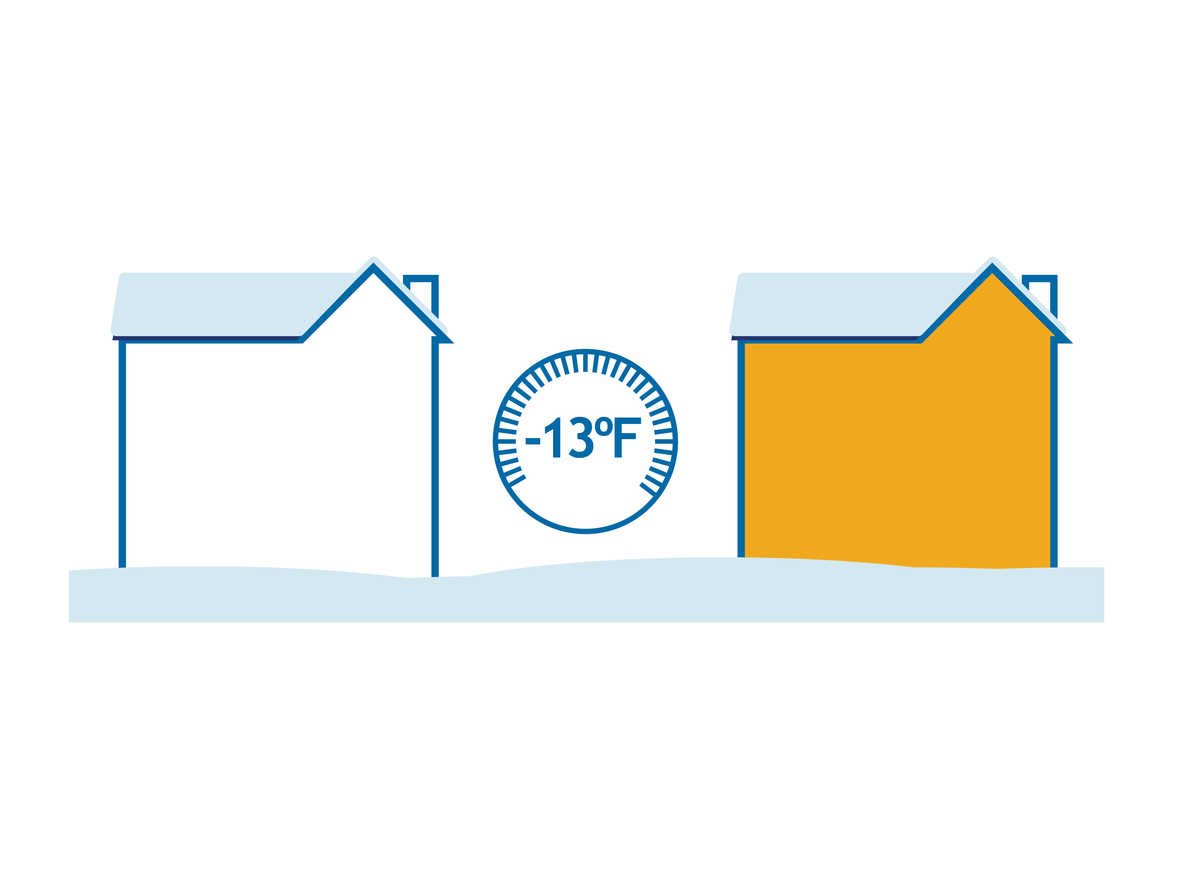
How Modulation Helps – Capacity
Traditional heat pumps cannot perform at low temperatures and therefore require supplemental heat
Cold climate heat pumps require less supplemental heat
Conventional Heat Pump
Cold Climate Heat Pump
0%
72%
Capacity
Capacity
Notes:
Cold climate heat pumps adjust the compressor speed and expansion valve settings leading to the right refrigerant pressure at the outdoor unit to still collect outdoor heat, even at extremely cold outdoor temperatures. The precise amount at any given temperature will differ model to model. Compared to conventional equipment Cold climate heat pumps usually have larger indoor and outdoor coils.

Slide 28
NEEP’s Cold Climate Specification
Variable capacity, residential-scale, air source heat pump. Ducted or ductless
High rated heating efficiency (≥ 9 HSPF ductless, ≥ 10 HSPF ducted)
High efficiency even at 5°F (COP ≥ 1.75)
Highly rated cooling efficiency
Capacity and efficiency data reported at multiple operating conditions
Sets and periodically updates the standard
Maintains a qualifying product list
Publishes the resultant engineering data
Notes:
Cold climate heat pumps are a subset of what are generically called a variable capacity heat pump, extended capacity heat pump, or inverter driven heat pump. The key is multiple operating speeds that can be fine tuned to match the indoor need and outdoor condition, rather than just on vs. off.
The same added capabilities that allow for improved heating performance on the coldest days extend its cooling performance on the hottest days

Slide 29
INTERACTION TIME! ASHP Function and Efficiency
Remote Delivery
Use polls to 1) name the parts of a heat pump and 2) ask which part of the heat pump does what
How does a heat pump achieve >100% efficiency?
In-person
Show parts of the heat pump and a list of functions – participants call out the match-ups like “The Price Is Right”
Participants call out how heat pumps achieve >100% efficiency
Notes:
Remember that efficiency in this context is delivered heat, divided by input energy. Since the delivered heat comes from the air, it is not breaking thermodynamics, as it is not converting the input energy to delivered heat.

Slide 30
System Design Options and Considerations

Slide 31
System Design Options Learning Outcomes
Understand the different ASHP designs and their intentions
Learn different design options for ASHPs by home need
Understand key considerations for system design
Notes:
Discuss why this is important to the audience. Cater to the specific audience’s roll and pre-knowledge.
Homeowner’s perspective
Contractor’s perspective
There are many ways, and many considerations in how to best distribute heat around the home. These decisions are the drivers for comfort and cost.

Slide 32
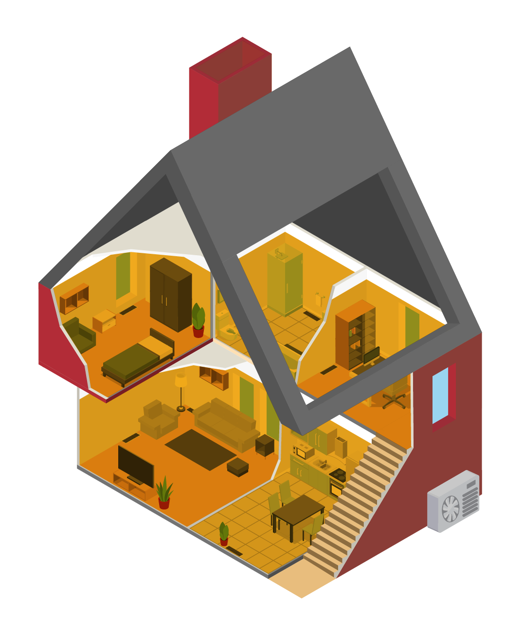
Design Intention #1 Displacement vs. Replacement
Only heat a portion of the home
Only serve a portion of the load
Leave or create supplemental heat
Heat the entire home at full load
Backup is optional
Displacement
(Partial Load)
Replacement
(Full Load)
Notes:
Displacement = Partial Load Replacement = Full load

Slide 33
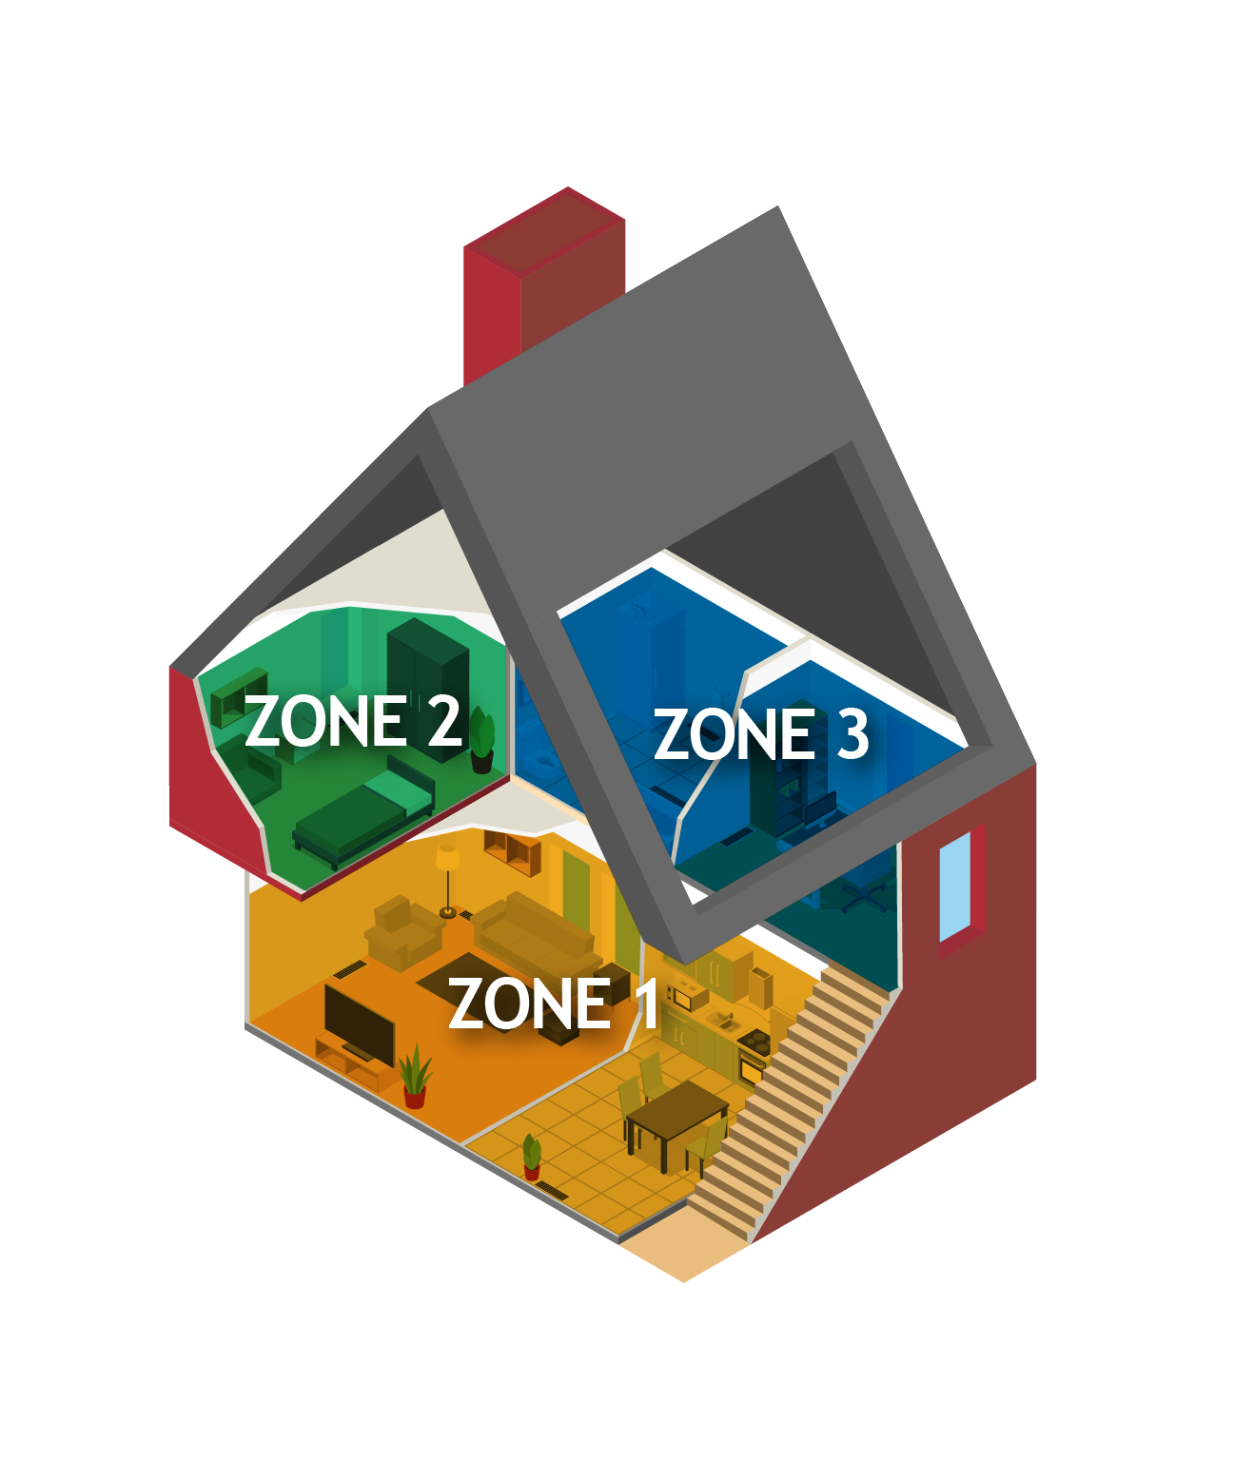
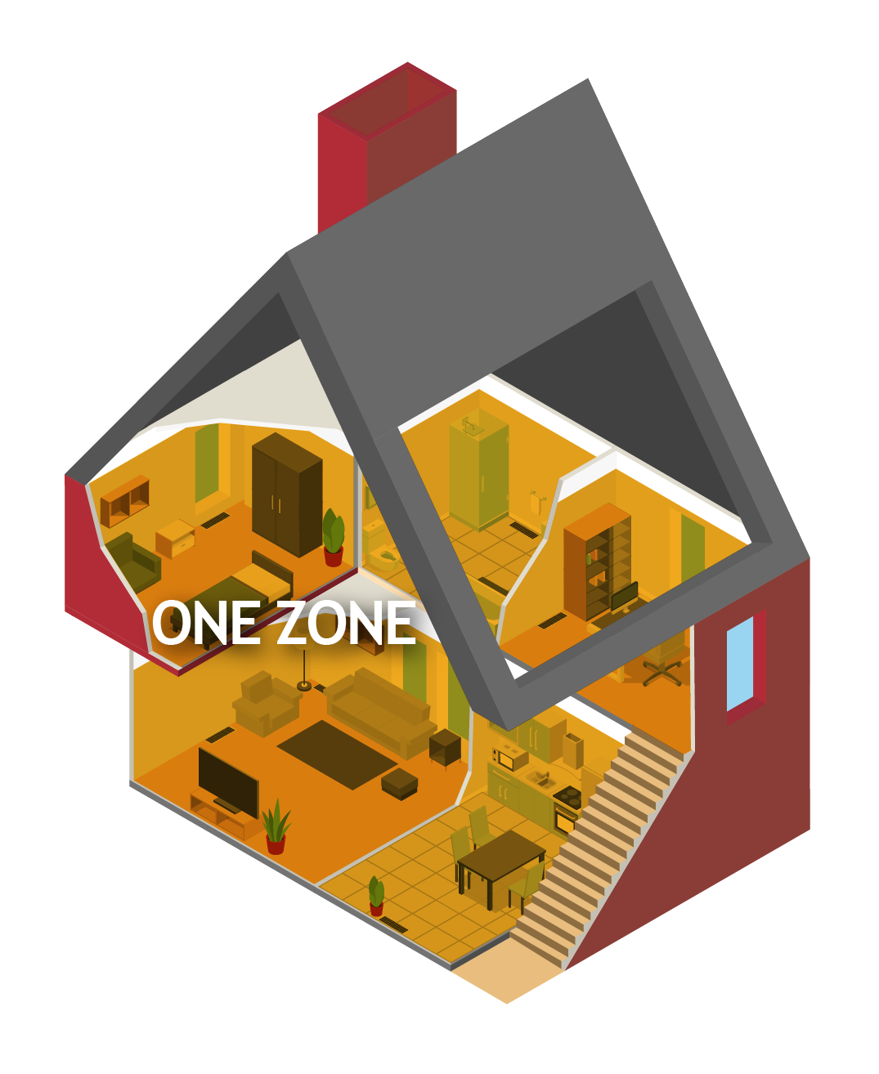
Design Intention #2 Zonal vs. Whole Home
The home is split into zones, each with its own heating
Each zone has its own thermostat and controls
Best for larger homes
Best for complicated layout
One thermostat controls the entire home
Best for smaller homes of simple geometry
Best with ducted systems
Zonal
Whole Home

Slide 34
Design Options Ducted vs. Ductless
Heat is distributed to each room through ducts
Best for replacement/full load scenarios
Individual heat pump heads in strategic locations
Best for displacement/partial load
Best in simple home layouts
Ducted
Ductless
Notes:
Both can be zonal. Both can serve either replacement/full load or displacement/partial load. The home’s specific geometry and layout, plus the nature of existing systems in a retrofit will drive the decision.

Slide 35
Ductless Design Options Mini-Split vs. Multi-Split
One head per outdoor unit
One thermostat
Can install multiple mini-splits in a home
Multiple heads per outdoor unit
Each head is controlled by its own thermostat
Requires careful sizing and zonal considerations
Mini-split
Multi-split
Notes:
Technically, a mini-split may have multiple indoor heads, but they are all controlled by a single thermostat.

Slide 36
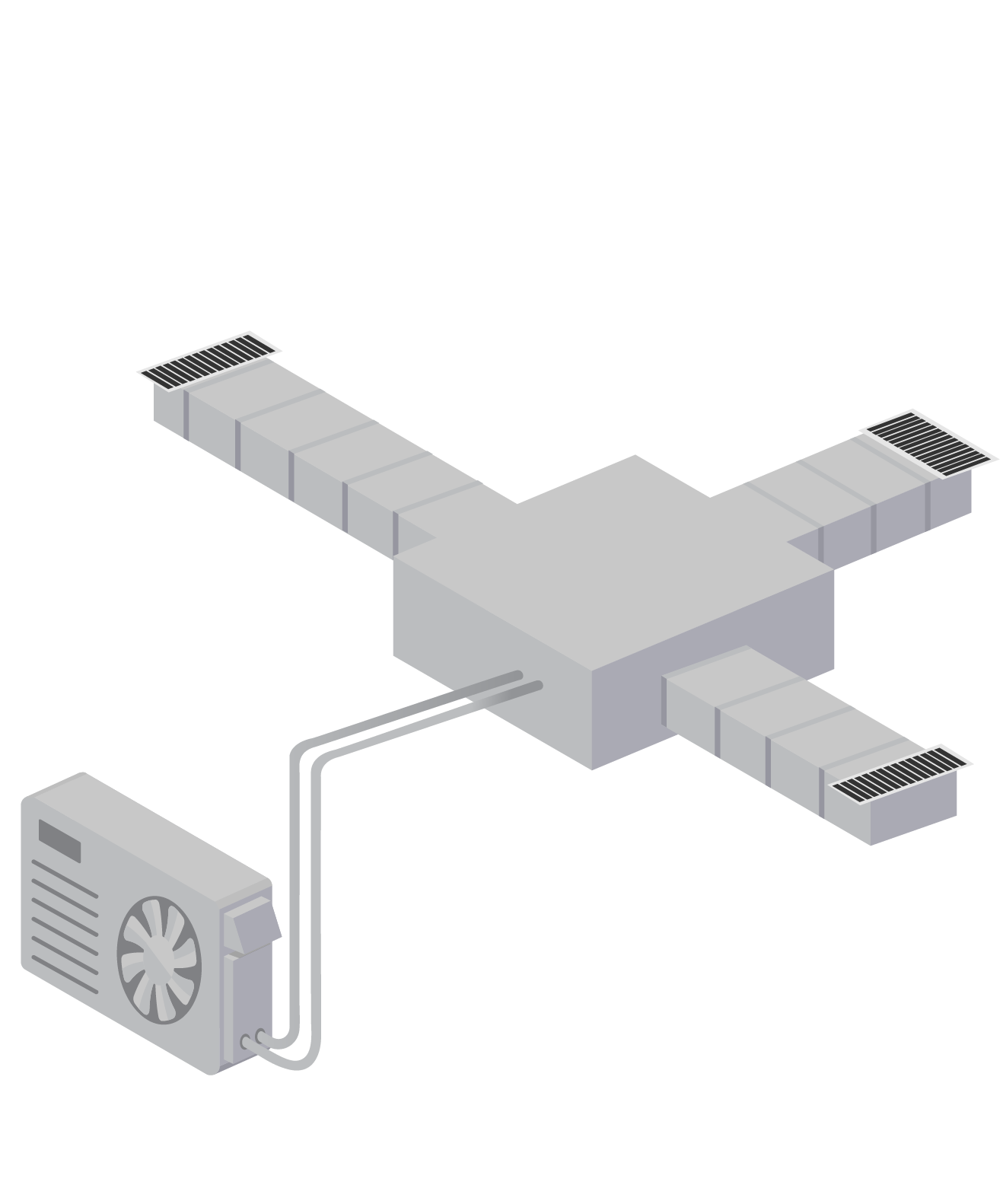
Other Design Options Compact Ducted and Combination
Short duct runs, 15 feet or less
Useful for closely located smaller rooms (bedrooms, office, etc.)
Minimizes pressure and thermal losses
Ducted in some zones, ductless in others
Example: 1st story vs. 2nd story
Example: Master suite vs. rest of house
Can improve load matching
Compact Ducted
Combination
Notes:
Unlike traditional heating systems where you typically have one single large heating plant (furnace or boiler), whose heat is then distributed throughout the house in ducts or hydronic loops, heat pumps solutions can be very modular and creative. Customized to the space and need.

Slide 37
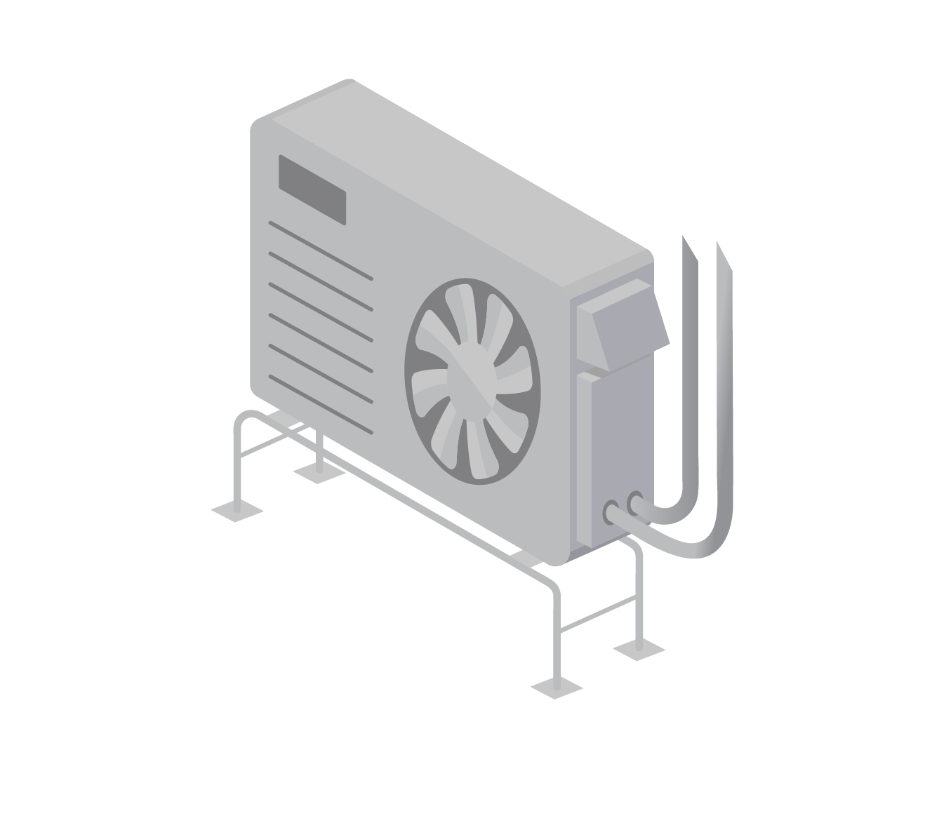
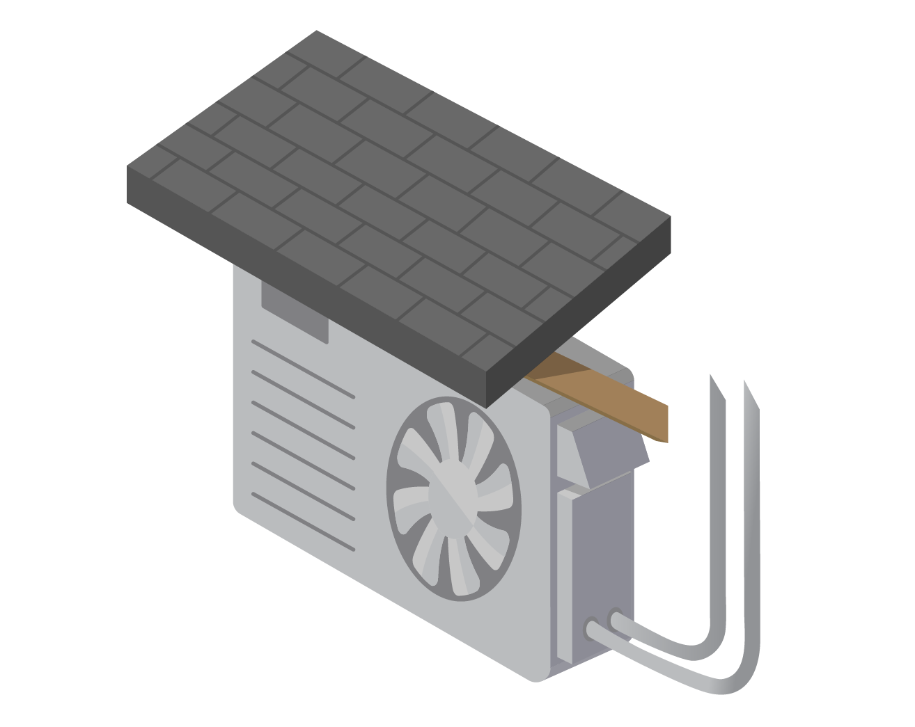
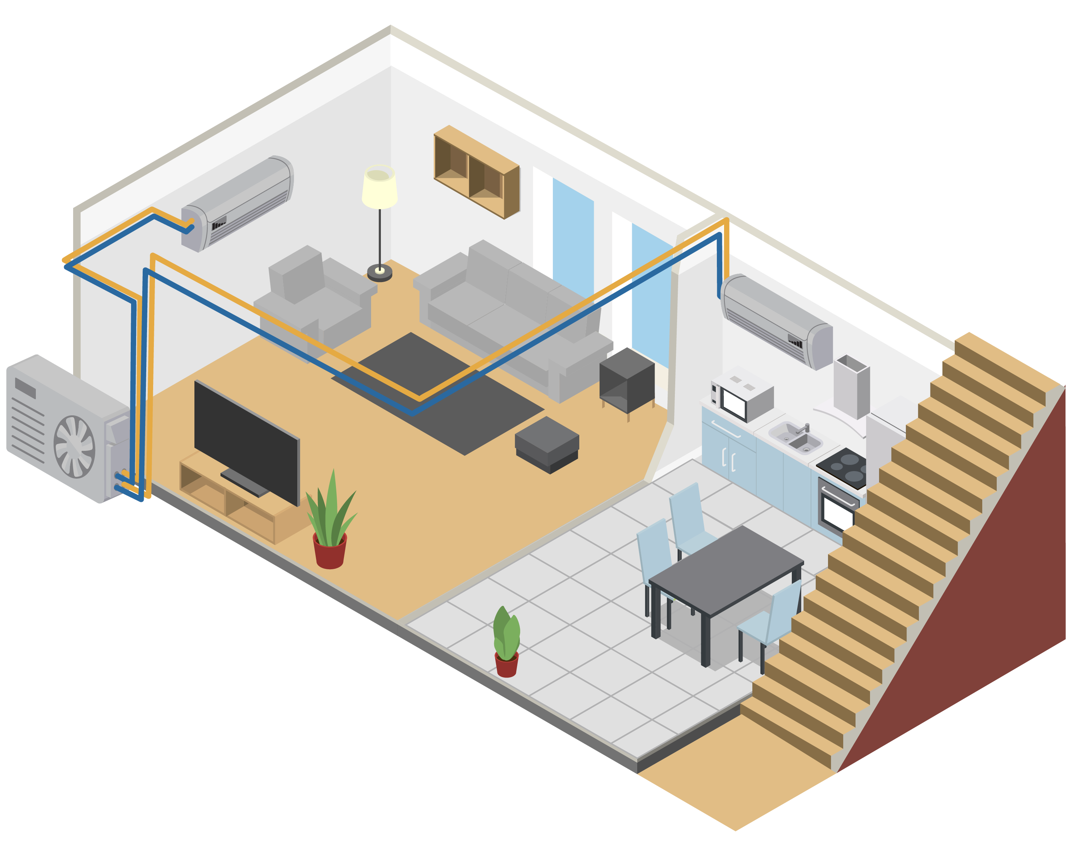
Other Design Considerations Outdoor Unit
Snow protection—off the ground on risers (preferred) or wall-mounted
Place on gable ends of the home to avoid roof dump
Wind protection—do not place in corners with wind-eddies
Condensate and defrost drain planning—ensure water has somewhere to drip that avoids freezing, walkways, and on top of other outdoor condensers
Lineset considerations:
Consult manufacturer guidance for correct lineset length, diameter, and unit height.
Adjust refrigerant charge if needed.
Can the refrigerant line be kept short (≤ 25 feet, ideally)?
Noise/vibration concerns
Nuisance and animal protection
Notes:
Wall mount is less desirable due to noise/vibration issues. Risers is the better method.

Slide 38
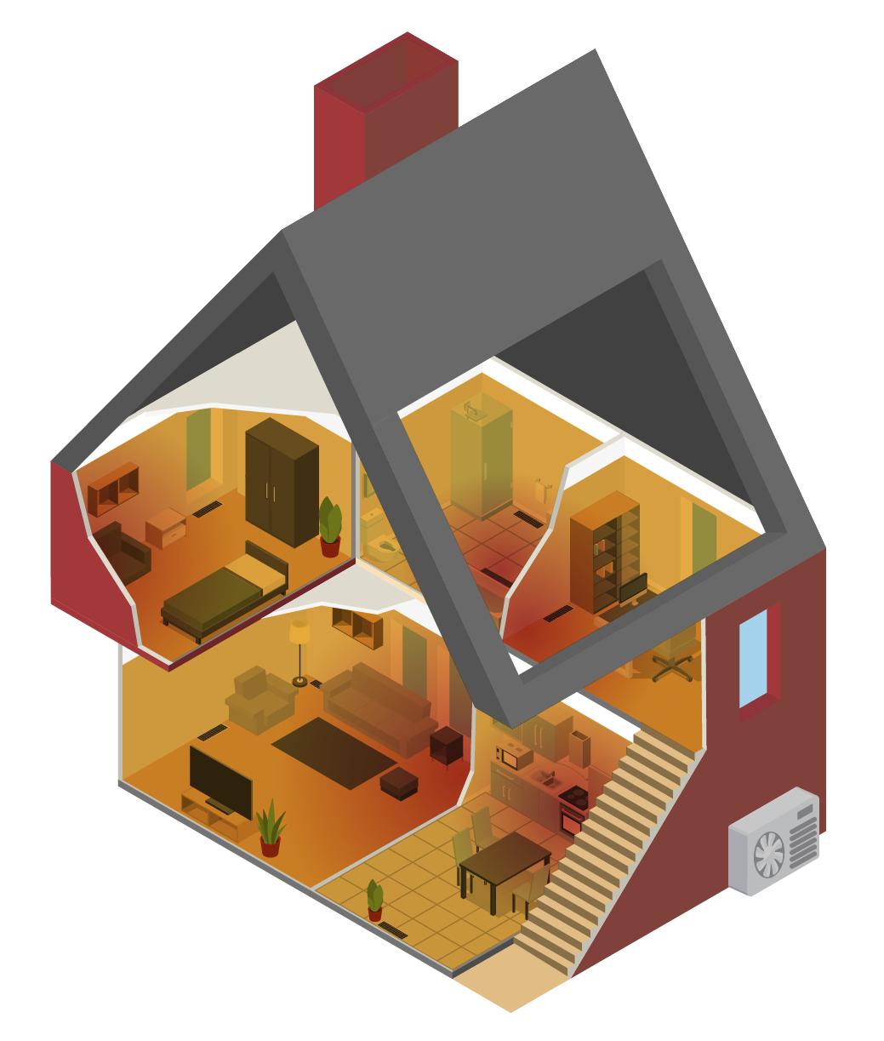
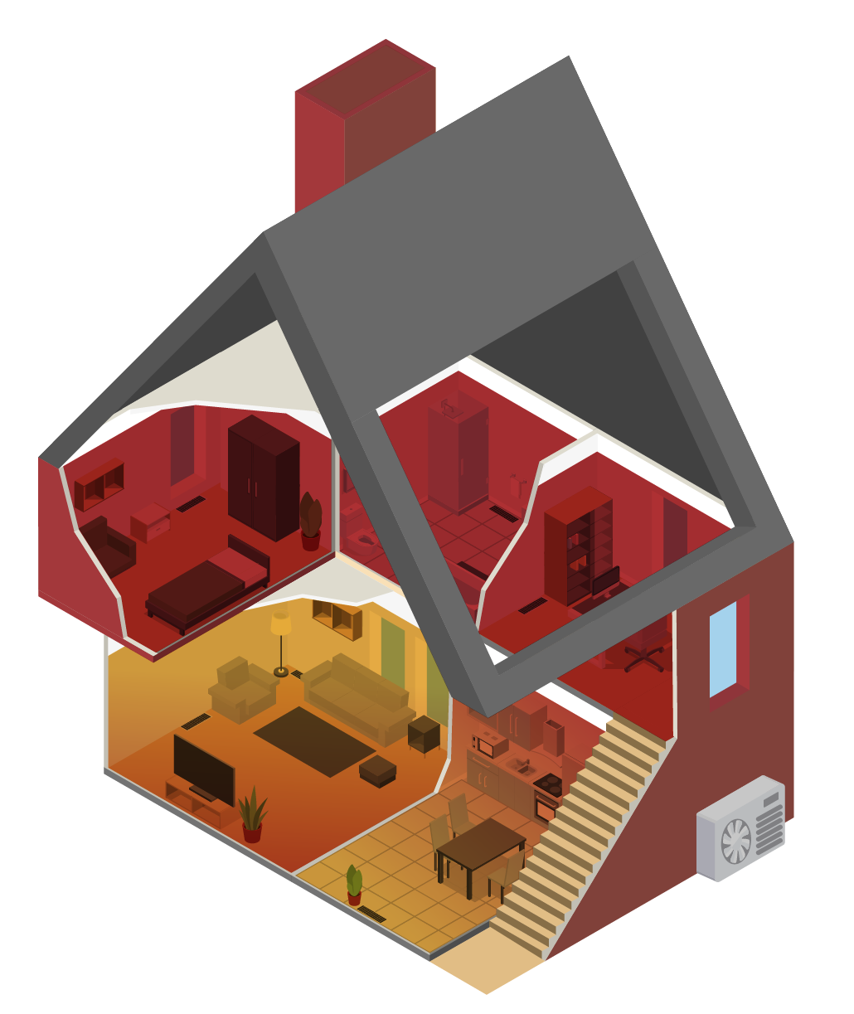
Other Design Considerations Backup vs. Supplemental Heat
Backup
Must cover nearly the whole home and the whole home’s load
Critical to include primary living area and water pipe locations
Can be gas, oil or electric resistance based
Intended to run infrequently—thermostat settings and controls must be integrated
Supplemental
Covers the portions of the home not served by heat pumps
Intended to run frequently—thermostat locations and settings must be integrated

Slide 39
Thank You!

Slide 40
Appendix A: Abbreviations and Acronyms
Abbreviation | Definition
ACCA | Air Conditioning Contractors of America
AHRI | Air Conditioning, Heating, and Refrigeration Institute
ASHP | Air source heat pump
BTU/hr | British thermal unit per hour
ccASHP | Cold climate air source heat pump
ccDHP | Cold climate ductless heat pump
COP | Coefficient of performance (instantaneous efficiency rating)
ECM | Electronically commutated motor
HSPF | Heating seasonal performance factor (heating efficiency rating)
HVAC | Heating, ventilation, and air conditioning
NEEA | Northwest Energy Efficiency Alliance
NEEP | Northeast Energy Efficiency Partnership
SEER | Seasonal energy efficiency ratio (cooling efficiency rating)
VCHP | Variable capacity heat pump

Slide 41
Appendix B: Resources Links
NEEP’s ccASHP Specification and Product List
NEEP’s Guide To Sizing & Selecting Air-Source Heat Pumps in Cold Climates
NEEA’s ccDHP Sizing Recommendations

