Slide 1
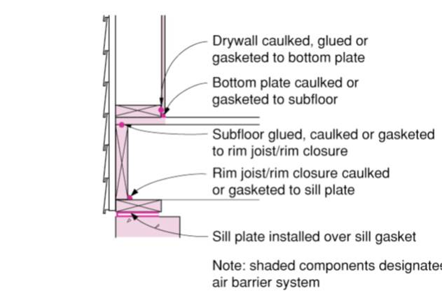
SILL PLATES ARE INSTALLED: SEALING RIM JOISTS
WHAT?
After the installation of sill plates and before drywall installation, comprehensive draft protection in a new home includes installing and sealing rim joists.
Notes:
After the installation of sill plates and before drywall installation, comprehensive draft protection in a new home includes installing and sealing rim joists.

Slide 2
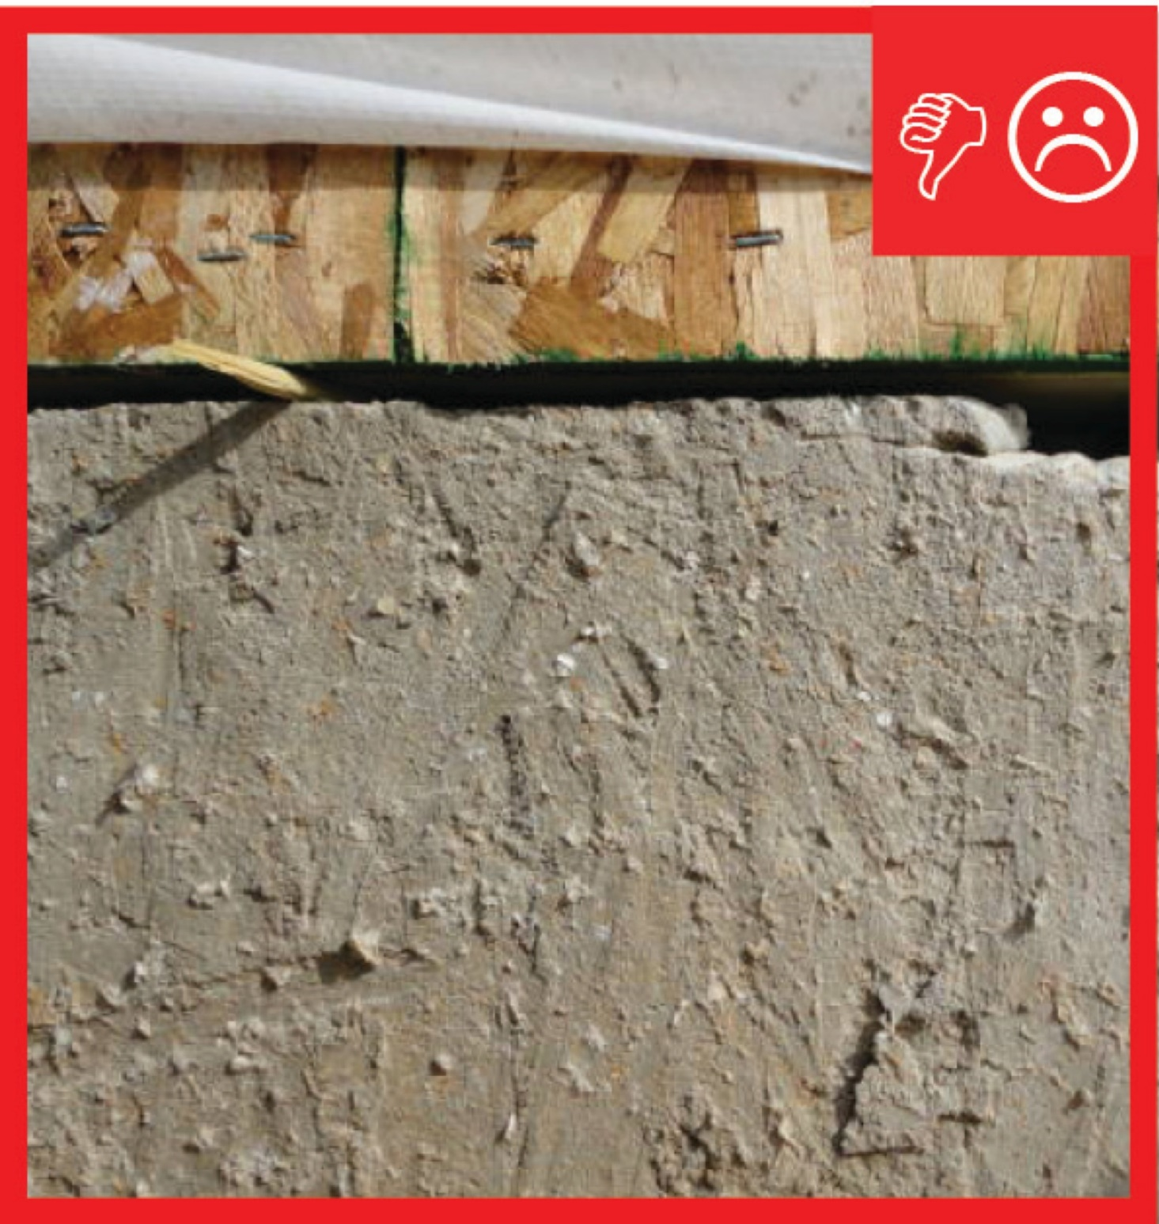
WHY?
Poorly sealed homes are less comfortable and cost more to maintain because they open the house to drafts, cold spots, moisture, and insects. Draft protection and air-sealing minimizes air flow that can otherwise hinder a high-performance insulation system, so being meticulous here means less wasted energy along with enhanced comfort, health, and durability.
Notes:
Poorly sealed homes are less comfortable and cost more to maintain because they open the house to drafts, cold spots, moisture, and insects. Draft protection and air-sealing minimizes air flow that can otherwise hinder a high-performance insulation system, so being meticulous here means less wasted energy along with enhanced comfort, health, and durability.

Slide 3
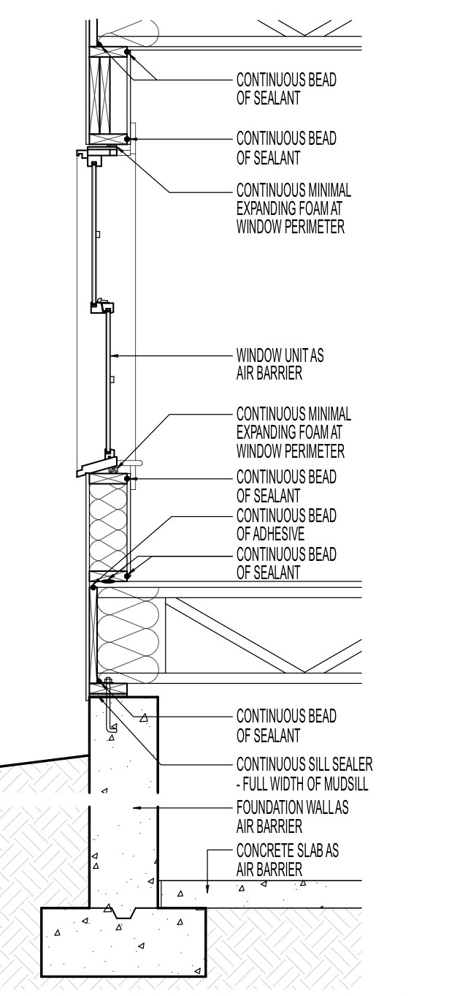
Install rim joists by putting rim board on the sill plate and creating a band around the perimeter of the floor system, matching the full depth of the joists.
Seal any seams between the sill plate and the rim joist with caulk.
Spray-foam the entire sill plate-rim joist area for further insulation.
Seal the hole where the anchor bolt comes through the sill plate with caulk. .
HOW?
Notes:
Install rim joists by putting rim board on the sill plate and creating a band around the perimeter of the floor system, matching the full depth of the joists.
Seal any seams between the sill plate and the rim joist with caulk.
Spray-foam the entire sill plate-rim joist area for further insulation.
Seal the hole where the anchor bolt comes through the sill plate with caulk.

