Slide 1
Electrical Panels

Slide 2
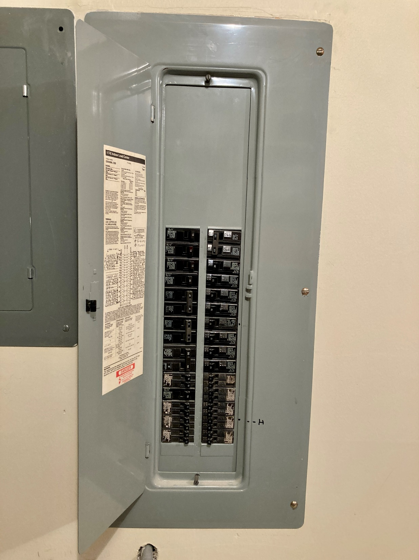
What are electrical panels?
Electrical panels are also known as:
Breaker boxes
Distribution boards
Divide incoming power from the utility into a number of circuits that feed power to the building’s electrical appliances, such as lighting, outlets, and heating and cooling.

Slide 3
What role do they play in switching from fossil fuel to electric heat pump heating?
When switching heating systems from fossil furnaces to heat pumps, it is recommended that a thorough electrical panel assessment be conducted.
Evaluate the existing panel condition and size, a whole house electrical load calculation including the consideration of any new or future electric loads and a determination of adequate physical space within the panel.
This will help determine if any panel or service upgrades are needed, including whether a subpanel may be beneficial for the new heat pump

Slide 4
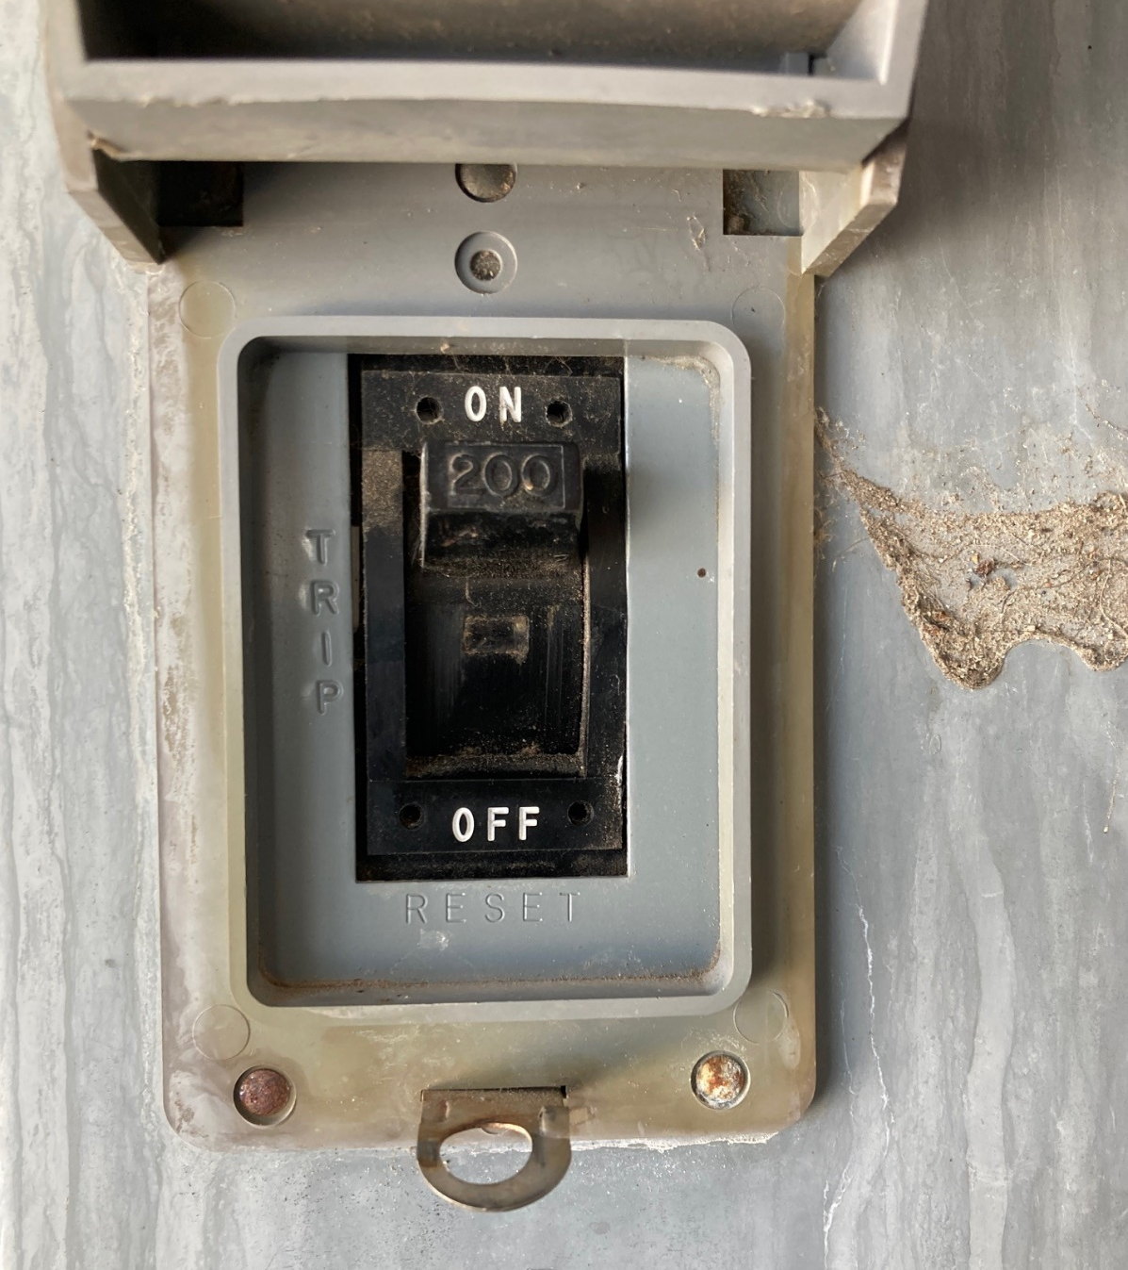
How to determine a home’s electrical panel size
The size of the home’s electrical panel can be determined by checking:
The amperage rating printed on the home’s electrical meter, which is typically located outside the home
The amperage rating printed on the label of the home’s main electrical panel
Capacity of the main breaker (shown to the left)

Slide 5
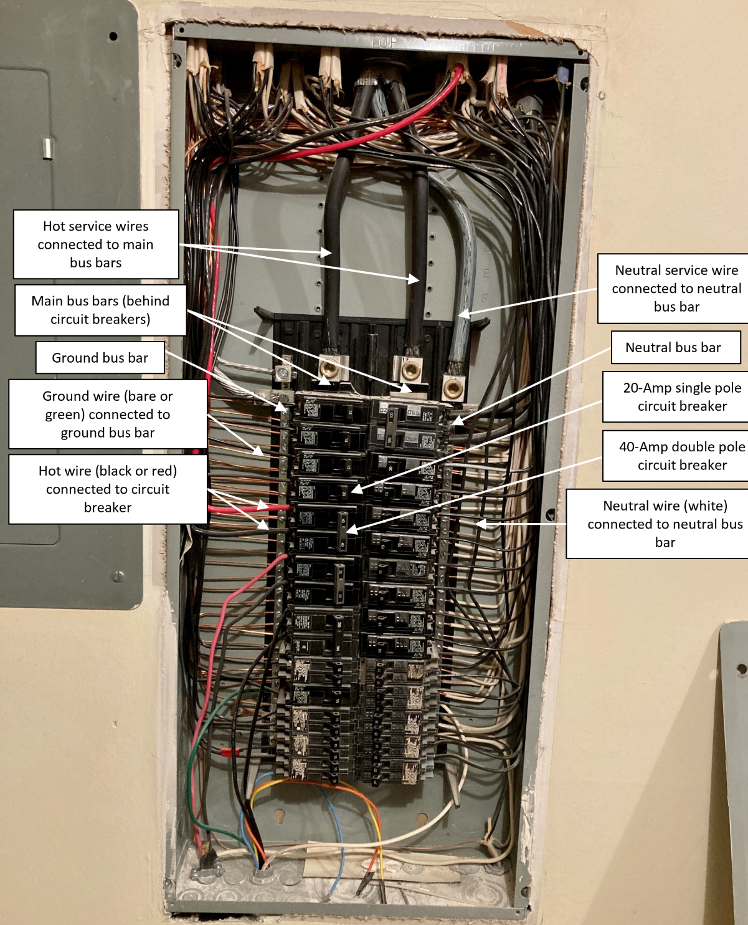
What are the components in a typical electrical panel?
Most residential electrical panels consist of typical components:
Hot and neutral service wires
Main bus bars
Neutral and ground bus bars
Circuit breakers
Hot, neutral, and ground wires

Slide 6
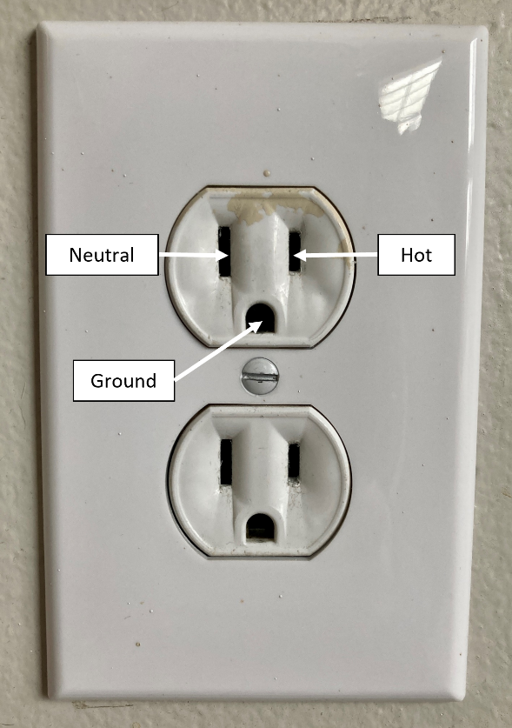
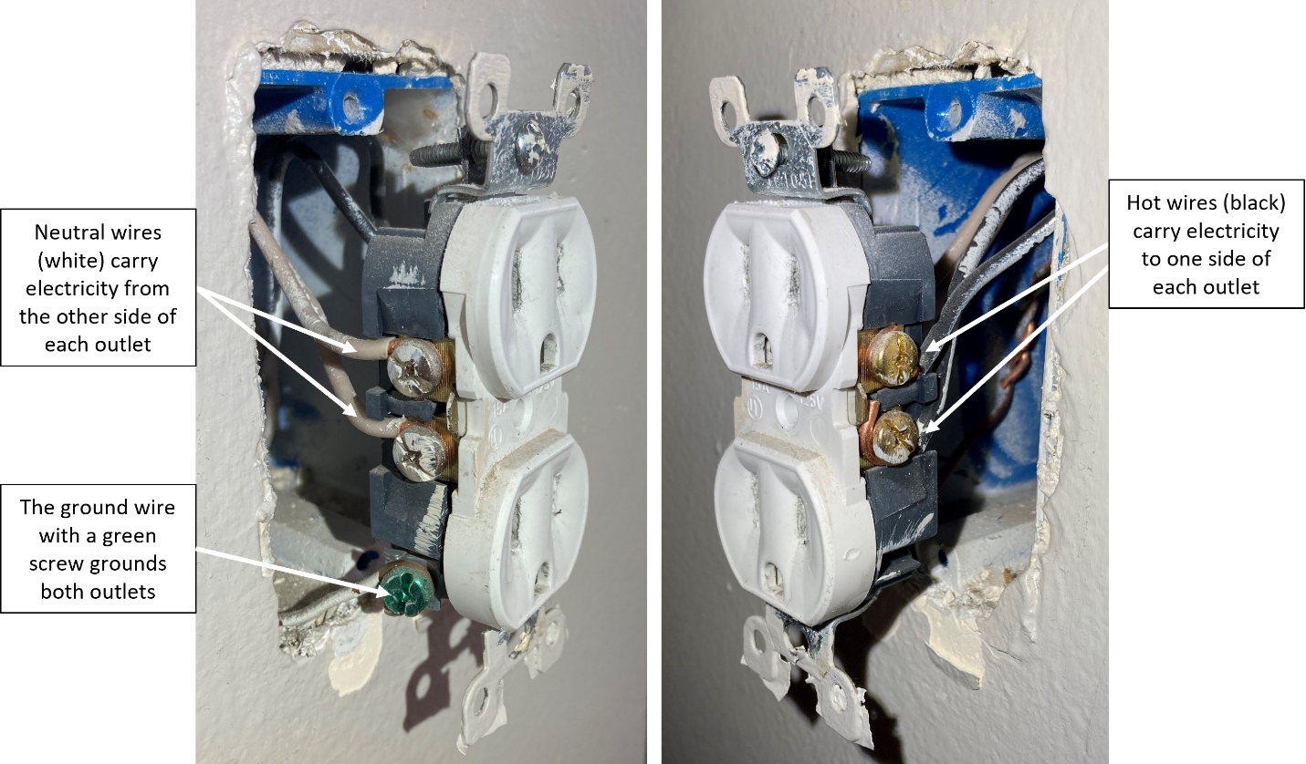
Where do the wires go?
An example of where the wires go is an electrical outlet or receptacle

Slide 7
Adding circuits for new appliances
To understand your electrical load and service capacity needs when adding circuits for new appliances, perform a load calculation
A load calculation sums the amperage of all the appliances in the home and then adds the new load of the heat pump to determine if the total amperage is less than the rating of the main breaker
To calculate the electrical load per National Electrical Code (NEC) Article 220.82, follow the steps on the next slides
First a key term to define:
Volt-Ampere (VA) - One VA is equal to one watt, but it describes apparent power, not real power. VA is used for an assumption of power that could be drawn instead of a measure of actual power drawn.

Slide 8
Performing Load Calculations
General Electrical Load Requirements
Take the area of the home, in square feet, and multiply the value by a general load assumption of 3 volt-amperes (VA) per square foot for lighting and general use receptacles.
Count the number of small appliance circuits in your home, which may include a kitchen countertop where a toaster and/or a blender may be plugged in, entertainment centers, or home offices. If your electrical panel is well labeled, you can count the number of breakers that serve those areas. Otherwise, count the number of areas in your home that service these types of appliances. For example, if your home has one kitchen, an entertainment area where a TV, internet modem, and gaming console is plugged in, a home office, and 2 bathrooms, that would be five small appliance circuits.
Multiply the number of small appliance circuits by an assumption of 1,500 VA per circuit.
The same 1,500 VA assumption will also be applied to the number of laundry circuits, which refers to each clothes washing machine in the home. Clothes dryers are included in the next section.

Slide 9
Performing Load Calculations
Appliance and Motor Loads
Sum the nameplate wattage rating as a VA value of each appliance listed below:
Appliances (like microwaves) that are fastened in place and/or permanently connected
Ranges, wall mounted ovens, counter mounted cooking units
Clothes dryers that are not connected to the laundry branch circuit
Once the lighting, small appliances, and motor loads are summed, apply the following demand factors:
The first 10,000 VA are factored at 100%
The remaining VA are factored at 40%

Slide 10
Performing Load Calculations
Heating and Air Conditioning Loads
Include only the largest from the following loads (i.e. only include the appliance from the list below with the highest power rating):
100% of the air conditioning nameplate wattage
100% of the heat pump when used without supplemental electric heating
If using supplemental electric heating, 100% of the heat pump compressor and 65% of the supplement electrical heating
65% of space heaters if using less than four separately controlled units
40% of space heaters if using four or more separately controlled units
100% of the nameplate wattage rating of electric thermal storage and other heating systems

Slide 11
Performing Load Calculations
Sum the loads above and convert to amps
Divide the total VA load by 240 volts, as that is the voltage supplied to the home. The resulting value is the total amps of the home which can be compared to the service capacity.

Slide 12
Calculating new appliances
Now that you’ve calculated the home’s existing electrical load, you can perform a similar calculation to determine if the existing service capacity is sufficient to power a heat pump.
This is important to ensure that the main breaker will not be tripped from drawing too much power when adding the new appliance.

Slide 13
Load calculation example
Calculate the electrical load for a 2,500 square foot single-family home using the following appliances:
3 appliance circuits
5,000W range
1,000W dishwasher
5,600W clothes dryer
15,000W baseboard heating (resistance heaters)
You can use the following assumptions:
3 VA per square foot for lighting
1,500 VA per appliance circuit
For general loads, assume the first 10,000 W at 100% demand factor and remainder at 40%.
For heating loads, assume 100% demand factor

Slide 14
Load calculation example
2,500 square feet x 3 VA = 7,500 VA for lighting
3 appliance circuits x 1,500 VA each = 4,500 VA
The general loads (range, dishwasher, and clothes dryer) can be added at their wattage rating as VA:
5,000 VA + 1,000 VA + 5,600 VA = 11,600 VA
Apply the demand factor to general loads:
10,000 VA x 100% = 10,000 VA
1,600 VA x 40% = 640 VA
Subtotal of general load is 10,640 VA
Add lighting and appliance circuits to the general load:
7,500 + 4,500 + 10,640 VA = 22,640 VA
Add in the heating load to the general load
22,640 VA + 15,000 VA = 37,640 VA
Divide total VA by 240V to get amps:
157A

Slide 15
Load calculation example
Now assume you want to add a 3-ton heat pump unit with 40-amp breaker to replace the floorboard heaters and add cooling. Will your electrical load exceed the home’s 200A service? Are you reducing or increasing the overall electrical load by adding the heat pump?
Redo the calculation removing the floorboard heating and adding in the heat pump

Slide 16
Load calculation example
2,500 square feet x 3 VA = 7,500 VA for lighting
3 appliance circuits x 1,500 VA each = 4,500 VA
The general loads (range, dishwasher, and clothes dryer) can be added at their wattage rating as VA:
5,000 VA + 1,000 VA + 5,600 VA = 11,600 VA
Apply the demand factor to general loads:
8,000 VA x 100% = 8,000 VA
3,600 VA x 40% = 1,440 VA
Subtotal of general load is 9,440 VA
Add lighting and appliance circuits to the general load:
7,500 + 4,500 + 9,440 VA = 21,440 VA
Divide total VA by 240V to get amps without heating:
89A
Add in the Amps of the heat pump
89A + 40A = 129A

Slide 17
Load calculation example
Adding the heat pump will not exceed the home’s 200A service and reduces the overall electrical load

