Slide 1
Duct Leakage Testing
Total Duct Leakage and
Duct Leakage to the Outdoors

Slide 2
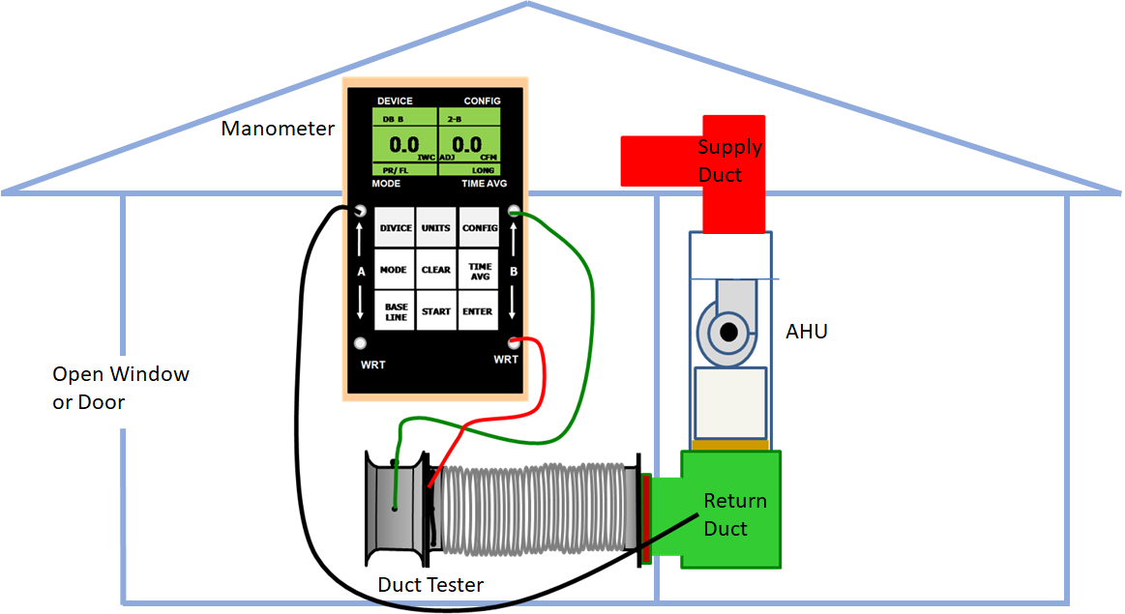
Total Duct Leakage

Slide 3
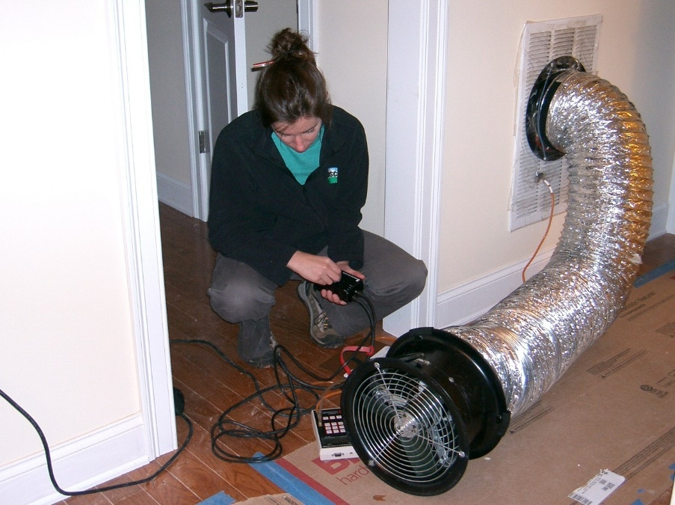
An energy rater uses a duct blower to test HVAC duct air leakage.

Slide 4
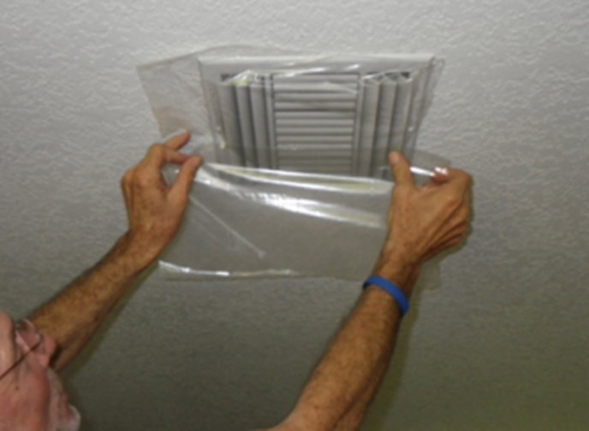
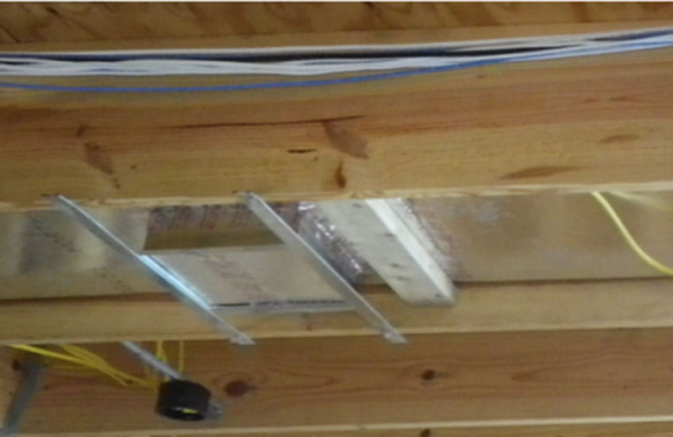
Covering the supply outlets and return inlets for a total duct leakage test at final.

Slide 5
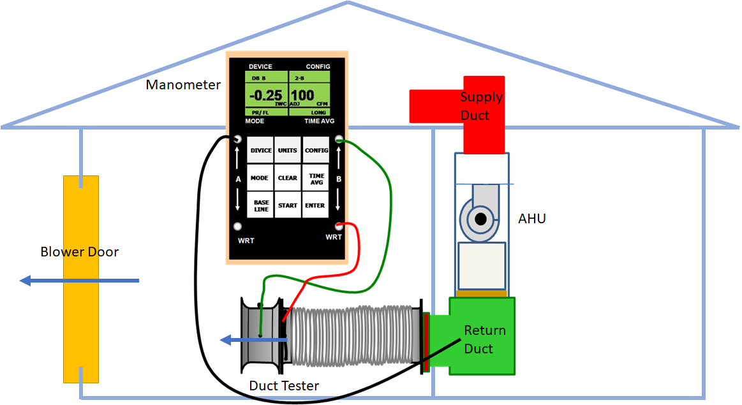
Duct Leakage to the Outdoors

Slide 6
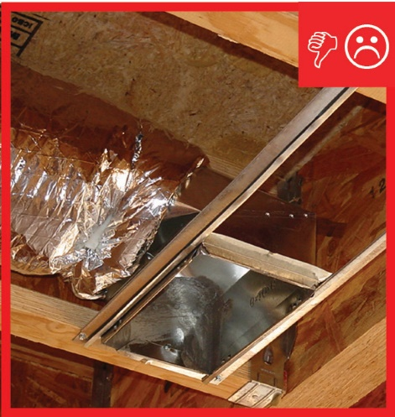
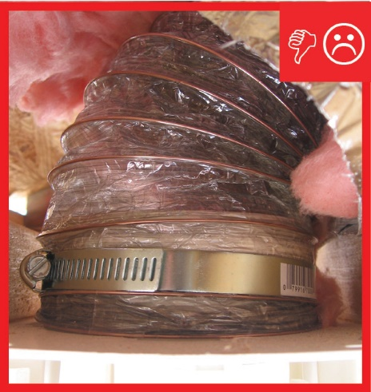
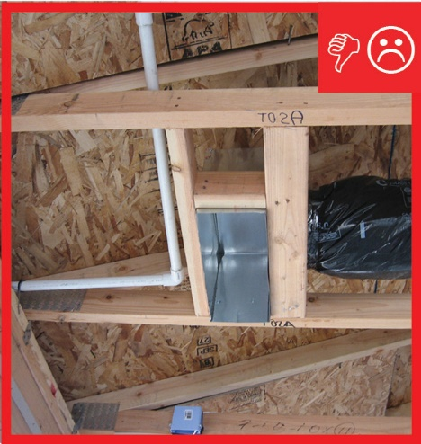
Incorrect Installation

Slide 7
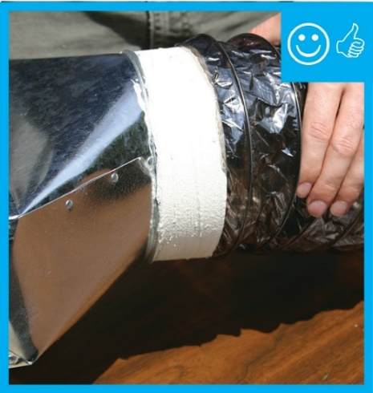
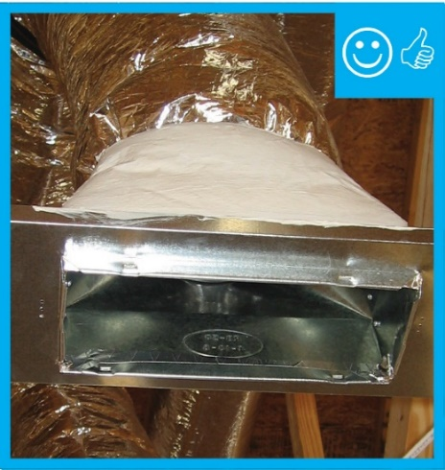
Correct Installation

