Slide 1
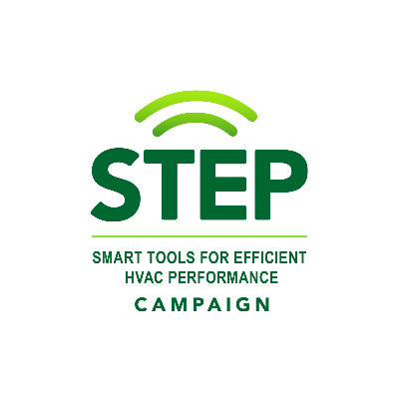
A Brief Overview of Smart Diagnostic Tools for Residential HVAC
STEP Campaign

Slide 2
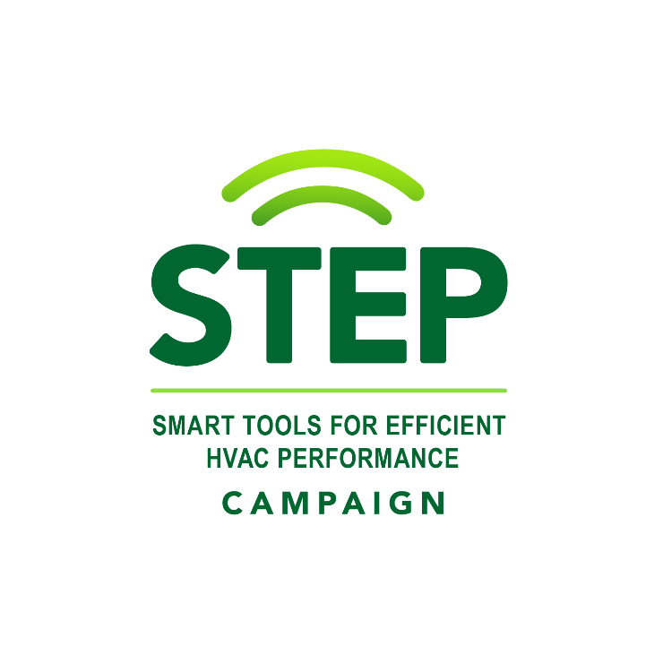







Smart Tools for Efficient HVAC Performance
Working in partnership to help ensure heat pumps and central air conditioners operate efficiently and maintain optimal performance over time, reducing contractor callbacks and delivering comfort, energy savings, and low carbon heating and cooling to homeowners
Why Smart Diagnostic Tools?
They allow technicians to quickly commission new heat pump and central air conditioning systems and identify faults in existing systems – improving the quality of installation and reducing energy waste due to faults
Automated Fault Detection and Diagnostic (AFDD) systems are currently only available in very high-end equipment for reliability, not energy efficiency
Why the Campaign?
A national one-stop-shop for unbiased information and resources to speed adoption of smart diagnostic tools
Provides access to key resources
Provides recognition for partner successes
Organizing Committee

Slide 3
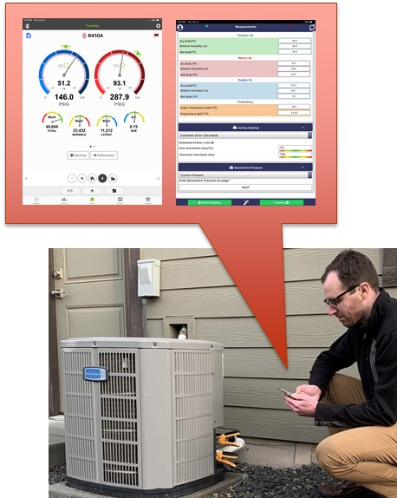
Why Smart Diagnostic Tools?
Expand Capabilities
Streamline Processes
Ensure HVAC Efficiency
Improve Customer Satisfaction
Boost Reputation
Create Business Value

Slide 4
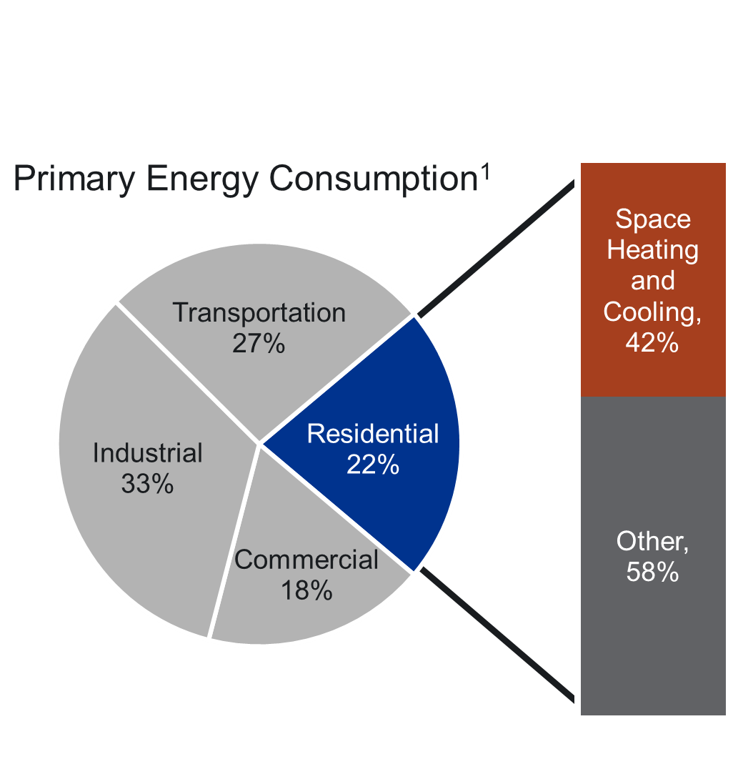
Why Residential HVAC Matters
Comfort
Health and Safety
Energy Use
Carbon Emissions

Slide 5
HVAC Efficiency Over the Years
Code-driven minimum HVAC efficiency continues to increase
Premium high-efficiency HVAC units perform much better than code minimum
Heat pumps are on the rise
Efficiencies are not always realized in the field
Figure: Performance standards for residential central air-conditioning equipment and heat pumps¹

Slide 6
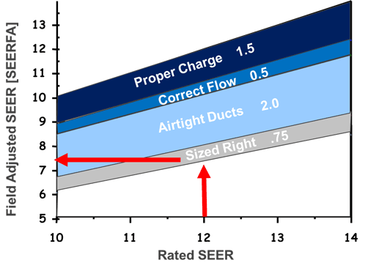
Impact of Improper Installation
Improper installation or maintenance of central air conditioning (CAC) and air-source eat pump (ASHP) systems results in decreased performance, energy waste, and reliability concerns.
  At least one energy wasting fault in 70-90% of homes²
  At least 20% of CAC/ASHPs experience failure due to improper installation²
  Estimated 9% energy waste due to decreased CAC/ASHP performance due to inadequate airflow and improper refrigerant charge³
Figure: Theoretical field adjusted SEER caused by installation and sizing issues¹

Slide 7

What Quality Contractors Strive For
Eliminating callbacks
Ensuring every HVAC system runs at peak efficiency
Every HVAC system is commissioned

Slide 8
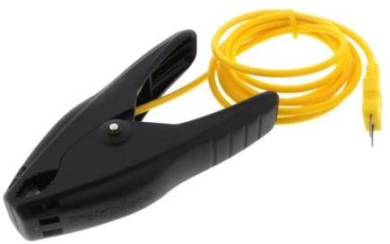
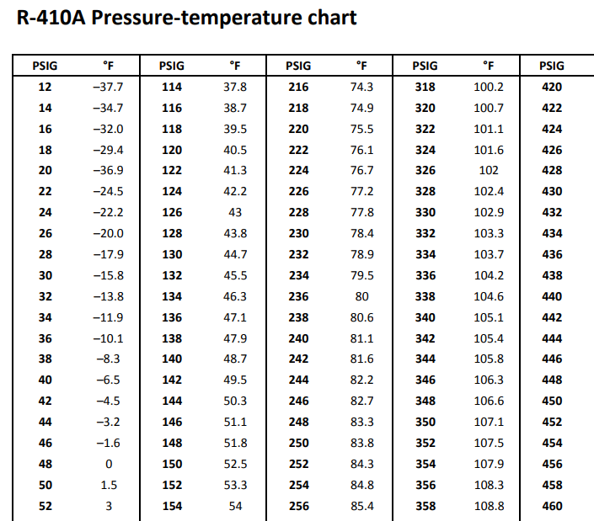
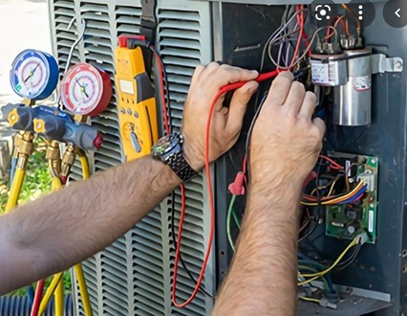
Old School Tools
Find data plate image:
Target Subcooling = 10°F

Slide 9
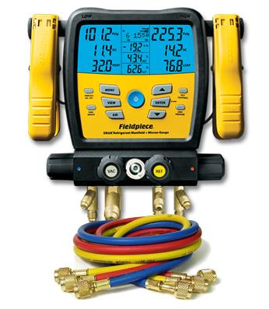
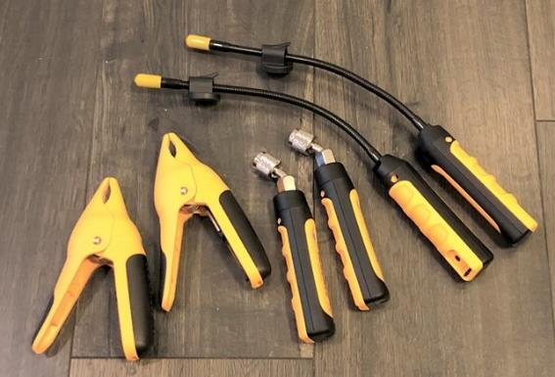
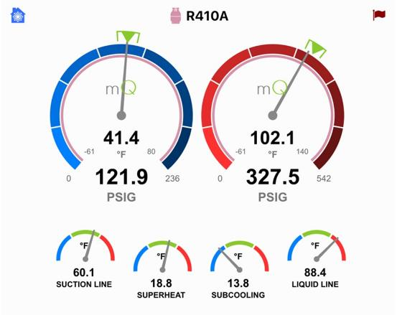

Smart Diagnostic Tools
Digital Sensors, Probes, and Manifolds
Smartphone/Tablet Diagnostic App
Wirelessly connected
Provides Diagnostics
Suggest Corrective Actions
Run Performance Calculations

Slide 10
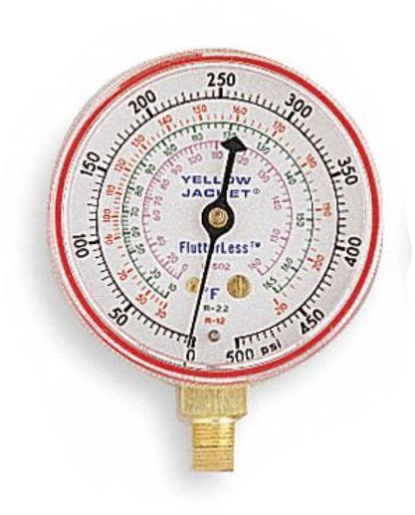
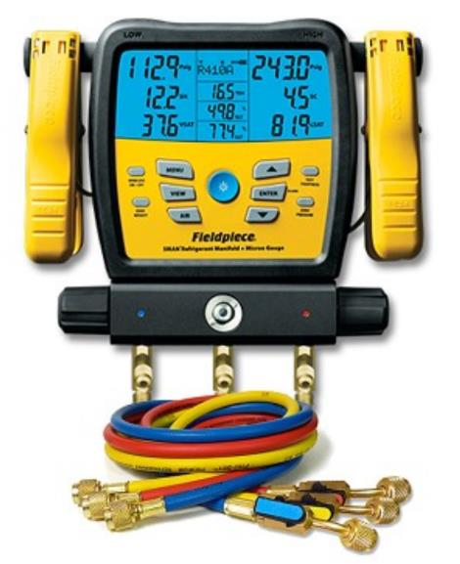
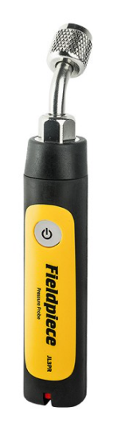
Measurement Uncertainty
Read between the lines!
Take for example a 500-psi gauge:
Class B, 3%-2%-3%
  ±10 psi to ± 15 psi
Class 1, 1% Accuracy
  ±5 psi
For 580-psig max digital probes/gauges:
Fieldpiece JL3PR Pressure Probe
  ±1 psi to ±2 psi
Fieldpiece SM380V
  ±1 psi to ±2.74 psi
Analog
Digital

Slide 11
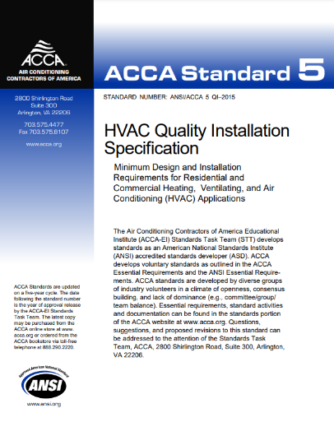
Measurement Uncertainty
ACCA QI5
4.3.1 Requirements:
The contractor shall ensure:
For the SUPERHEAT method, system refrigerant charging per OEM data/instructions and within ±5°F of the OEM-specified superheat value
Example:
R410A, non-TXV,
Indoor Wetbulb = 66°F, Outdoor Drybulb = 95°F
Target Superheat of 10.0°F
Measured Suction Temp = 49.6°F
Suction Pressure = 118.0 psig → 39.6°F Saturation Temp
34.6
39.6
44.6
34 | 35 | 36 | 37 | 38 | 39 | 40 | 41 | 42 | 43 | 44 | 45
(°F)
Class B, 3-2-3 Gauge
(±10 psig)
35.4
44.2
Class 1, 1% Accuracy Gauge
(±5 psig)
37.7
42.1
Digital Gauge, Fieldpiece SM380V
(±2.74 psig)
-5°F
38.7
41.1
+5°F

Slide 12
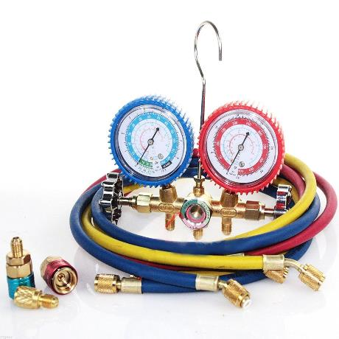

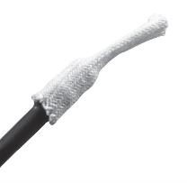
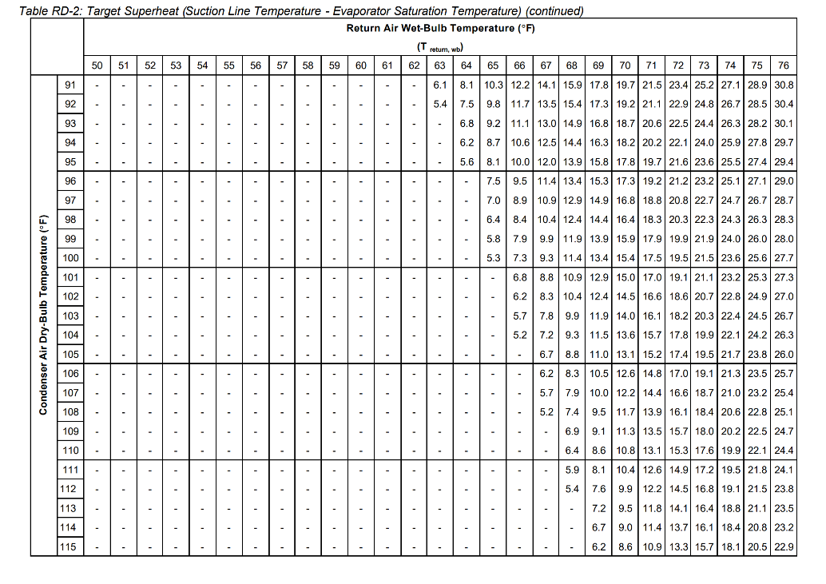
Refrigerant Charge
Airflow is correct, system is clean
Suction pressure and saturation temperature
Vapor line temperature
Outdoor air temperature
Return wet bulb temperature
Total Superheat = Measured Vapor Line Temperature – Saturation Temperature
Add or remove charge and wait!
Moving Target!

Slide 13
Commissioning
Pen and Paper Calculations and Reporting
Verify components
Verify Proper Airflow
Measure return and supply WB and DB temperatures, convert to enthalpies
Operating Capacity [btu/h] = 4.5 x CFM x Δh
Percent of Rated Capacity: Operating Capacity ÷ AHRI Rated Capacity (should be within 10%)
With Smart Diagnostic Tools
Enter system information
Measure airflow and input into application, or let application auto-calculate
Insert psychrometer probes into supply and return airstreams
Application calculates operating capacity and percent capacity
Application generates reports that you can share with the homeowner

Slide 14
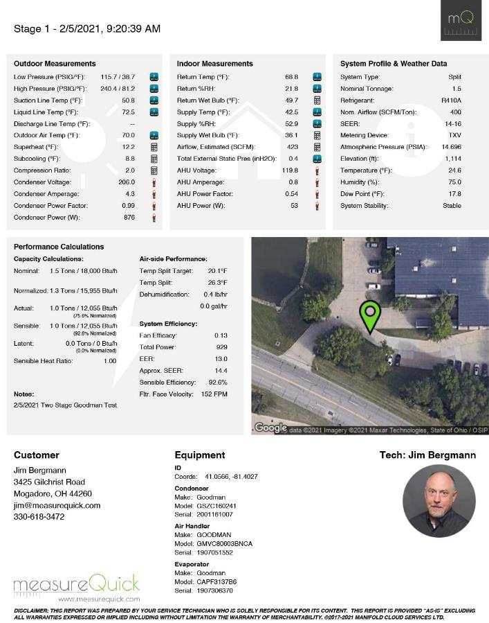
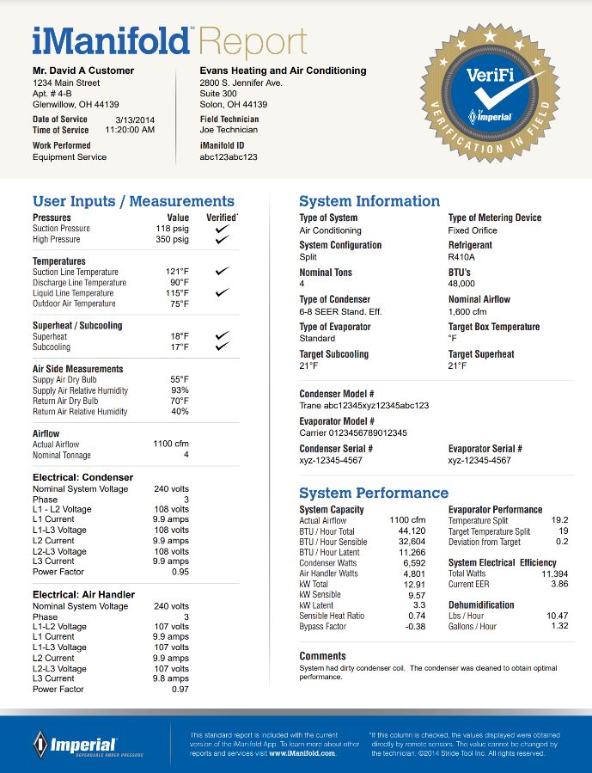
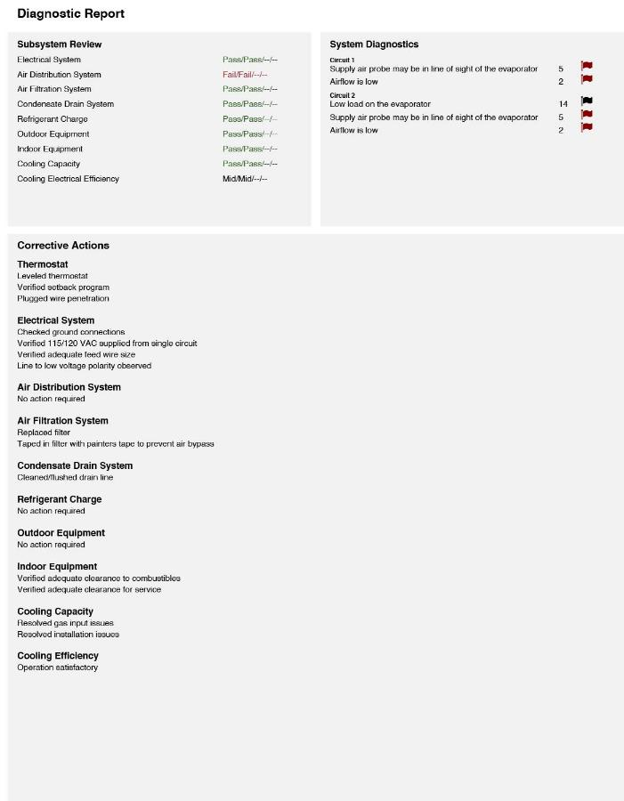
Commissioning

Slide 15
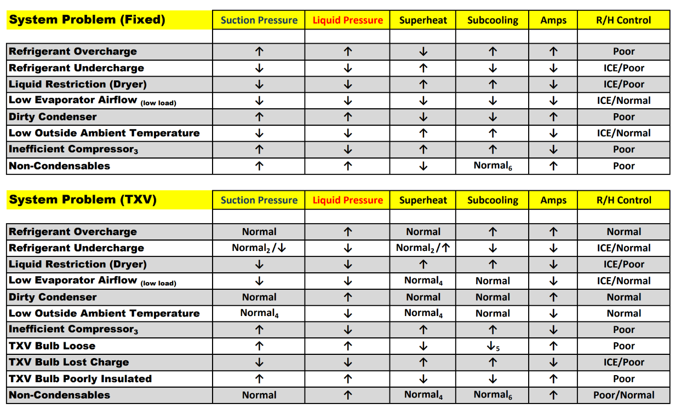
Troubleshooting & Diagnostics
https://www.trutechtools.com/assets/images/EducationalMaterials/AC%20troubleshooting%20guide%20generic.pdf

Slide 16
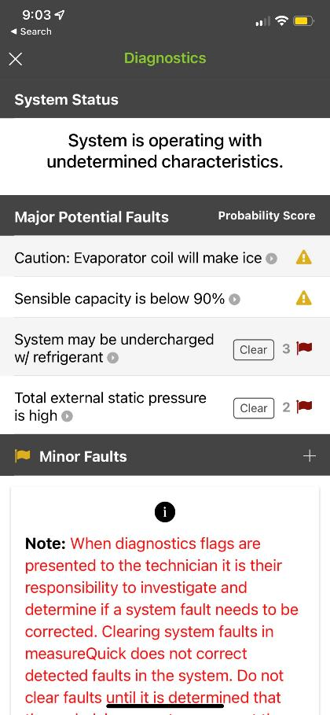
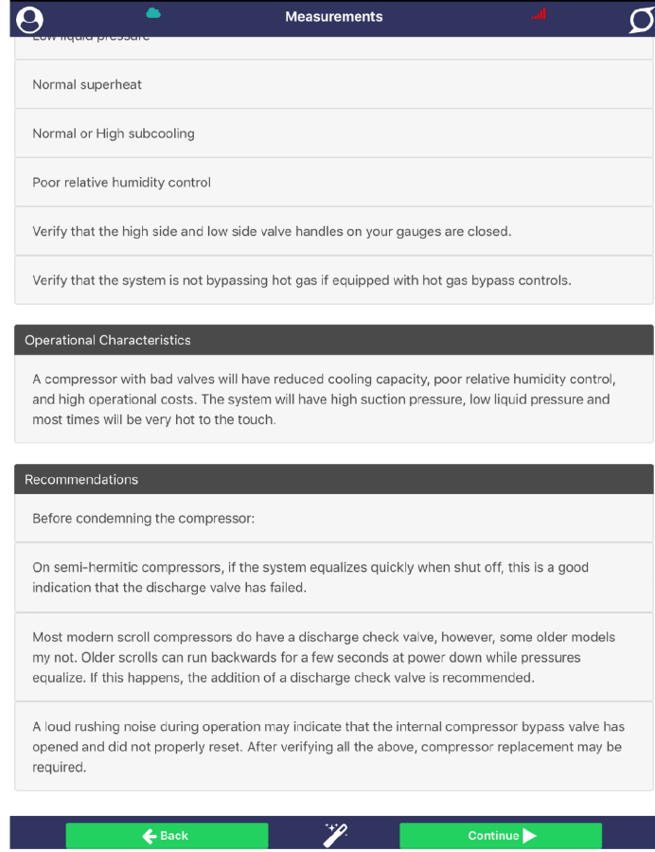
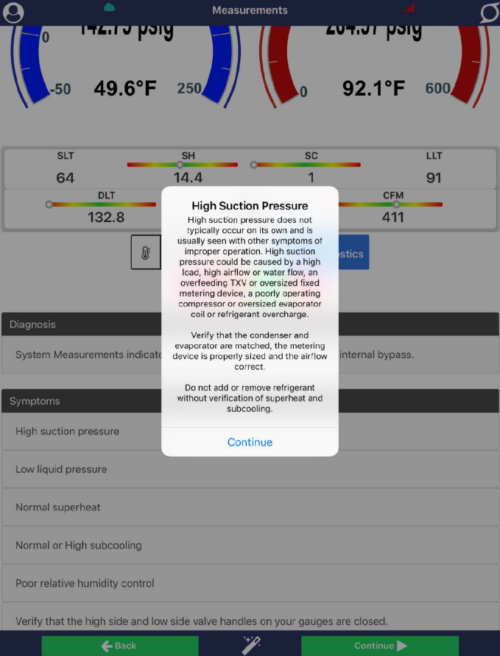
Troubleshooting & Diagnostics

Slide 17
So … What About Cost?
First Cost
  Examples from the web
    Mechanical Manifold Gauge Sets: $72 - $635
    Digital Manifold Gauge Sets: $247-$764¹, $257-$711² (many included vacuum and temperature probes)
    Smart Probe Kits $330-$670² (pressure probes, thermocouple pipe clamps, psychrometers, etc.)
Subscription Cost
  Free versions available (limited features), paid subscription unlocks more features
  Paid subscription for Fieldpiece Job Link and iManifold is on a per user per month basis, whereas measureQuick is on a per system per year basis
Cost of Callbacks
  Truck rolls
  Unpaid time on jobsite
  Loss of business
  Opportunity costs
Smart Diagnostic Application | Cost | Source
measureQuick Premier Services | $5 / system / 365 days | https://measurequick.com/premier-services/
iManifold Pro+ | $14.95 / user / month (yearly) $19.95 / user / month (monthly) | https://imanifold.com/products/cloud/imanifold-cloud-2/
Job Link Pro | $12.00 / month $29.00 / month (Job Link Pro + Invoicing) | https://www.fieldpiece.com/product-category/job-link-system/

Slide 18
Some Training Required
Familiarization with the smart diagnostic application or digital manifolds
Navigating user interface
Pairing digital instruments
Sensor and probe placement
Workflows
Sensor and probe placement
Diagnostics and Reporting

Slide 19
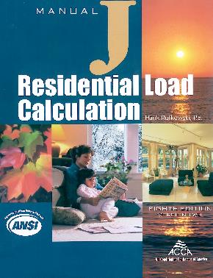
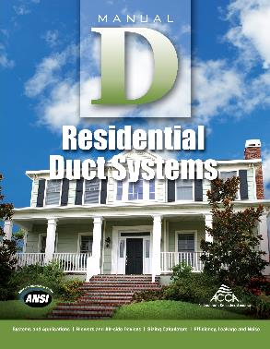
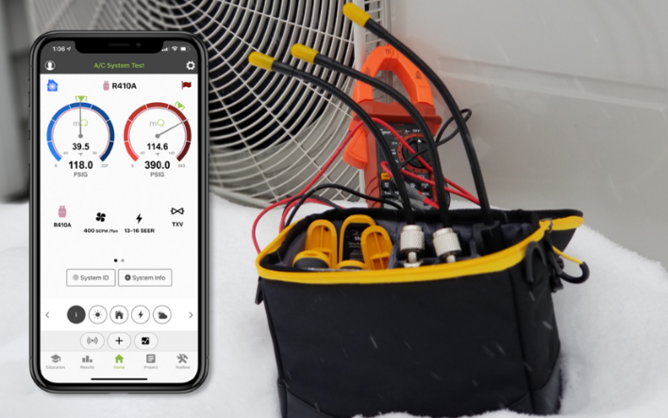
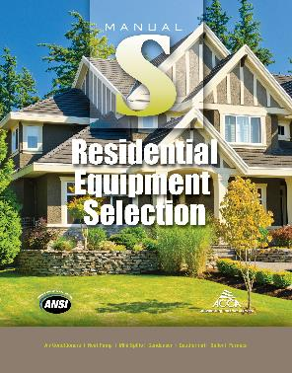





Other Considerations for Quality HVAC
Smart Diagnostic Tools
Sizing
Selection
Design
Installation
Commissioning
Maintenance
  DOE’s Building America Solutions Center
    Traditional Split Heat Pumps (https://basc.pnnl.gov/resource-guides/traditional-split-heat-pumps)
    Mini-Split (Ductless) Heat Pumps (https://basc.pnnl.gov/resource-guides/mini-split-ductless-heat-pumps)
    Central Air Conditioners (https://basc.pnnl.gov/resource-guides/compression-cooling)

