Slide 1
Introduction to Heat Pump Water Heaters

Slide 2
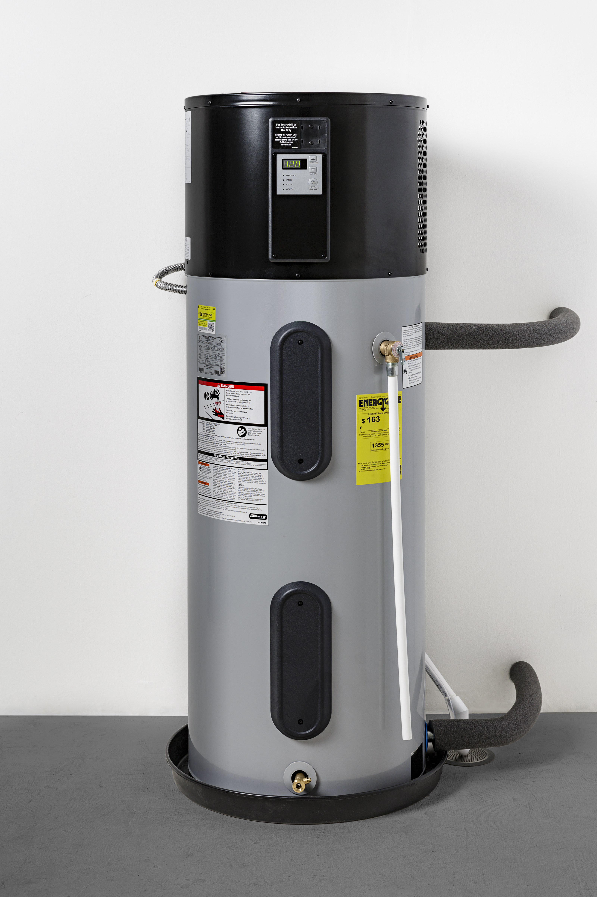
Section 1 - Remember
Know what a heat pump water heater (HPWH) is
Know the different modes of operation for a HPWH
Know the consumer benefits of a HPWH
Know how to make an economic case for HPWH

Slide 3




Know what a heat pump water heater (HPWH) is
Water heaters are appliances that create and provide hot water for households.
This includes providing water to other appliances (dishwasher, clothes washer, etc.) and sinks.
Notes:
What is a Water Heater?
Water heaters, as the name implies, are appliances dedicated to heating water used by people, either directly via water fixtures (e.g., sink) and other appliances that require hot water draws (e.g., dishwasher). Water heaters themselves vary in the fuel they use, whether they store hot water or create it on-demand, the size of the storage tank, and the efficiency of their energy usage.

Slide 4
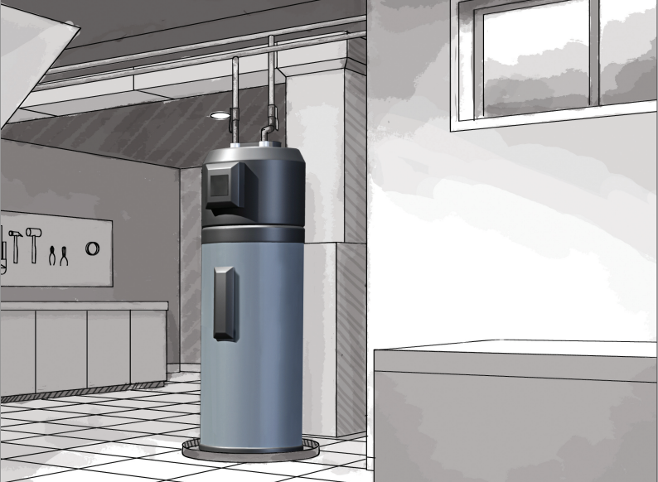
Know what a heat pump water heater (HPWH) is
Notes:
What is a Heat Pump?
Heat pumps use electricity to transfer heat from one space to another, which is a more energy efficient process than creating heat itself. Reversible heat pumps can provide both heating or cooling to a space by using a reversing valve, which determines the direction in which refrigerant flows from the compressor through either the evaporator or condenser coils. Because they transfer heat rather than generate heat, heat pumps can efficiently provide comfortable temperatures for your home. Heat pumps are typically used in heating, ventilation, air conditioning and refrigeration (HVAC&R) systems.
What is a Heat Pump Water Heater?
Using a similar concept, a Heat Pump Water Heater (HPWH), also referred to as hybrid electric water heater when designed to use 240 volts, uses heat pump technology to produce hot water. This is done by using electricity to move heat from one place to another. A HPWH creates hot water by capturing heat and humidity from the surrounding air, transferring it to a working fluid (e.g., refrigerant), and using a heat exchanger to transfer the heat from the refrigerant to water. Because HPWHs use electricity to move heat rather than creating it directly, they are generally regarded as one of the most energy efficient methods for water heating.

Slide 5




Know the different modes of operation for a HPWH
Heat Pump Mode
Electric Mode
Hybrid Mode
Vacation Mode
Notes:
HPWH Modes of Operation
HPWHs supplied by 240 V typically have four operating modes: heat pump (also referred to as “efficiency” mode), electric, hybrid, and vacation. The four modes allow occupants to adjust HPWH operation to suit their needs.
Heat Pump Operating Mode
Heat pump mode is the most efficient mode for a HPWH to heat water and provides the most energy and utility bill savings to the household. In this mode, only the heat pump operates to heat water. The drawback of using heat pump mode is that it takes longer to heat water (referred to as recovery) once the tank is depleted. For this reason, if a household plans to use heat pump mode predominantly, it’s important to identify a HPWH model with a larger tank size to prevent a hot water run out. ⁴
Depending on how the HPWH is sized to the home’s hot water load, heat pump mode may meet all of the household’s hot water needs. However, in certain circumstances, heat pump mode may be insufficient. For example, if the household has high hot water needs on a particular day (e.g., overnight guests visiting), heat pump mode may not produce enough hot water to fulfill the household. ⁴
Hybrid Operating Mode
When heat pump mode is insufficient to meet a household’s hot water needs, then hybrid mode should be selected. Hybrid mode is the default mode for HPWHs when shipped. Hybrid mode uses the HPWH’s control logic to shift between heat pump and electric resistance to heat water. When the household uses hot water to the point in which the heat pump cannot recover quick enough and there is the risk of a hot water run out, the HPWH uses the electric resistance back-up to heat water. This approach allows the HPWH to be efficient when demand is typical while also meeting the household’s hot water needs when demand is high. ⁴
Electric Operating Mode
When hybrid mode still may not meet a household’s hot water needs, electric mode can be used. In this mode, electricity is used to directly heat water using an electric resistance element (the lower heating element) like a conventional electric resistance water heater. This mode of operation is the least efficient. If a household needs to use electric mode often, it’s a sign that either the HPWH was poorly sized or not installed properly. ⁴
Vacation Operating Mode
The last mode of operation is vacation mode. This mode is applicable when no one is home for an extended period of time. During such time, there is little need for the production of hot water, so the water heater will keep the water in the tank at a moderate temperature range. Certain HPWH models may allow the user to set a duration for vacation mode, whether using the HPWH’s digital display or the manufacturer’s mobile app. ⁴

Slide 6



Know the consumer benefits of a HPWH
Consumer Benefits
  Lower operating cost
  Available rebates and incentives
  Safer operating mechanism
  Lower greenhouse gas emissions
  Longer lifetime of the unit
  Easier maintenance
  Demand response / grid interactive
Notes:
Operating Costs
The main benefit of installing a HPWH over a conventional electric resistance water heater is the operating cost savings. While the purchase price of a HPWH usually exceeds that of other water heaters for the same tank size, the savings in operating the water heater over the course of its lifetime makes up for its capital cost investment in approximately 3-5 years (for a 10–12-year HPWH expected lifetime). The lifetime energy savings become more significant the longer a household uses a HPWH to meet their hot water needs. Also, the household size affects the overall lifetime savings from utilizing a HPWH, where in a larger household with higher hot water needs will see more significant savings.
Rebates
To alleviate the initial purchase cost of a HPWH, utility providers and local government agencies (State, City, etc.) regularly offer incentives in the form of rebates or tax credits for residents to purchase the more efficient HPWH. Ultimately, it is the responsibility of consumers to find and apply for these rebates by contacting their local utility providers. The following tool can be used to facilitate the search for available offers:
Cooling Loads and Combustion Safety
Beyond monetary savings and incentives, HPWH also provide non-financial benefits. One benefit that a HPWH has over a conventional gas/oil water heater is in safety assurance. HPWHs are not subject to the combustion-based risks and failures that arise from utilizing natural gas/oil. Ventilation for gas and its associated risks are removed as well. Lastly, a HPWH uses the ambient humidity and heat to heat the water in the tank; as a byproduct, cold air is created. The cold air lowers the ambient temperature and could slightly offset the cooling burden on an HVAC system in warmer climates.
A list of previously discussed and additional benefits can be found below:
Lower Operating Cost
Available rebates and incentives
Safer operating mechanism
Lower greenhouse gas emissions
Longer lifetime of the unit
Easier Maintenance
Demand response / grid interactive

Slide 7
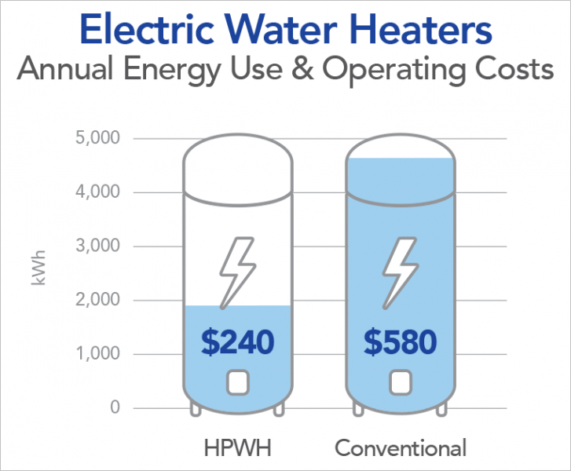
Know the consumer benefits of a HPWH
Consumer Benefits
  Lower Operating Cost
  Available rebates and incentives
  Safer operating mechanism
  Lower greenhouse gas emissions
  Longer lifetime of the unit
  Easier Maintenance
  Demand response / grid interactive
Statistics are from Butzbaugh, 2017.
Notes:
Operating Costs
The main benefit of installing a HPWH over a conventional electric resistance water heater is the operating cost savings. While the purchase price of a HPWH usually exceeds that of other water heaters for the same tank size, the savings in operating the water heater over the course of its lifetime makes up for its capital cost investment in approximately 3-5 years (for a 10–12-year HPWH expected lifetime). The lifetime energy savings become more significant the longer a household uses a HPWH to meet their hot water needs. Also, the household size affects the overall lifetime savings from utilizing a HPWH, where in a larger household with higher hot water needs will see more significant savings.
Rebates
To alleviate the initial purchase cost of a HPWH, utility providers and local government agencies (State, City, etc.) regularly offer incentives in the form of rebates or tax credits for residents to purchase the more efficient HPWH. Ultimately, it is the responsibility of consumers to find and apply for these rebates by contacting their local utility providers. The following tool can be used to facilitate the search for available offers:
Cooling Loads and Combustion Safety
Beyond monetary savings and incentives, HPWH also provide non-financial benefits. One benefit that a HPWH has over a conventional gas/oil water heater is in safety assurance. HPWHs are not subject to the combustion-based risks and failures that arise from utilizing natural gas/oil. Ventilation for gas and its associated risks are removed as well. Lastly, a HPWH uses the ambient humidity and heat to heat the water in the tank; as a byproduct, cold air is created. The cold air lowers the ambient temperature and could slightly offset the cooling burden on an HVAC system in warmer climates.
A list of previously discussed and additional benefits can be found below:
Lower Operating Cost
Available rebates and incentives
Safer operating mechanism
Lower greenhouse gas emissions
Longer lifetime of the unit
Easier Maintenance
Demand response / grid interactive

Slide 8
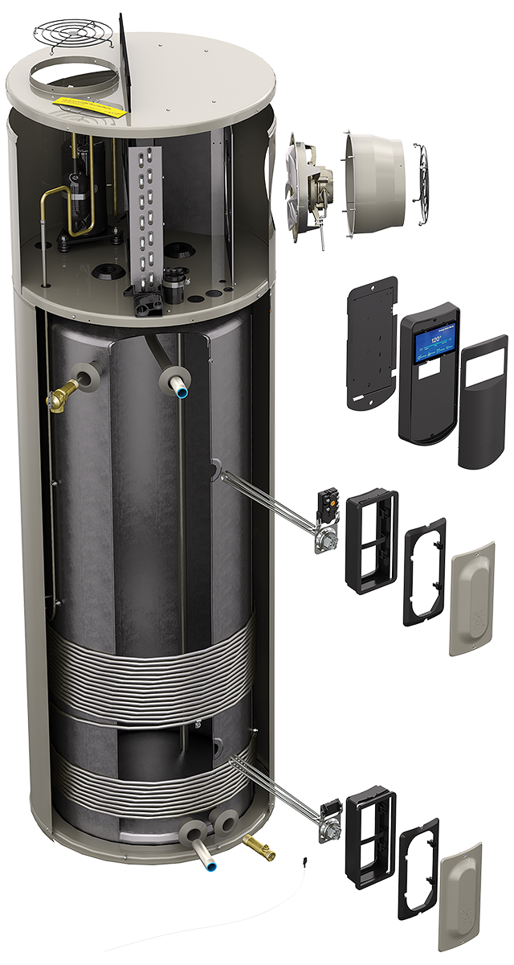
Section 2 - Understand
Understand how a HPWH works
Considerations when choosing a HPWH
Understand how water heaters measure efficiency
Know how to make an economic case for HPWH

Slide 9
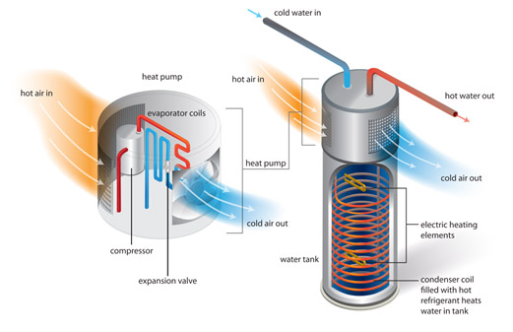
Understand how a HPWH works
Notes:
How does a HPWH heat water?
A HPWH uses the heat and humidity from the surrounding air to heat water inside its insulated tank. An example of the components and process that make up a HPWH can be seen in (Figure 1 of the lecture notes). The process begins when a fan pulls in air and transfers the heat in the air to an evaporator coil filled with refrigerant. The refrigerant changes state from a liquid to vapor and is then transported to a compressor to further increase the pressure and temperature of the refrigerant gas. The compressor pumps the refrigerant vapor through a heat exchanger coil that is lined around the insulated water tank. The heat from the refrigerant is transferred to the water. In the process, the refrigerant returns to a liquid state as it cools and runs through an expansion valve. The refrigerant returns to where it first began and the process repeats. The heated water in the tank is then distributed to the home’s water fixtures and appliances through a network of pipes. In addition, cooled dehumidified air is exhausted back into the surrounding space after it runs past the evaporator. As a backup measure, 240-volt HPWH models also contain electric resistance elements, such as those found in conventional water heaters, for times in which the HPWH is unable to produce enough hot water to meet demand. This can happen when the surrounding air isn’t warm enough to transfer heat, such as when the air temperature is below the compressor cutoff temperature of approximately 40 ºF (4.4 °C).

Slide 10

Considerations when choosing a HPWH
HPWH Size
  What is the size requirements for the household
    Number of occupants
    Hot water usage habits
    HPWH first hour rating
Initial Cost of HPWH
  The installation cost of an efficient HPWH is generally two to three times larger than that of a conventional water heater
  Initial cost is offset by lower operational cost
HPWH Locations
  Temperature
  Air space
  Nearby drain
Notes:
Determine Ideal Size for HPWH
Sizing a HPWH to a household’s hot water demand is important to maximizing energy efficiency benefits. Since HPWHs can take longer to recover compared to conventional electric resistance water heaters, storage tank size ensures adequate hot water delivery. For 240-volt HPWHs, increasing tank size can decrease operation of inefficient electric-resistance back-up, and thus maximize return on investment. Since typical 120-volt HPWHs have a smaller electric resistance element or no back-up heat source, choosing the appropriate tank size or identifying a model with an integrated mixing valve can help prevent hot water run outs. If the storage tank is too small, the HPWH runs the risk of being unable to provide the needed amount of hot water and frustrating occupants. If the homeowner is unsure on what size to choose, it is generally better to oversize than to undersize a HPWH. While an oversized HPWH will have increased stand-by losses, it would still be more energy efficient than an electric water heater.
When determining an appropriate size of a HPWH for a household, a couple factors should be considered. The first is the number of occupants, and their hot water usage habits. Careful consideration should be given to the “First Hour Rating” (FHR) value found on the yellow energy label. The higher the FHR, the higher the quantity of hot water the HPWH can deliver in a single hour. If the homeowner may sell the house in the next ten years, it’s better to use number of bedrooms to size the HPWH rather than number of occupants. More details on how to better determine the ideal size of a HPWH can be found in the HPWH - Decision Guidance module.
Initial Cost of HPWH
The installation cost of an efficient HPWH is generally two to three times larger than that of a conventional water heater. Because of that, it is important to take into consideration the yearly energy consumption (See the Level 3 module) to determine operational costs. With this information, a potential buyer can get a rough estimate as to how many years of reduced energy bill costs is needed to offset the initial purchase cost difference between a HPWH and a conventional water heater.
Limitations of HPWH Location
Since typical HPWHs require a supply of roughly 40 °F (4.4 °C) or warmer air to operate most efficiently, installation locations may be limited and should be addressed on a case-by-case basis. HPWHs should either be installed in a room with at least 700 cubic feet (19.8 cubic meters) of air space around the water heater or the ability to make modest alterations (e.g., louvered door, intake/exhaust ducting) to provide airflow when less than 700 cubic feet (28.3 cubic meters) of air is available. Depending on the model, some HPWHs can also work effectively in smaller spaces such as 450 cubic feet (12.7 cubic meters).
Other Considerations
Ideally, HPWHs are installed in locations that remain above 40°F (4.4°C) year-round. Below this temperature, the compressor may turn off. However, certain installation locations (e.g., garages) may fall below 40°F (4.4 °C). In this case, a HPWH with back-up electric resistance is preferable to prevent hot water run out when it’s cold. If a HPWH without back-up is the only viable option, then a model with an integrated mixing valve and/or a larger tank size may limit a hot water run out if the installation location falls below 40°F (4.4 °C) only occasionally (e.g., winter nights). If the location’s temperature falls below 40°F (4.4 °C) regularly during certain times of year, then a HPWH without back-up may have issues providing adequate hot water delivery. In this scenario, it may make sense to duct the HPWH both in and out of conditioned space so it can meet household demand or consider moving the HPWH.
Because of the addition of the heat pump on top of the tank, HPWHs tend to be taller than their conventional counterparts, so the space should be tall enough to accommodate for the additional height (approximately 12-18 inches (30.5 – 45.5 centimeters) taller). The height and space clearance around the HPWH should also be sufficient such that there can proper airflow for both the intake and output vents and access to the filter for cleaning/rinsing.
In addition to the items above, other factors should be considered. HPWHs create noise (approximately 50 dB) and vibration, so they should be installed in locations where noise and vibration are not an issue (e.g., not near bedrooms). Because HPWHs produce condensate (i.e., water) as a byproduct, the space should also accommodate for a condensate drain or pump, to drain or dispose of the condensate water. Lastly, 240-volt wiring or a 120-volt outlet should be located nearby to provide electrical power to the HPWH.

Slide 11
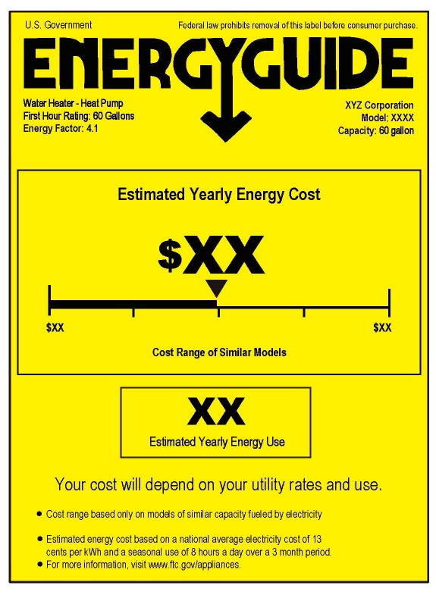
Understand how water heaters measure efficiency
Uniform Energy Factor
Estimated Yearly Energy Cost
Estimated Yearly Energy Use
Recovery Efficiency
Standby Losses
Cycling Losses
Based electricity cost estimate of $0.13 KWh
Estimate on how much energy is used in a year
Notes:
How is Energy Efficiency Measured
The energy efficiency of appliances, such as water heaters, are displayed on a yellow Energy Guide label (Figure 2 of the lecture notes) attached to the appliance. This allows interested parties to easily compare energy efficiency across multiple models of a specific appliance. The Energy Guide label on a water heater contains the Uniform Energy Factor (UEF), which is an energy efficiency rating based on the U.S. Department of Energy’s test method (detailed in 10 CFR Part 430, Subpart B, Appendix E). This value takes into consideration a water heater’s recovery efficiency, standby loss, and cycling losses. Recovery efficiency is how efficiently the heat generated by the HPWH is transferred to the water. Standby losses are the percentage of heat loss per hour from the stored water. Lastly, cycling losses are the losses of heat as water circulates through a tank or pipe. Further information on the unit found on the Energy Guide label include product type (Water Heater – Heat Pump), First Hour Rating, manufacturer, model, storage capacity/volume, estimated yearly energy use, and estimated yearly operation cost.

Slide 12
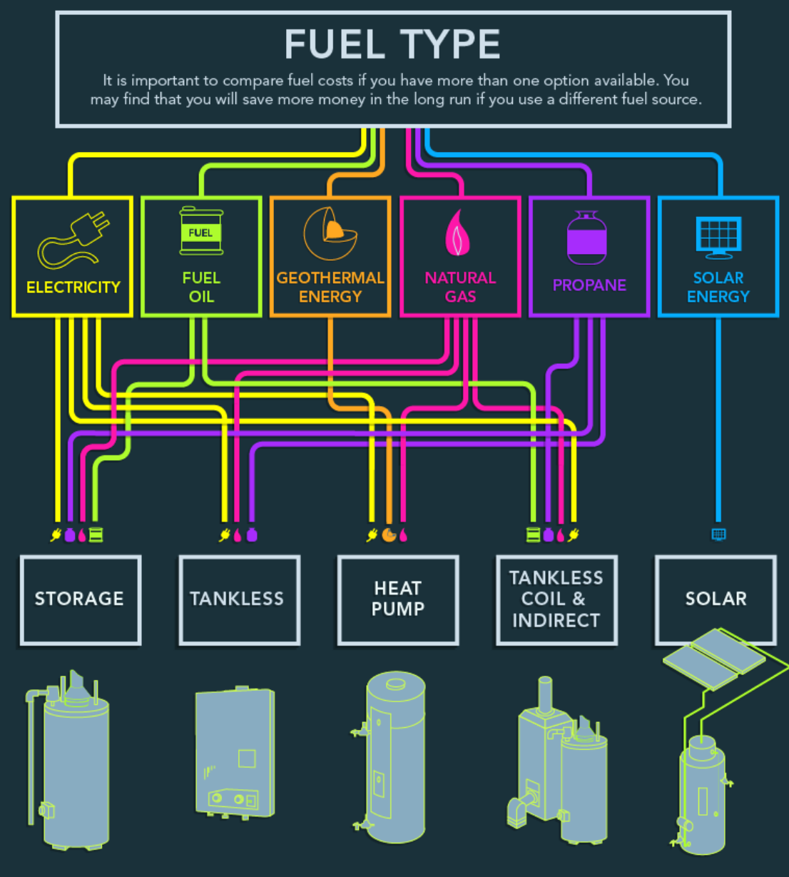
Fuel Sources
Electricity
Geothermal
Natural Gas
Notes:
Fuel Sources of Water Heaters
There are multiple fuel types or energy sources for heating water, including electricity, natural gas, propane, fuel oil, solar thermal, solar photovoltaic, and geothermal. HPWHs rely on electricity to heat water. As the U.S. transitions to low- or zero-carbon sources of electricity generation, HPWHs can provide permanent load reduction relative to conventional electric resistance water heaters, and thus reduce the extent of low- or zero-carbon electricity generation required to power the U.S. building stock.

Slide 13
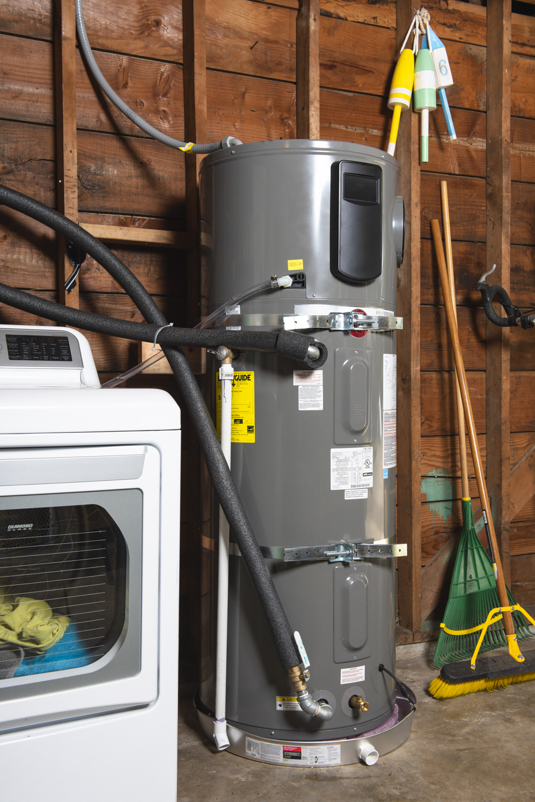
Section 3 –
Apply
Calculate HPWH operating costs and savings

Slide 14


Calculate HPWH operating costs and savings
Gas / Oil
UEF : 0.58
Fuel Cost : $1.82/therm
Electric
Initial Price : $500
Heat Pump
Initial Price : $1,500
Estimated Fuel Usage : 0.41 therm/day
1 Year Cost : $970
10 Year Cost : $5196
Initial Price : $500
UEF : 1.0
Estimated Fuel Usage : 12.03 kWh/day
Fuel Cost : $0.168/kWh
10 Year Cost : $7877
UEF : 4.0
Estimated Fuel Usage : 12.03 kWh/day
Fuel Cost : $0.168/kWh
1 Year Cost : $1684
10 Year Cost : $3344
1 Year Cost : $1238
Notes:
How to Calculate Yearly Operational Costs
In order to determine the economic benefits of installing a HPWH, the average annual operating cost should be considered. When comparing the average annual cost of operating a water heater, prospective buyers should consider two things: the energy factor of the water heater and the fuel source cost powering the water heater. The higher the energy factor displayed on the yellow label is, the more efficient the water heater is. Additionally, customers should consider size and first hour rating. To estimate the yearly cost of operating a unit, the Uniform Energy factor (displayed on the yellow energy label) is multiplied by the fuel type and current price rates (this information can be provided by local utility providers). Then the total cost should be extrapolated for the entirety of a year (365 days) to understand the annual cost. A simplified form of how to determine the yearly operating cost is found in Equation 1.
Equation 1 : $\frac{(Days in a Year)×(Energy Consumption in a day)}{(Uniform Energy Factor)}×(Cost of Energy)$
Calculation Examples
Below are three examples. These examples include gas or oil water heaters, conventional electric water heater, and heat pump water heater. The energy usage per day in the below equations is based on the DOE test procedure for water heaters, which assumes an incoming water temperature of 58 °F, hot water temperature of 135 °F, and total hot water production of 64.3 gallons per day, which is the average usage for a household size of three people. This corresponds to and average energy us of ~41,000BTU/day (0.4 therms/day, or 12.03 kWh)
Other items to consider as well include rebates from utility suppliers and tax-based incentives from local, state, and federal government sources. Additional research based on individual local is needed for the consumer to identify potential rebates from incentives program.
FOR CONVENTIONAL GAS AND OIL WATER HEATERS
You need to know the unit cost of fuel
$$\frac{\left[365\frac{days}{year}×0.41\frac{therm}{day}\right]}{UEF}×\left[Fuel Cost \left(\frac{\$}{therm}\right)\right]= annual cost of operation$$
Example: A natural gas water heater with an UEF of 0.58 and a fuel cost of $1.82/therm ²
$$\frac{\left[365\frac{days}{year}× 0.41\frac{therm}{day} \right]}{0.58} × \left(1.82\frac{\$}{therm}\right)$$
(The cost of natural gas on the Energy Label) = $470 per year
FOR CONVENTIONAL ELECTRIC WATER HEATERS
You need to know or convert the unit cost of electricity by kilowatt-hour (kWh)*.
$$\frac{\left[365\frac{days}{year}×12.03\frac{kWh}{day}\right]}{UEF}×\left[Fuel Cost \left(\frac{\$}{kWh}\right)\right] = annual cost of operation$$
Example: A conventional electric water heater with an UEF of 1.0 and an electricity cost of $0.17/kWh ²
$$\frac{\left[365\frac{days}{year}× 12.03\frac{kWh}{day}\right]}{1.0}×\left[0.17\frac{\$}{kWh}\right]$$
(This is the latest cost of electricity used on the Energy Label) = $738 per year
FOR HEAT PUMP WATER HEATERS
You need to know or convert the unit cost of electricity by kilowatt-hour (kWh).
$$\frac{\left[365\frac{days}{year}×12.03\frac{kWh}{day} \right]}{UEF}×\left[Fuel Cost \left(\frac{\$}{kWh}\right)\right] = annual cost of operation$$
Example: A heat pump water heater with an UEF of 4.0 and an electricity cost of
$0.17/kWh ²
$$\frac{\left[365\frac{days}{year}× 12.03\frac{kWh}{day}\right]}{4.0}×\left[0.17\frac{\$}{kWh}\right]$$
(This is the latest cost of electricity used on the Energy Label) = $184 per year
Assuming an initial purchase cost distribution of $500 for the conventional gas and oil water heater, $500 for the conventional electric water heater, and $1,500 for the HPWH, we can extend the total cost of each option over the course of 10 years of operation. kWh = 3412.14 BTU - 12.03 kWh is an estimate energy usage per household
therm = 100,000 BTU – 0.4105 therm is an estimated fuel usage per household
² Electricity cost and Fuel cost are the US National average costs for January 2023. Average energy prices for the United States, regions, census divisions, and selected metropolitan areas : Midwest Information Office : U.S. Bureau of Labor Statistics (bls.gov)

Slide 15
References
Heat Pump Water Heaters | Department of Energy
Estimating Costs and Efficiency of Storage, Demand, and Heat Pump Water Heaters | Department of Energy
New Infographic and Projects to Keep Your Energy Bills Out of Hot Water | Department of Energy
Sizing a New Water Heater | Department of Energy
Selecting a New Water Heater | Department of Energy
ENERGY STAR Ask the Experts | Products | ENERGY STAR
Special Offers and Rebates from ENERGY STAR Partners | EPA ENERGY STAR
Considerations – Heat Pump Water Heaters (HPWHs) | ENERGY STAR
HotWaterSolutionsNW.org | Heat Pump Water Heaters Cut Electric Bills |
PG&E Energy Education Classes (docebosaas.com)
Craft Details (nccer.org)
Replacing your Water Heater | Smarter House
Northwest Energy Efficiency Alliance (NEEA) | Northwest Heat Pump…

Slide 16
For additional information on available Heat Pump Water Heater products and brands, use the following website:
ENERGY STAR Certified Water Heaters | EPA ENERGY STAR

