Slide 1
The Business Case for Heat Pump Water Heaters (HPWHs)

Slide 2
Section 1 – Understand
Explain HPWH current trends, market potential, and customer segments
Identify installation scenarios and best practices
HotWaterSolutionsNW.org

Slide 3
Growing Market Potential
Global Market Insights
Image Reference Source | Formatted Hyperlink
Notes:
The introduction of heat pumps into the water heater market is disrupting many of the existing installer business models that are based on a bid over the phone process that emphasizes like-for-like replacement. The decision to replace existing water heaters used to be a straightforward decision – simply replace the older tank with a newer model. Most upgrades consisted of going from a storage tank to a tankless system.

Slide 4
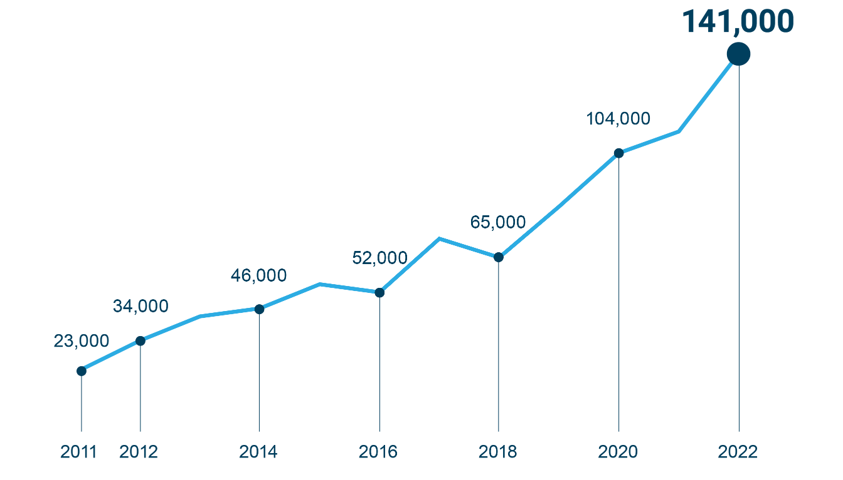
Growing Market Potential
175,000
HPWH growth over the past 11 years: The Y axis is the number of HPWs sold in a year
Units sold
per
year
100,000
0
New Buildings Institute
Image Reference Source | Formatted Hyperlink
Notes:
However, today’s market is more complex to navigate. The market now includes energy efficient heat pump water heaters, incentives, tax credits and customers motivated by the desire to limit their carbon footprint.

Slide 5
How HPWHs Operate
https://www.youtube.com/watch?v=f7KeX8bse-0
HotWaterSolutionsNW.org
Notes:
https://www.youtube.com/watch?v=f7KeX8bse-0 The average household may already have multiple types of heat pumps. Refrigerators, freezers, central and window mount air conditioners all use the same basic technology as heat pumps. Simply put, heat pumps move heat energy from one place to another. In the case of air conditioners, the heat energy is moved from where it's not wanted (inside the house) to outside the house. In the case of refrigerators, heat energy is moved from the inside of the refrigerator to outside the refrigerator. Heat pump water heaters remove heat from the surrounding areas and move it to the water inside the tank.

Slide 6
Customer Segments
Environmentally motivated
Existing heat pump users
Home remodels and/or re-piping
Long-term savings
Tax credits and utility incentives
Tech savvy and seeking smart devices
BPI.org
Image Reference Source | Formatted Hyperlink
Notes:
Now let’s consider the different customer segments that are more likely to invest in higher-cost equipment. This changing marketplace presents a business opportunity for installers to increase their market share while maintaining the level of profit margin. Like any product, HPWHs are not the best product for every installation. This training will help those contractors wishing to diversify their water heater options identify when HPWHs are a good fit for homeowners AND the contractor’s bottom line.
The Northwest Energy Efficiency Alliance (NEEA), a utility-sponsored nonprofit organization, has been interviewing purchasers of HPWHs for the last 5 years to better understand consumer decision making behind their purchase of a heat pump water heater. At a high level, the top six reasons are:
Customers motivated by environmentally minded reasons
Customers already having a heat pump for space conditioning in their home
Customers undergoing remodels and re-piping
Customers interested in long term savings
Customers interested in the availability of tax credits and utility incentives
Customers that seek out smart devices and are tech savvy

Slide 7
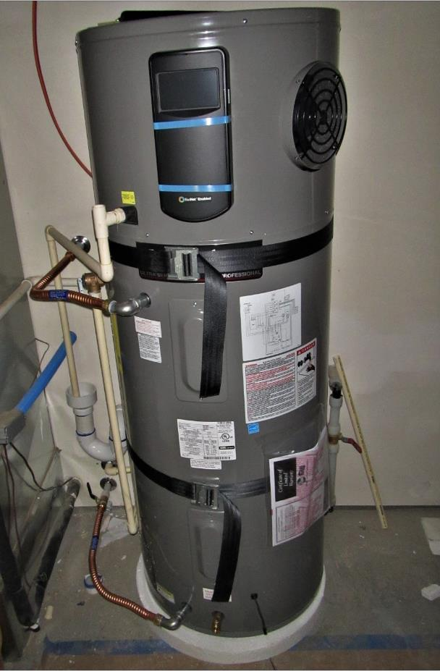
Key Differences: HPWHs vs Standard Storage Tanks
Electrical requirements
Condensate management
Low-level noise
Cool air exhaust
Potential space or ducting requirements
Image Reference Source | Formatted Hyperlink
HotWaterSolutionsNW.org
Notes:
While installing HPWHs in sites that meet the volumetric requirements is very similar to installing other types of storage water heaters, there are some key differences that you’ll need to consider. The primary considerations include electrical requirements and condensate management. The next slides will go into detail on these topics. In addition, there are some more subtle differences to take into account in order to achieve high levels of customer satisfaction. Heat pump water heaters generate a low-level noise while operating, and they also exhaust cooler than room temperature air that can lead to comfort complaints if not dealt with properly.

Slide 8
Installation Challenges
Electrical
240 volts and 30 amps are required
Plumbing Connections
Location of inlet and outlet may differ from old water heater
Condensate Drain
Floor or sink drain should be located nearby
Condensate pump can be used
HotWaterSolutionsNW.org

Slide 9
Installation Challenges
Temperature
Space should be able to maintain a temperature range of 40º–120ºF (4.4º–49.9ºC).
Clearance
HPWH should be installed in a space with 700-cubic feet (28.3-cubic meters) of air space around the water heater
Space Considerations
Noise
Sound generated tends to run between 40 dBA to 80 dBA, where the majority of HPWHs are below 55 dBA
HotWaterSolutionsNW.org

Slide 10
Installation Scenarios
All Installs
Electric to HPWH
Sufficient Volume
Requires Ducting or Venting
Gas to HPWH
Electric Upgrade or 120V
Sufficient Volume
Requires Venting or Ducting
Image Reference Source | Formatted Hyperlink
Notes:
There are two primary install scenarios for heat pump water heaters. These are when replacing standard electric storage tank water heaters and existing gas water heaters with HPWHs. The electric-to-electric scenario tends to be a more standard install since it does not involve providing new electrical connections. Converting from a gas water heater to a HPWH can be more difficult as it may involve electrical upgrades and gas flue reconfiguration.
Of course, there are other factors that will influence the installation of any water heater – such as sizing and locations – while some may be particular to heat pump water heaters. These HPWH-specific factors include the previously mentioned electrical requirements and condensate disposal, as well as considering that when the manufacturer’s minimum volumetric requirements are not met, ducting and or venting of the space containing the water heater may be needed. The volumetric requirement is the minimum cubic feet of surrounding space in which the tank can efficiently operate. You will find that each model clearly details this information in the installation manual for that model. These requirements range from 450 cubic feet to 700 cubic feet. It is recommended that installers new to the installation of heat pump water heaters focus on installs that meet the volumetric requirement before tackling more complicated installations that require ducting and or venting. Garage and open basement installations typically meet these requirements.

Slide 11
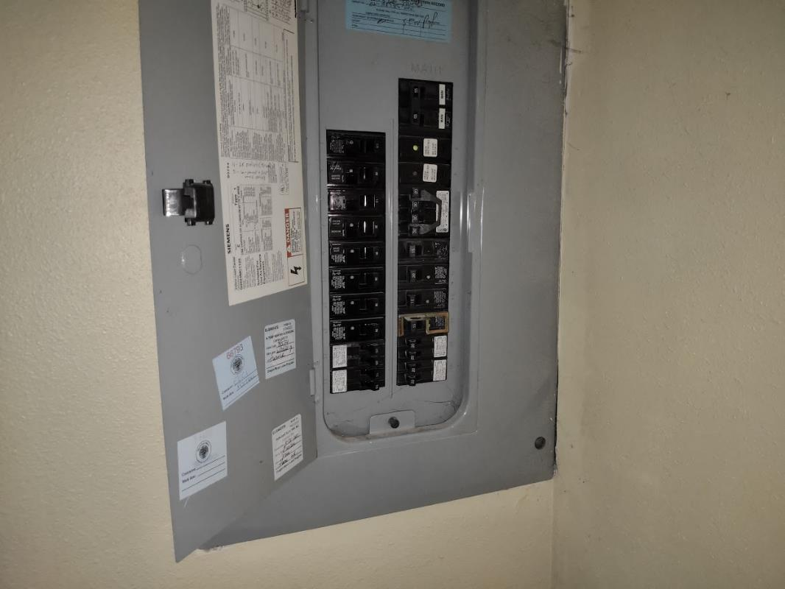
Electrical Considerations
Amperage
240-volt HPWHs require 25 or 30 amps
120-volt HPWHs typically require 15-amps
Smart solutions
Older homes
Image Reference Source | Formatted Hyperlink
Notes:
Currently, most new homes have an electrical service of 200A. However, many older homes may have electrical service of less than 100A. Since the power needed for a 240-volt HPWH must be adequate for both the heat pump system and the backup electrical resistance element, either 25 or 30 amps are required for the units. If a standard electric water heater is replaced with a HPWH, this will not be an issue. 120-volt models typically require a 15-ampamp breaker.

Slide 12
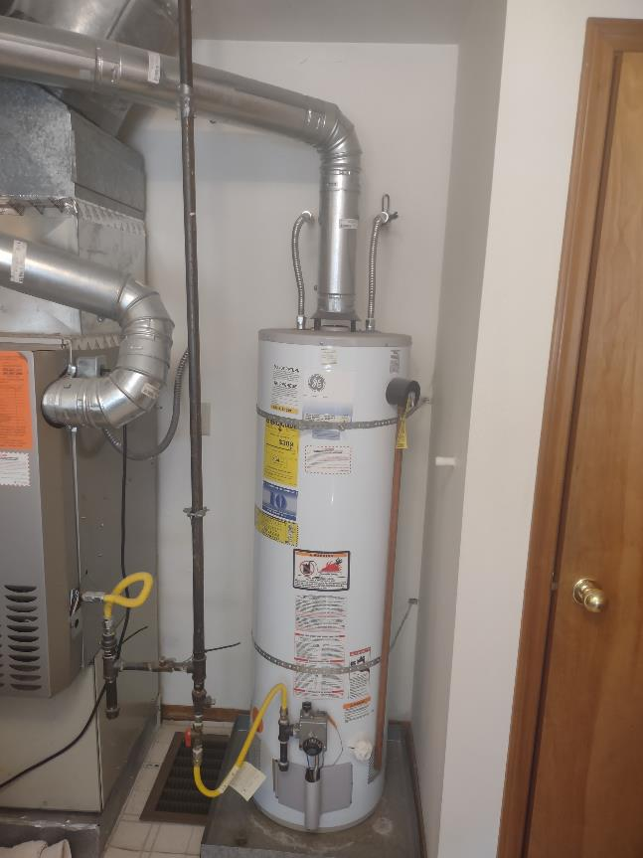
Gas to Electric Conversions
Conversion Challenges
Electrical upgrades often delay immediate hot water availability.
Temporary Solutions
Loaner gas water heaters or 120-volt HPWHs can provide interim hot water solutions.
Permanent Solutions
Installing 120-volt HPWHs can avoid extensive electrical upgrades and streamline the conversion process.
Image Reference Source | Formatted Hyperlink
Notes:
Converting from gas water heaters to HPWHs often requires some wait time for an electrician to schedule and complete an electrical upgrade. This obviously will not solve the immediate problem of the customer wanting hot water today. Companies that specialize in HPWH sales have formulated workarounds to solve this problem. They include a loaner gas water heater that is removed when the HPWH is installed, or a 120-volt HPWH that can be plugged into an appropriate outlet. One permanent solution is, if circumstances allow, to permanently install a 120volt HPWH.
Talk to your electrician about using smart breakers and/or smart splitters. These devices allow appliances to use and share the same circuit and may present a less expensive upgrade.

Slide 13
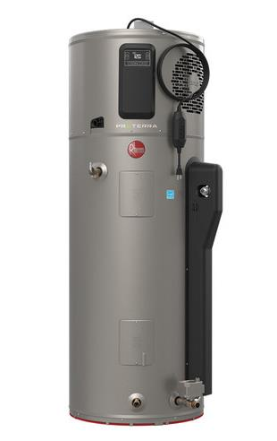
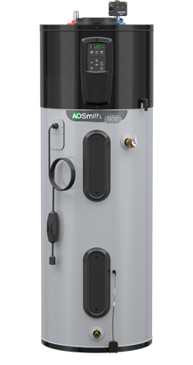
Ideal for Gas Replacements
These models can replace gas water heaters without major electrical upgrades.
Plug Requirements
Must use a grounded, standard three-prong plug, and adhere to specific installation guidelines.
Installation Guidelines
No extension cords allowed; ensure proper grounding and circuit requirements.
120-volt Models
Image Reference Source | Formatted Hyperlink
Notes:
120-volt models can be ideal when replacing gas water heaters since they may not require electrical upgrades. These units, sometimes called plug-in HPWHs, are equipped with a standard three prong plug. The water heaters must not use extension cords and the outlet utilized must be grounded. Depending on the model, it may require a dedicated circuit, while other models can be used on a shared circuit.

Slide 14
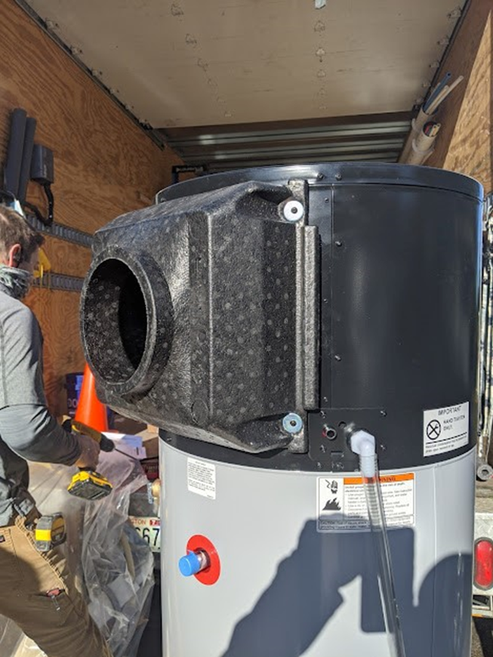
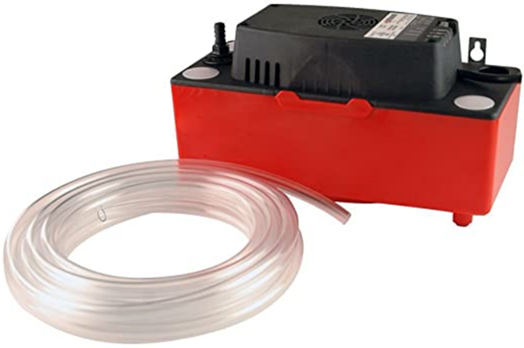
Condensate Management
Drainage options
Non-acidic condensate
Gravity is your friend
Condensate drain on A.O. Smith model
HotWaterSolutionsNW.org
Image Reference Source | Formatted Hyperlink
Notes:
The creation of condensate is a standard part of HPWH operation and should be addressed accordingly when installing a HPWH. To address condensation, a floor or sink drain can be used. Unlike the condensate produced by condensing furnaces and water heaters, the condensate is not acidic, so neutralizers are not required. If close to a condensate pump that serves an existing central AC unit, in most cases that condensate pump can manage the extra load produced by the HPWH. In many cases the condensate can be run to the outside. It is important to keep the condensate as sloped and as straight as possible.
Remember: Gravity is your friend.

Slide 15
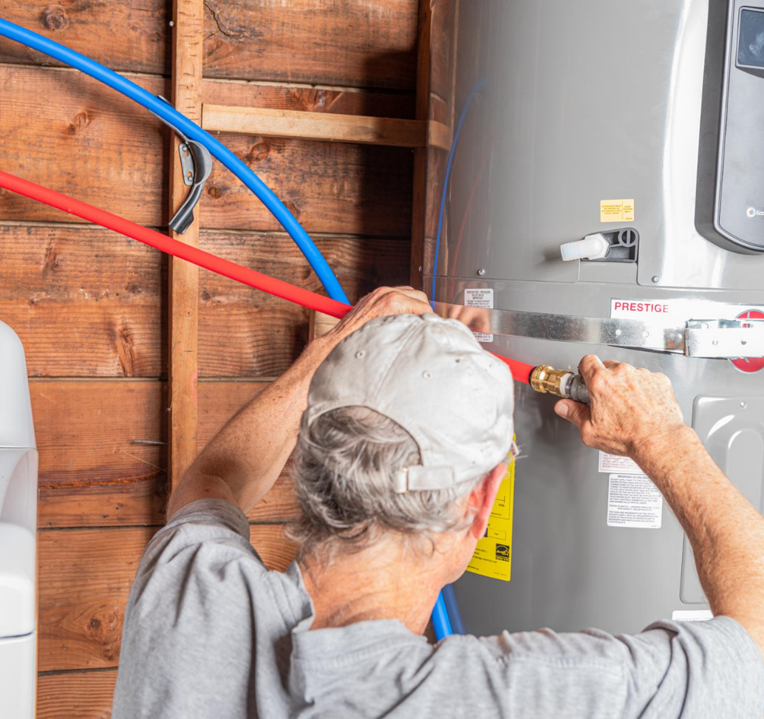
Section 2 – Apply
Apply specification and installation best practices
Incorporate into business models
Achieve customer satisfaction
HotWaterSolutionsNW.org

Slide 16
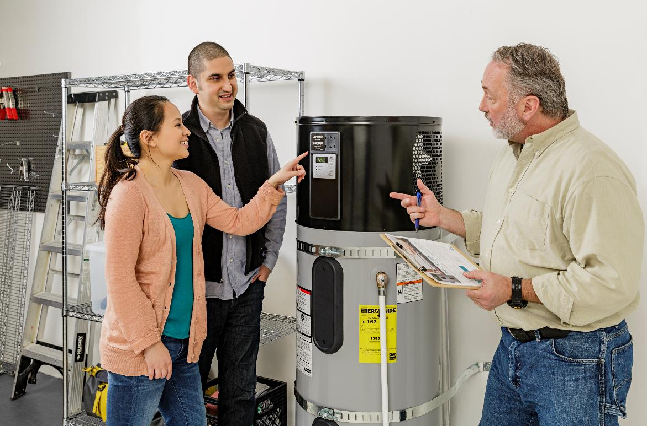
Specification and Installation Best Practices
Customer Satisfaction
Tank Sizing
Tank Location
Noise Management
Recirculation Pumps
Model Selection
HotWaterSolutionsNW.org
Notes:
As with any water heater installation, customer satisfaction is necessary. All installers know that call backs are unwelcome interruptions and expensive. Achieving high levels of customer satisfaction with HPWHs is dependent on a few key details that contractors must consider:
Tank sizing that maximizes availability of hot water and efficiency,
Tank location to avoid comfort complaints due to the cool air discharge from the tank,
Use of isolation pads and neoprene washers when securing the tank to reduce noise levels,
If the household has a recirculation pump, installing on demand controls, and
Physical dimensions, exhaust air discharge locations, and piping connections.

Slide 17
_
Space Constraints
Will tank fit into space
Electrical
Amperage of breaker
Ducting (If Required)
Right exhaust
Back exhaust
Wire size
Include duct adaptors if required
Sizing
Include side plumbing
Household size
High usage spa tubs
Possible use of whole house tempering valve
Water Connections
Top-plumbed
Side-plumbed
Tank Selection Criteria

Slide 18
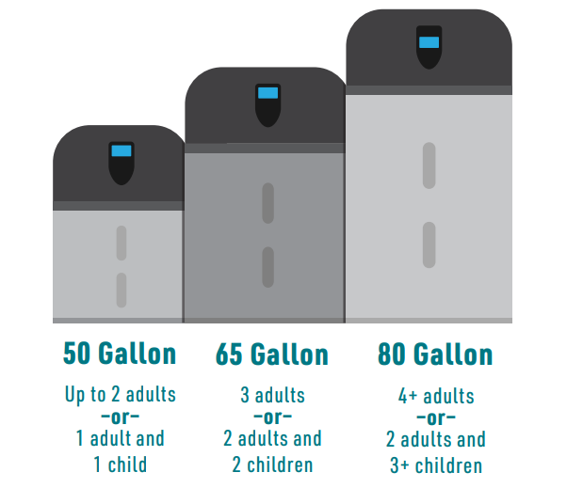
Tank Sizing
Size Recommendations
50-gallon tank for up to 2 adults or 1 adult and 1 child
65-gallon tank for 3 adults or 2 adults and 2 children
80-gallon tank for 4 or more adults or 2 adults and 3 or more children
Efficiency Improvement
Upsizing the tank can increase capacity and efficiency.
Thermostatic Mixing Valve
Allows storing water at higher temperatures, effectively increasing capacity by 10 gallons for every 10°F rise.
HotWaterSolutionsNW.org
Notes:
Let’s now discuss applying tank sizing for sufficient availability of hot water and maximizing efficiency. Choosing the right tank for a specific installation includes considerations for the hot water needs of the household and the physical constraints of the tank location. If the location allows for a larger tank, it’s best practice to size up one tank size. The plumbing code dictates the minimum size of a tank is based on the number of bedrooms and bathrooms. The code is based on providing sufficient hot water, and not maximizing the efficiency of heat pump water heaters. Sizing recommendations for HPWHs include:
50-gallon tank for up to 2 adults, or 1 adult and 1 child
65-gallon tank for 3 adults, or 2 adults and 2 children
80-gallon tank for 4 or more adults, or 2 adults and 3 or more children
Upsizing the HPWH provides more capacity, it also increases the overall efficiency of the HPWH. More importantly, sizing the tank correctly avoids the inconvenience of your customers running out of hot water.
If the install location cannot accommodate the best size tank, consider using a thermostatic mixing valve. These devices allow the tank to store water at a higher temperature while keeping the delivered hot water safe. For every 10 degree rise in temperature, the tank will increase its effective storage capacity by 10 gallons. The overall efficiency of the tank will only drop slightly.

Slide 19
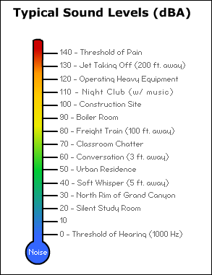
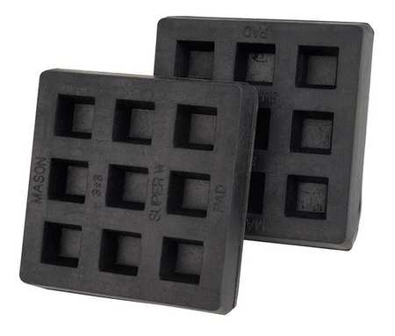
Tank Location: Minimizing Noise
Noise Management
HPWHs generate a low, soft humming sound similar to a dishwasher or refrigerator.
Noise Reduction Tips
Use iso pads between the tank and wall, and neoprene washers on securing bolts.
Ideal Locations
Basements or garages, away from living spaces and thermostats.
Average HPWH
Isolation (ISO) Pads
Notes:
It’s also important to identify the location of the tank and apply methods to minimize noise transmission. Noise created from a HPWH is a new sound to homeowners and can be bothersome, so this will need to be accounted for when choosing a location to install the water heater. The noise generated is a low, soft humming sound, similar to the noise generated by a dishwasher or a refrigerator. The majority of HPWHs generate sound less than 52 dBA. When looking up model specifications, remember the decibel scale is logarithmic and an increase of 10 decibels represents a doubling of sound. The sound is caused by the moving fan and compressor components of the heat pump on the appliance. This source of sound is expected, and not an indicator of an issue or error – whereas any additional, distinctive sounds not caused by the heat pump system can be an indicator of an issue. Because of the sound generated from the heat pump and the cold, dry air exhausted from the fans, it is generally recommended that the unit is installed in a remote part of the house that is adequately conditioned with sufficient space. Avoid locations near a thermostat, as the exhaust may impact HVAC operation. Usually, these requirements make HPWHs best suited for basement or garage installations.
When using earthquake strapping that requires cinching the tank to a wall, iso pads between the tank and wall helps to minimize sound transfer through the wall. Using neoprene washers on the bolts that secure the strapping to the wall will also help.

Slide 20
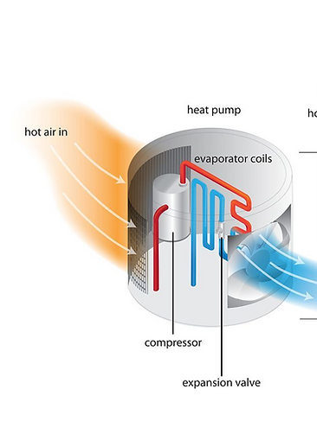
Tank Location: Managing Cool Air Exhaust
Exhaust Management
Ensure the exhaust air is at least 12 inches away from walls or other solid objects.
Comfort Complaints
Avoid directing cool air to areas where occupants spend a lot of time, especially during heating season.
Notes:
HPWHs discharge cool air. It is important not to block this exhaust air by keeping the exhaust air at least 12 inches away from walls or other solid objects in order not to restrict the airflow. Having this cool air directed to places where the occupants will be spending large amounts of time should be avoided as it may cause comfort complaints during the heating season.

Slide 21
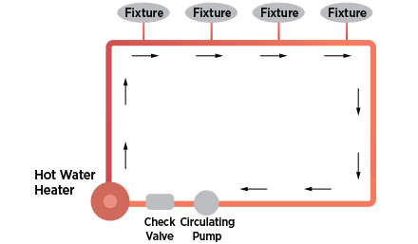
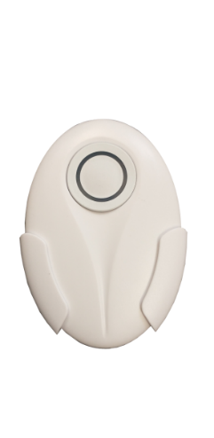
Recirculation Pumps
Uncontrolled recirculation pumps waste substantial energy and can disrupt HPWH predictive controls.
Use on-demand controllers to run recirculation pumps efficiently.
Actuators for on-demand recirculation system (left: Hard Wired; right: Bluetooth)
EPA WaterSense Guide for Efficient Hot Water Delivery Systems
Notes:
Uncontrolled recirculation pumps should not be used with any HPWH. Uncontrolled recirculation pumps waste substantial amounts of energy regardless of the water heating system used. In addition to the energy wasted, the hot water returning to the tank will undermine the predictive controls of the tank and may cause the tank to fail to heat enough hot water for delivery. It is not recommended to run continuous recirculation, but to run with an on-demand controller.

Slide 22
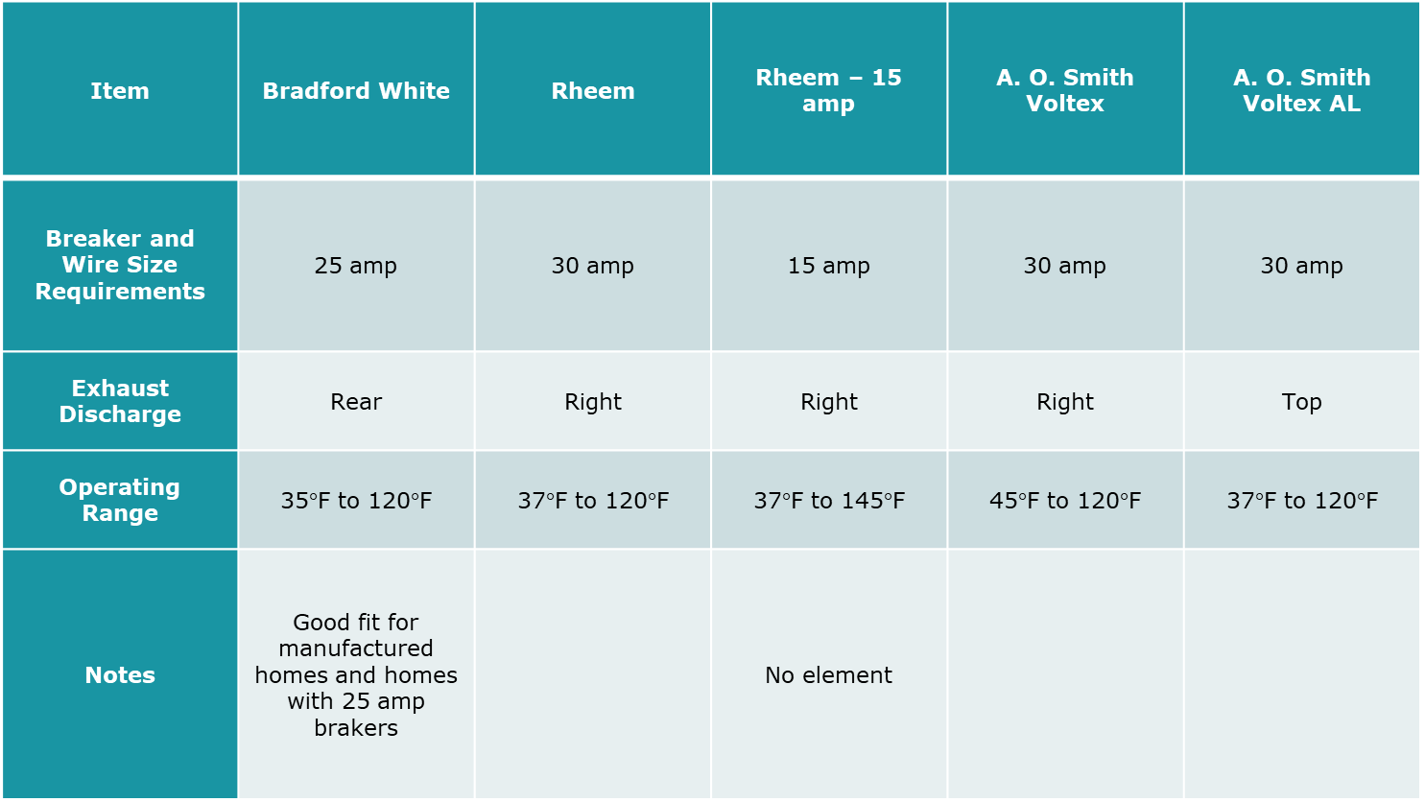
Selecting the Right Model for the Job
Tank 1 Tank 2 Tank 3 Tank 4 Tank 5
Physical Dimensions
Exhaust Air Discharge
Piping Connections
120-Volt Models
Notes:
As with any product there is no universal best HPWH model for every installation scenario. We have covered selecting the best size of HPWH, and other differences between HPWH models include:
The physical dimensions of the tank – will it fit in the existing space and will fit through the entrance to the space?
Some models discharge the exhaust air from the tank out of the top and others are side discharged while others are rear discharge. Depending on the site, where the discharge air is located may make the installation more or less difficult.
As with the location of the discharge air, models differ where the piping connections are made. Some models are side plumbed, some are top plumbed while other models can be side or top plumbed.
120-volt models have their own features that may influence the model chosen for a particular job. These include the capacity of the compressor, the existence of a small electric resistance heater and if the unit does or does not require a dedicated circuit.

Slide 23
Sales Approaches
Ensure your entire team can speak to HPWH benefits (when applicable):
Overall Cost Efficiency
Low Operational Costs
Simplified Installation Process
Incentives and Financial Assistance
Quick Turnaround Time
Create a connection with the customer
Listen to their needs
Develop a plan to address their needs
Make the sale
Establish a lasting relationship with follow up
Notes:
The upfront cost of HPWHs will be more than a standard tank. These higher upfront costs can be offset by incentives, tax credits and lower operating costs. It is important that the bid includes these details. Most importantly, it is important that your entire team -- from the receptionist to the service technician -- can speak to the benefits of heat pump water heaters.
In recognizing the diverse needs of potential customers, including those in the low to moderate income bracket, it's essential to adapt our pitch to emphasize affordability, ease of installation, and the long-term savings offered by HPWHs. To effectively communicate these benefits, consider incorporating the following points into your sales approach (when applicable):
Highlight Overall Cost Efficiency: Emphasize that despite the higher upfront cost, HPWHs are highly efficient and can reduce monthly energy bills when installed in specific scenarios. This can make them a financially viable option in the long run due to their efficiency.
Low Operational Costs: Stress the low operating costs of HPWHs, a critical factor for customers prioritizing affordability in their heating solutions. When switching from a standard electric tank to a HPWH, the savings will be significant. When switching from oil or propane, the savings will also be significant. When switching from natural gas to a HPWH, the change in operating costs will depend on the relative costs of gas and electricity.
Simplified Installation Process: Assure customers that in many cases, especially when replacing existing electric water heaters, the installation process for HPWHs can be straightforward and quick, similar to traditional units. Highlight that while some scenarios, particularly those involving upgrades from non-electric systems, might require additional steps, many installations do not involve extensive modifications, thus minimizing household disruption.
Incentives and Financial Assistance: Inform about government rebates, tax credits, and utility incentives that can offset the initial investment, making the technology accessible, especially for low to moderate income customers.
Quick Turnaround Time: Commit to fast installation times, which ensure that the transition to a new HPWH is as seamless and hassle-free as possible, catering to those who cannot afford long waiting periods.

Slide 24
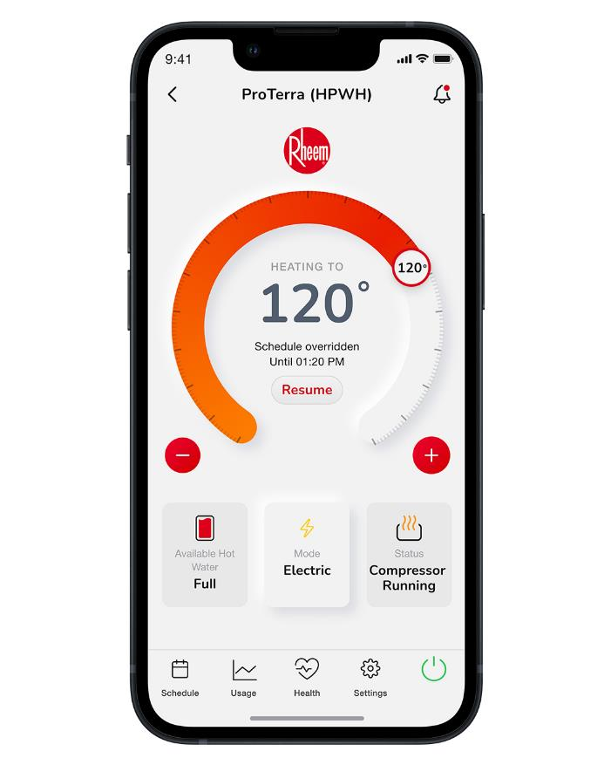
Smart Technology
Highlight remote control and energy monitoring via apps as attractive features.
Appeal to environmentally conscious and tech-savvy consumers with smart technology integration.
Your HPWH
Notes:
Giving consumers options is critical to growing your business. Today's consumers expect options – from the coffee they order to the trim package on their truck or car they buy. In addition, many of today's consumers expect higher tech solutions and are tech savvy themselves. The ability to remotely control their water heater and see their day-to-day energy consumption via the HPWH app is a big plus to many of today’s consumers. Additionally, consumers can easily use an app to schedule the operating hours of the HPWH during hours of lower electric rates.

Slide 25
Smart Technology
According to Service Titan, the #1 way to grow your plumbing business is to embrace smart technology:
“Consumers utilize technology to control everything on their smartphones — from regulating their home’s indoor air temperature to creating a grocery list.
Today’s homebuyers, many of whom grew up with smartphones, are not only extremely tech savvy, but also environmentally conscious.
Consumers actively seek service providers who use high-tech solutions, such as water leak detection to prevent unexpected water damage.”
Notes:
According to Service Titan, the number one way to grow your plumbing business is to “Embrace Smart Technology”:
Consumers utilize technology to control everything on their smartphones — from regulating their home’s indoor air temperature to creating a grocery list.
Today’s homebuyers, many of whom grew up with smartphones, are not only extremely tech savvy, but also environmentally conscious.
Consumers actively seek service providers who use high-tech solutions, such as water leak detection to prevent unexpected water damage. Giving consumers options on their water heater option won’t always result in a HPWH sale, but as that old sales adage goes: “If you don’t offer it, for sure they won't buy it.”

Slide 26
Strategic Partnerships
Develop key partnerships with solar PV installers, electricians, EV companies, home performance contractors, and green builders to expand market reach.
Position HPWHs as part of a comprehensive suite of energy solutions for home electrification, new construction, or major renovations.
Appeal to eco-conscious consumers.
Include tax credits and utility incentives
Internal Revenue Service | Home energy tax credits (irs.gov)
Notes:
Building on these direct-to-consumer strategies, it is equally important to establish strategic partnerships that extend our reach beyond individual customers to larger, systemic projects. By collaborating with industries such as solar PV installers, electricians, electric vehicle companies, and green builders, you can help position HPWH offerings within the broader context of sustainable home solutions. These partners often have established customer bases that are already invested in green technology and are looking for comprehensive solutions that include water heating.
Collaborating with these partners not only expands market access but also aligns with the growing trend of home electrification and sustainability, which can significantly enhance the perceived value of a HPWH offering. These partnerships can allow you to leverage their marketing and customer education efforts, making the integration of HPWHs into their projects more seamless and attractive. Chances are that your organization already has formal or informal business agreements with other trades. Expanding that network to companies that specialize in energy efficiency upgrades -- such as solar PV, electric panels, insulation, and windows -- allows those companies to offer even greater savings to their customers. Electricians, solar and HVAC companies are key players in the broader trend toward home electrification, and partnering with them can be mutually beneficial.
Teaming up with solar PV installers, in particular, can offer a significant opportunity. Solar PV is often viewed as more attractive and marketable than water heating. Combining solar PV with HPWHs is an excellent way to lower operating costs. By aligning with solar companies, HPWHs can market to a segment that may not typically engage with plumbing services directly but is actively seeking comprehensive energy upgrades. This partnership is also advantageous for solar companies, as it allows them to propose more extensive PV systems calibrated to new energy needs, including those of the HPWH. Additionally, integrating HPWH installation with solar panel installation minimizes perceived barriers related to electrical upgrades since these are typically part of the solar setup. Encouraging solar PV companies to include HPWHs in their offerings not only expands their product line but also enhances their appeal to customers looking for complete home electrification solutions. This strategy effectively utilizes the ongoing electrical work, making the addition of an HPWH seem like a natural extension rather than a separate project.
In addition, companies that specialize in whole house upgrades and/or electrification (including but not limited to Home Performance Contractors) currently exist or are emerging in many markets. These companies often do not have plumbers on staff and are willing to partner on an exclusive basis.
Of course, it is important to stress the long-term energy and money savings, as well as any incentives, rebates and/or tax credits they may be eligible to receive.

Slide 27
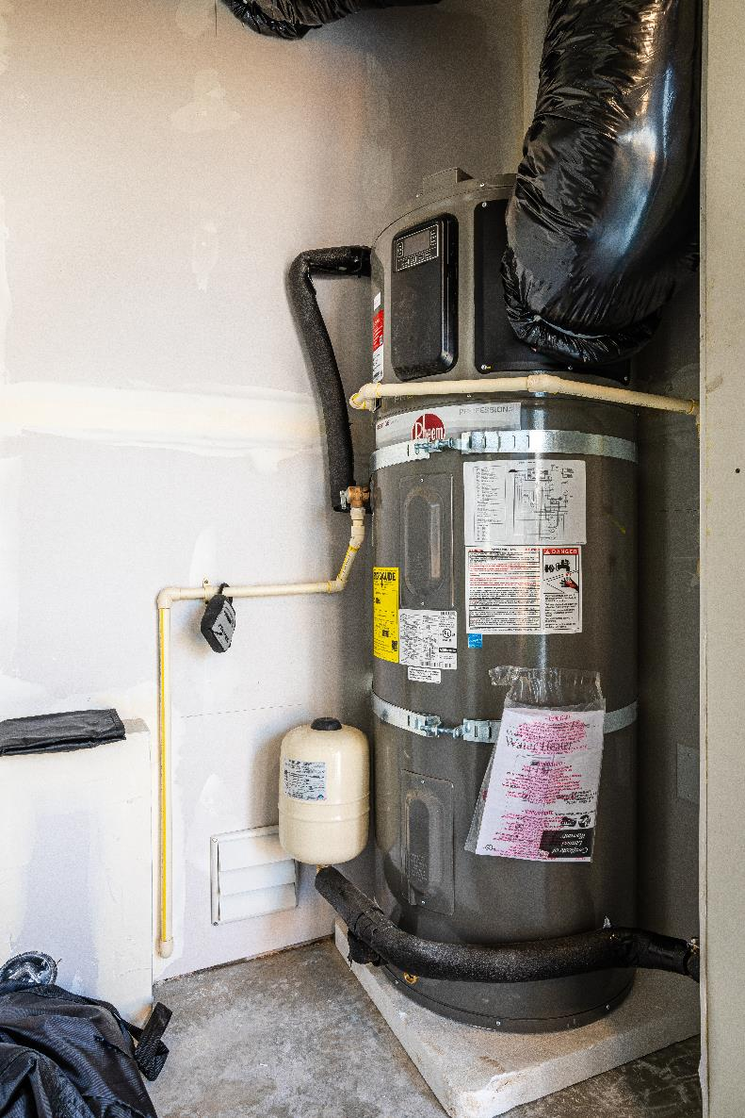
Cost Options & Financing
Multiple Options
Financing Solutions
Bundle Upgrades
Notes:
Selling higher cost water heaters may require a shift in how your company presents the bid to your customer. The first shift might be to offer more than one choice. As we have noted, today's customers want options and by simply offering options you can enhance your company's image. The practice of offering three options – such as bronze, silver, & gold -- could include a standard 50-gallon electric tank as the bronze option, a 50-gallon HPWH as the silver option, and a 65-gallon HPWH as the gold option.
Other sales tactics may include financing. For many households, financing is the preferred option for larger purchases or to help close the remaining gap after incentives, rebates &/or tax credits. While there are interest rates charged by financing companies, there is a good chance that it is lower than the rate charged by their credit card company. In many cases, the monthly payment will be offset by energy savings. In addition, many utilities offer low or no interest loans to customers making energy efficient upgrades.
Other options include bundling with other upgrades, such on demand recirculation pumps and leak detection systems.

Slide 28
Pricing Considerations
Labor Hours
Standard tank replacement hours
Hours for any required venting or ducting
Possible Extra Parts
Duct adaptors
Other Line Items
Tax credits
Local incentives
Hours for condensate system
Duct work
Grills
Condensate pump
Maintenance agreement
Maintain Profit Margin
Ensure Comprehensive Bids
Additional Labor Hours
Notes:
As with any water heater, it’s important that your company earns the expected profit margin on the install. While certain HPWH installations will be similar to a standard water heater tank installation – with the exception of the price of the tank and condensate management – it’s important to include parts and labor that are not usually a part of standard tank installation.
If an upgraded electrical panel and a new circuit are required, then of course an electrician will be involved. While this will add significant costs to the bid, this does provide an opportunity for the homeowner to perceive value in the upgrade.
In terms of parts, you will want to be sure to consider including any of the following:
Mixing valves
Condensate management / pumps
New recirculation controls
Calculating labor hours will be based on the specifics of any given installation. Open garages and basements will entail the fewest additional hours, with the potential extra time required to install the condensate management system.
Larger tanks such as the 80-gallon models may include sending two technicians to the site to help with transport and lifting. This is especially true with basement installations with a less-than-code-approved staircase.
If you are aiding in the processing of rebates and incentives, be sure to include the extra administrative hours.
If you are conducting more advanced installations that require ducting or venting to overcome volumetric constraints, be sure to include those parts as well as the extra labor hours. A short list of those parts include:
Duct work
Vents
Duct adaptors, if required
Duct terminations such as grilles and wall vent hoods
For more information on installs that may require ducting and or venting, we recommend the Northwest Energy Efficiency Alliance (NEEA) online course available at: https://hotwatersolutionsnw.org/partners/on-demand-trainings

Slide 29
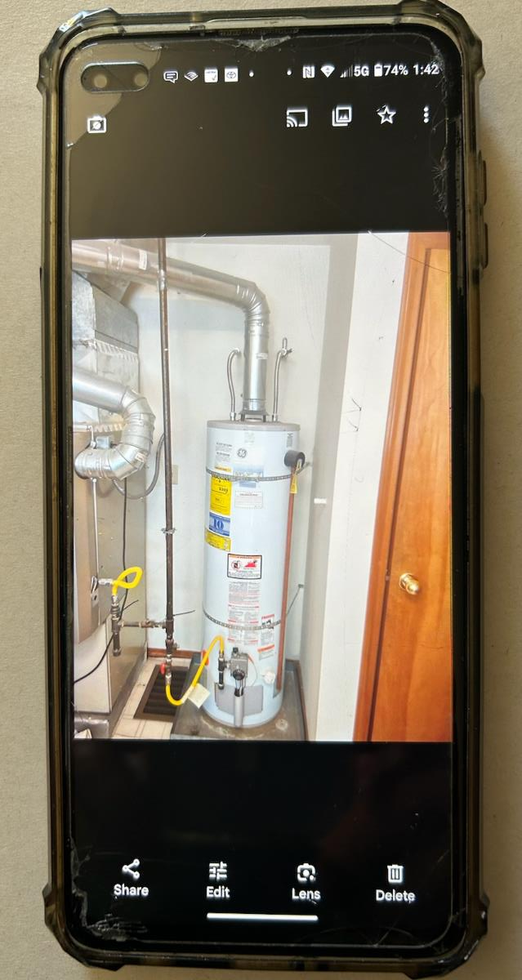
Over-the-Phone Bidding
Collect photos and videos of volumetric space, name plates, recirculation pumps, and drains.
Perform a quick household survey to ask about # of occupants and extra hot water loads to recommend the right tank size.
Notes:
A phone call is usually a contractor’s first contact with a customer. When it comes to replacing a failed water heater, the customer’s first question is likely to be: How fast can you do it?
While on-site bidding will always be more accurate and personal, phone bidding is sometimes a necessity. Standard installs, such as those in spaces that do not require ducting or venting, can be done easily if the customer has a cell phone and is willing to take pictures. In fact, there are mobile apps and platforms that allow an estimator to see what the customer is seeing in real time. This gives the estimator the ability to better direct the customer to specific locations of interest.
Key pictures or video to include:
Volumetric space availability
Name plate picture
Looking for a recirculation pump
Looking for drains and existing condensate pumps
Picture of the existing water heater tank (e.g. is it gas or electric? will it require a drain pan?)
With the name plate there is a good chance you can look up the existing physical size of the tank.
For sizing purposes, a quick household survey will guide you in choosing the right size. Questions to ask:
Household size (# of occupants)
Extra loads (ex. walk in tubs)

Slide 30
Customer Education and Messaging
Informational Materials
Flyer or Brochure
Team Member Script
Pre-Education Resources
Northwest Energy Efficiency Alliance (NEEA)
ENERGY STAR
Richard Heath and Associates
Advanced Water Heating Initiative
Appliance Family Meeting (Hot Water Solutions)
How To Install a Heat Pump Water Heater: Consumer Version (Hot Water Solutions)
Notes:
Informing homeowners as to the benefits of HPWHs is a required part of selling HPWHs. As an option, your company may want to develop a simple 1-page flyer or brochure, as well as a script that can be used to by your team members to quickly and effectively convey the customer benefits of HPWHs. Pre-educating customers through online resources is one way to inform potential customers of the benefits of HPWHs, what is involved in the best fit selection of a HPWH, and what to expect during the installation process. The following websites provide valuable and publicly available customer education resources:
Northwest Energy Efficiency Alliance (NEEA) https://hotwatersolutionsnw.org/
ENERGY STAR www.energystar.gov/partner_resources/residential_new/educational_resources/sup_program_guidance/heat_pump_water_heater_guide
Richard Heath and Associates https://www.rhainc.com/index.php/2023/09/05/hpwh-best-practices-field-guide/
Advanced Water Heating Initiative https://www.advancedwaterheatinginitiative.org/
Additionally, here are links to some consumer-oriented videos you can share:
Appliance Family Meeting (Hot Water Solutions)
How To Install a Heat Pump Water Heater: Consumer Version (Hot Water Solutions)

Slide 31
Customer Communication Strategies
Clear Explanation of Benefits:
Emphasize the efficiency of HPWHs by explaining that they are 3 times more efficient than traditional water heaters.
Highlight potential cost savings over time due to lower energy consumption.
Mention available tax credits and rebates to reduce the initial investment.
Addressing Objections:
Prepare for common objections such as higher upfront cost and unfamiliar technology.
Counter these by explaining the long-term savings and environmental benefits.
Use real-world examples and testimonials to build credibility.
Highlight Key Selling Points:
Point out the significant reduction in monthly energy bills.
Discuss the convenience of features like remote monitoring and control via the app.
Stress the environmental benefits, including reduced carbon emissions.
Notes:
Let’s briefly cover some of these types of customer communication strategies that can be helpful when conveying the benefits of HPWHs, addressing common objections, and setting realistic expectations:
Clear Explanation of Benefits - When discussing HPWHs with customers, it's crucial to simplify the benefits. Emphasize that HPWHs are 3 times more efficient than traditional water heaters, which can sometimes translate to significant energy savings. Highlight how this efficiency may lead to lower energy bills over time, making the initial investment worthwhile. Additionally, inform customers about available tax credits and rebates that can reduce the upfront cost, making the switch to HPWHs more financially accessible. Cost and emissions savings calculations and calculators can be found in Introduction to Heat Pump Water Heaters – Level 3.
Addressing Objections - Be prepared to handle common objections such as the higher upfront cost and unfamiliar technology of HPWHs. Counter these concerns by explaining the long-term savings of HPWHs. Stress the environmental benefits, such as reduced carbon emissions, which are increasingly important to many consumers. Use real-world examples and testimonials to build credibility and show how other customers have benefited from making the switch.
Highlight Key Selling Points - Focus on the key selling points of HPWHs. Point out the significant reduction in monthly energy bills that customers may expect. Discuss the convenience features, such as the ability to monitor and control the water heater remotely through an app. This not only provides ease of use but also allows customers to optimize their energy consumption. Emphasize the environmental benefits, including reduced carbon emissions, which contribute to a greener home.

Slide 32
Customer Communication Strategies
Use of Visual Aids:
Show brochures and visual materials that illustrate the benefits and features of HPWHs.
Demonstrate the HPWH app, highlighting its user-friendly interface and functionality.
Demonstrate filter cleaning procedure.
Personalized Recommendations:
Ask about the customer's specific needs, household size, and energy usage patterns.
Recommend the most suitable HPWH model and size based on their individual situation.
Setting Expectations
Explain that the installation of HPWHs may require additional space and electrical modifications, and that proper condensate management is essential.
Inform customers about the routine maintenance required, such as filter cleaning and periodic checks to ensure optimal performance.
Highlight the differences in operation, such as the cool air discharge and potential noise levels, and how these can be managed to ensure comfort.
Notes:
Use of Visual Aids - Leverage visual aids to help customers understand the benefits and features of HPWHs. Show them brochures and visual materials that clearly illustrate these points. Demonstrate the HPWH app, highlighting its user-friendly interface and functionality. Visual aids can make complex information more accessible and engaging, helping customers make informed decisions.
Personalized Recommendations - Make personalized recommendations based on the customer's specific needs, household size, and energy usage patterns. Ask questions to understand their situation better and suggest the most suitable HPWH model and size for their home. Tailoring your advice to their unique circumstances will help build trust and show that you have their best interests in mind.
Setting Expectations - It's important to set clear expectations regarding the installation, maintenance, and operational differences of HPWHs compared to standard water heaters. Explain that the installation may require additional space and electrical modifications, and that proper condensate management is essential. Inform customers about the routine maintenance required, such as filter cleaning and periodic checks to ensure optimal performance. Highlight the differences in operation, such as the cool air discharge and potential noise levels, and how these can be managed to ensure comfort. Setting these expectations upfront helps avoid misunderstandings and ensures a smoother customer experience.

Slide 33
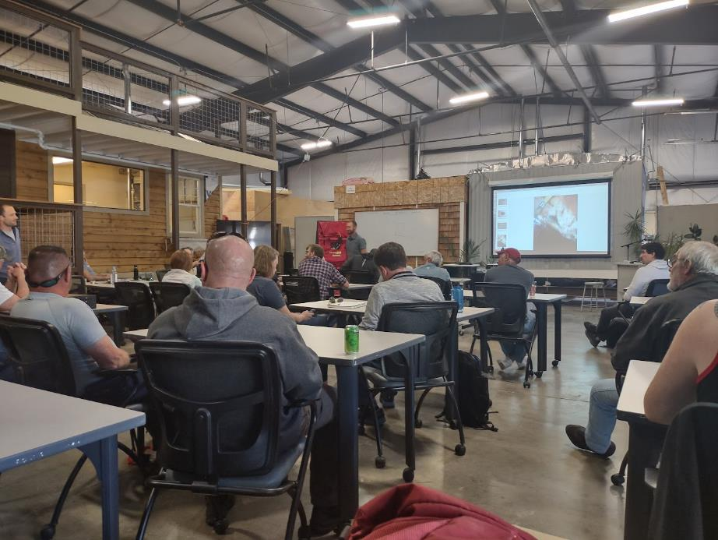
Staff training on HPWHs
Educate all staff to explain HPWH efficiency, cost savings, and available incentives.
Emphasize filter maintenance and familiarize with the four modes of operation (Heat Pump Only, Hybrid, High Demand, Vacation).
Train on downloading and using the app for remote monitoring and control.
Highlight environmental advantages, such as reduced carbon emissions.
Notes:
In addition to educating your customers, educating your entire staff is also very important. Imagine a customer calling in about the possibility of a HPWH installation due to their local utility promoting and incentivizing them, only to find that the receptionist is unaware of the product and ends up sending them elsewhere. The training resources listed on the previous slide are a great place to start.
Topics of particular importance are:
The ability to explain in simple terms how a heat pump operates efficiently, such as:
HPWHs are 2-4 times as efficient than standard gas and electric water
They save money over time because of this efficiency
Available tax credits and other incentives lower the cost
The importance of filter maintenance
The modes of operation – while the terminology changes depending on the model, all HPWHs have 4 modes:
Heat pump only
Hybrid mode - tank relies on compressor with some help from the heating element
High demand mode - tank relies more heavily on the element
Vacation mode - allows the user to set the number of days they expect to be away, which will turn down the temperature during that period and then turn the temperature back up before they arrive home
How to download the app
Environmental benefits (e.g. reduced carbon emissions)
For more information on installs that may require ducting and or venting, we recommend the Northwest Energy Efficiency Alliance (NEEA) online course available at: https://hotwatersolutionsnw.org/partners/on-demand-trainings

Slide 34
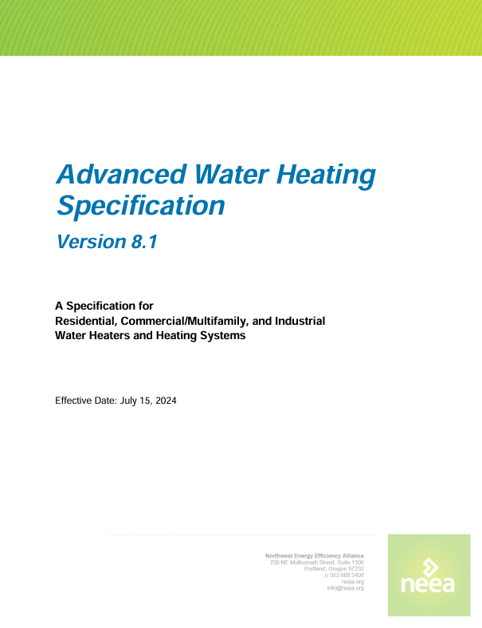
Staff training on HPWHs
Richard Heath & Associates with TECH Clean California | Best Practices for the Retrofit Installation of HPWHs
Northwest Energy Efficiency Alliance (NEEA) | Advanced Water Heating Specification

Slide 35
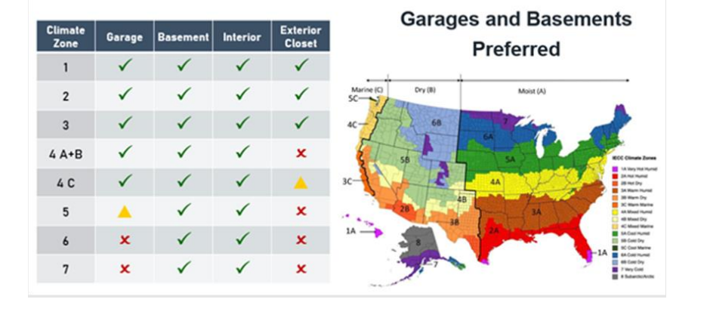
Navigating Common Misconceptions
HPWHs work efficiently in conditioned or semi-conditioned spaces in colder regions
Minimal impact on heating bill (none when installed in basement or garage)
HotWaterSolutionsNW.org
Notes:
One prominent myth about HPWHs is that they do not work in cold climates. As with all myths, there is an element of truth to this myth. Heat pump water heaters typically operate only as standard electric tanks when the incoming air is below 37F. In the warmer parts of the country, this will not be a problem regardless of where the tank is located. In colder parts of the country, the existing tank will need to be located in a conditioned or semi- conditioned space such as an unfinished basement. In this case the tank will not experience temperatures below the 37F cutout temperature. In milder climates, garages may dip below the cut off temperature for a few days a year, so the overall negative impact is minimal.
Another myth revolves around the fact that since HWPHs extract heat energy from the surrounding area, this means they will negatively affect the home’s heating bill in a significant way. Several studies have researched this, and when the tank is in a basement or garage, it has been proven there is no effect on the heating energy usage. When the tank is located in a fully conditioned space, there is a small, less than 5% increase during the heating season, no effect during the shoulder months, and even a small benefit during cooling season.

Slide 36
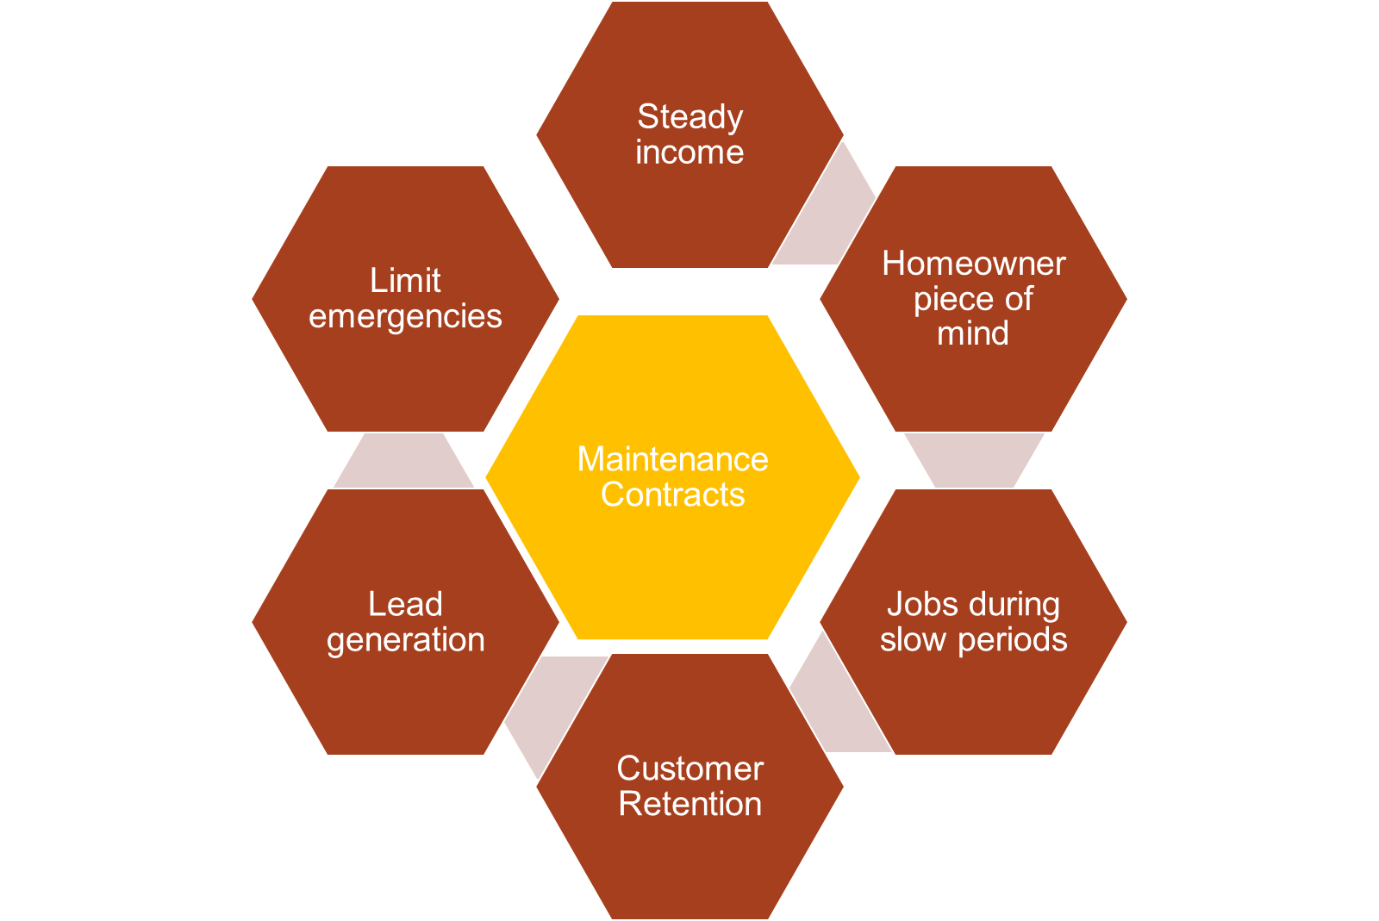
Incorporating “After Sales Service”
Maintenance Contracts
Notes:
All water heaters require some maintenance to ensure they achieve rated life spans and maintain peak efficiency. One method of doing this is to sell annual maintenance contracts that cover the HPWH and include an inspection of other plumbing fixtures. These contracts offer peace of mind, greater customer satisfaction, and provide your company a steady revenue stream. Many companies that use maintenance contracts also include 5-point inspections that include inspections of other plumbing fixtures such as toilets, drains and condensate pumps. These inspections can lead to additional sales.
One advantage of HPWHs is their on-board diagnostics. In the event of a problem, the HPWH will display an error code. Knowing the error code in advance of a service call will help prepare the service technician for the visit, or in some cases eliminate the need for a visit, by informing the homeowner they can complete the required action by undertaking the required “fix” themselves, such as cleaning the air filter.

Slide 37
Next Steps to Offering HPWHs
Organize technical and manufacturer training
Know your pricing
Educate your entire staff on HPWHs
Make connections with other trades to support their installs
Identify how to select the best tank for the job
Understand and be willing to aid customers in receiving any incentives or tax credits
Pre-educate your customers as to what to expect from their HPWH
Consider offering annual maintenance agreements
If new to incorporating a HPWH offering, focus at the outset on standard installs that do not require venting or ducting
Notes:
Choosing to offer and install HPWHs is similar to choosing to install any new product. By focusing on standard installs at the outset, incorporating HPWHs into your offering will be made easier. Standard installs are those installs that do not require venting or ducting. HPWHs appeal to a wide variety of customers, from the technologically savvy to the environmentally minded to those wanting lower monthly operating costs. In many cases, offering HPWHs will help your company to increase its customer base.
The important steps to a successful incorporation of HPWH offerings include:
Organize for technical training from the manufacturer or other trusted sources
Know your pricing
Educate your entire staff on HPWHs
Make connections with other trades to support their installs
Identify how to select the best tank for the job
Understand and be willing to aid customers in receiving any incentives or tax benefits
Pre-educate your customers as to what to expect from their HPWH
Consider offering annual maintenance agreements
Remember: If you don't bid it, nobody will buy it!

Slide 38
Tax Credits & Rebates
Useful link explaining federal tax credits:
ENERGY STAR - Federal Tax Credits for Energy Efficiency
Useful link for various local rebates:
ENERGY STAR - Rebate Finder
*Note the above resources are not exhaustive, and contractors should investigate and confirm locally available programs.
Notes:
Below is useful link explaining federal tax credits: ENERGY STAR - Federal Tax Credits for Energy Efficiency
While not exhaustive, here is a link for various local rebates: ENERGY STAR - Rebate Finder
*Note the above resources are not exhaustive, and contractors should investigate and confirm locally available programs.

Slide 39
Additional Training & Resources
For more info on how HPWHs operate:
Heat Pump Water Heater - Introduction For more info and guidance on unit selection:
Heat Pump Water Heater - Decision Guidance https://bsesc.energy.gov/training-modules/heat-pump-water-heater-decision-guidance
For more info on installs that may require ducting and or venting:
Hot Water Solutions On-Demand Training https://hotwatersolutionsnw.org/partners/on-demand-trainings

