Slide 1
Installation of Heat Pump Water Heaters

Slide 2
Section 1 – Apply
Prepare to install a heat pump water heater
Maintain a heat pump water heater
HotWaterSolutionsNW.org | Save Money with a Heat Pump Water Heater

Slide 3
Preparing to install a heat pump water heater
Obtaining a permit
Check if the city or county requires a permit to perform mechanical or plumbing work on the premise. If applicable…
Apply for the building permit
Prescreen plans
Review
Pay permit fees
Notes:
Obtain a permit, if necessary
Before installing any water heater, check if the city or county in which the work is being performed requires a permit to perform plumbing or mechanical work. This information can usually be found on the municipality’s website by searching for the permit office. If a permit is required, it usually involves the following steps:
Apply for a building permit. Applying for a permit submits information about the work being performed and includes specifying the tasks that are required to complete the work.
Prescreen the plans. Prescreening evaluates if the plans submitted contain the minimum requirements to meet building code.
Plan review. The municipality reviews the submitted plan and either approves the plans or determines that corrections are required.
Pay fees and obtain permit. After plans are reviewed, permit fees must be paid before the permit is issued and work may begin.

Slide 4
Preparing to install a heat pump water heater
Select a Location
When selecting a location to install a HPWH, the following items, which are created by the unit, should be considered
Cool exhaust air
HPWH’s create cold air and should be installed in locations where this exhaust can compliment the desired environment.
Noise
Because heat pumps have fans as moving parts, they can generate noise.
Condensate
Liquid water in the form of condensate is created around the water heater and should be drained away. Easy access to a drain for this is ideal.
Notes:
Select a location
Most often, a heat pump water heater will be replacing a gas fired or electric resistance water heater, and will be installed in the same space. However, there are some additional considerations that might affect installation location, including cool exhaust air, noise, and condensate.
Because of heat pump technology, heat is being extracted (pumped) from the surrounding air into the water tank, and cool air is exhausted from the unit, which may result in cooler air temperatures and increased heating needs in winter months. Ideal locations for heat pump water heaters are non-conditioned spaces, such as garages or utility closets. However, the air temperature around the water heater should not drop below freezing.
Heat pumps use compressors and fans for the refrigerant cycle, which make noise and may result in discomfort in the living space. This is another reason that non-conditioned and non-inhabited locations are ideal. Condensate is produced from normal operation of the heat pump and must be drained away. As such, a location with a drain is ideal to avoid water damage. More information on properly locating a HPWH and managing condensate can be found in the module “Decision Guidance for HPWH.”

Slide 5
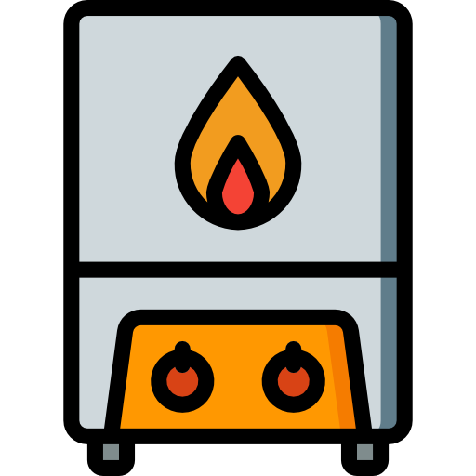
Preparing to install a heat pump water heater
Remove the old water heater / prepare for install
Turn off the power for the water heater's circuit at the electrical panel
Fully drain the tank
Disconnect the associated supply lines and plumbing
Clear out the space for the new HPWH, with a minimum of 6inch clearance from the walls
Inspect all remaining fittings to make sure they are sound and functional
Notes:
Remove the old water heater and prepare for install
Whether replacing an old water heater or installing in a new construction, turn the power to the water heater’s circuit off at the electrical panel. This ensures the electrical components are safe to work on.
If removing an old water heater, first remove the sediment by opening the drain valve at the bottom of the tank and leaving the cold-water supply on to flush the unit. Once all sediment is removed, shut off the water supply, and allow the tank to fully drain.
Remove the supply lines and associated plumbing. Once all the lines and hardware are removed, remove the old water heater.
The heat pump water heater should be installed with at least 6inches of clearance from the wall to allow for adequate airflow to carry the cool air away from the unit. Additionally, the plumbing may need to be altered, as most heat pump water heater’s inlet and outlet water lines are located on the side of the unit, not the top, as is typical with traditional water heaters.
Inspect all remaining fittings to make sure they are sound and functional, and replace if needed. If replacing the cold-water valve, water to the whole house will need to be shut off at the main valve.

Slide 6
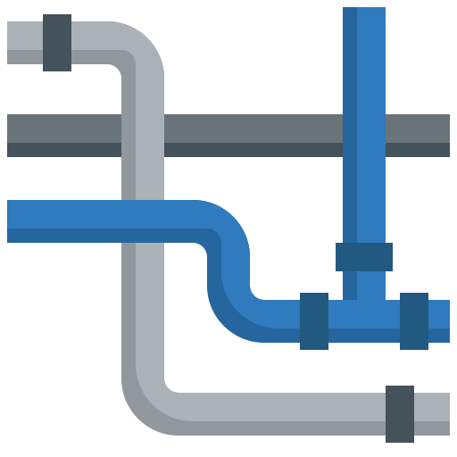
Preparing to install a heat pump water heater
Prepare the plumbing
Determine if the current plumbing in the space is compatible with the new HPWH
*Refer to the installation manual of the HPWH for specific requirements.
Common plumbing issues include…
HPWHs tend to be larger in diameter or height than older water heaters, possibly complicating current plumbing connections
Inlet and outlet lines could be in a different positions than the prior water heater, so plumbing connection point locations may need to be adjusted
Installing a HPWH in a closed water system requires the additional installation of a thermal expansion tank
The need to install shutoff valves for the cold-water inlet line
Notes:
Preparing the plumbing
A heat pump water heater may require a couple of changes to the location and plumbing.
First, the heat pump water heater may have a larger diameter than the old water heater, and six inches of clearance from the wall is recommended. Refer to the installation manual for clearance requirements around the exhaust fan.
Second, unlike the old water heater, the water inlet and outlet lines on some heat pump water heaters may be located on the side of the unit instead of on top. Longer supply lines to reach the inlet and outlet may be needed. Use solid pipe and flexible pipe connections if they are permissible according to local code. These do not require soldering, clamps, unions, or glue. Use thread tape on all threaded connections.
If installing the heat pump water heater in a closed water system, which lets water in through the supply line and doesn’t let it back out except through drains and sewer lines, a thermal expansion tank to prevent problems resulting from pressure buildup is needed. Install the temperature and pressure relief valve and a discharge line per the manufacturer’s instructions and local code.
Install a shutoff valve in the cold-water inlet line near the water heater. If flexible connectors are not used, use union fittings to join the hot and cold-water supply lines to make removal of the water heater easier for service or replacement. If required by local code, install a mixing valve or anti-scald device, which are mechanical devices mix cold water in with outgoing hot water so that the hot water that leaves a fixture is not hot enough to scald a person, in the domestic hot water line, and a pressure reducing valve in the cold-water inlet line.

Slide 7
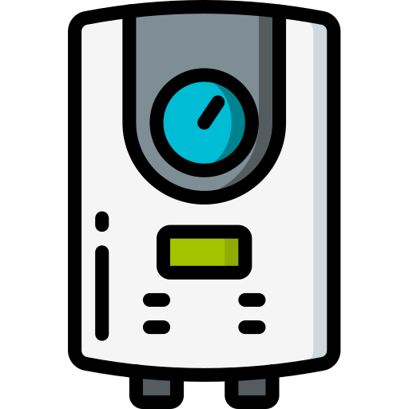
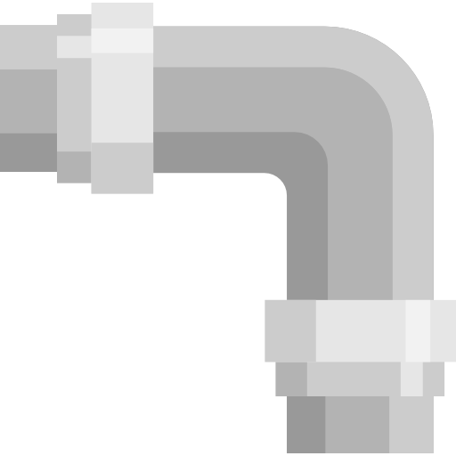
Preparing to install a heat pump water heater
Position and connect the HPWH
Place the HPWH
Place the rigid foam pad and drain pan on the floor where the HPWH will be placed
Place the HPWH on the drain pan
Make sure the unit is facing outward and properly leveled
Connect the Plumbing
Connect the supply lines to the cold-water inlet and the hot-water outlet
Insulate the hot-water supply lines with a foam pipe sleeve
Notes:
Position the heat pump water heater, then connect and insulate plumbing
Place a rigid foam pad (this reduces heat loss through the floor) and drain pan for the heat pump water heater on the floor, or if local code requires, place the drain pan atop a stand. Move the water heater onto the drain pan. Ensure that the control panel is facing outward for easy access. Level the unit using shims, if necessary. If required by local code, install seismic strapping.
With the new water heater in place, connect the supply lines to the cold-water inlet and hot water outlet. Insulate the hot water supply line with a polyethylene or neoprene foam pipe sleeve. This reduces heat loss and can raise water temperature 2–4 °F hotter than uninsulated pipes can deliver. Wait time for hot water from faucets and showerheads is also reduced, which helps conserve water and maximize energy savings.

Slide 8
Preparing to install a heat pump water heater
Address condensate management
Locate a nearby water drain to direct water condensate to, from the capture tray
If no nearby drainage is located refer to manufacturer manual/instruction for additional instructions on proper HPWH installation
Notes:
Address condensate management
Unlike traditional water heaters, heat pumps may produce condensate that needs to be drained. If there is a nearby floor or sink drain, attach PVC pipe to the water heater’s drain port(s), and route the condensate in a downward slope.
If there is not a drain nearby, a condensate pump is required. Refer to the manufacturer instructions before connecting the condensate drain line into an existing drain or discharge line. Most condensate pumps can be attached to a wall hanger and plugged into a standard 120 Volt outlet. Ensure that the tubing is connected securely with hose clamps to the pump output, and drains to a suitable termination point. If a drainage pipe is directed outside, make sure the pipe will not freeze by having it terminate at least 6 inches above the ground, and making sure there are no low spots in the tubing outside. Install the condensate pump per the manufacturer instructions. Verify that the pump is working properly by filling it slowly with water until the pump engages.

Slide 9
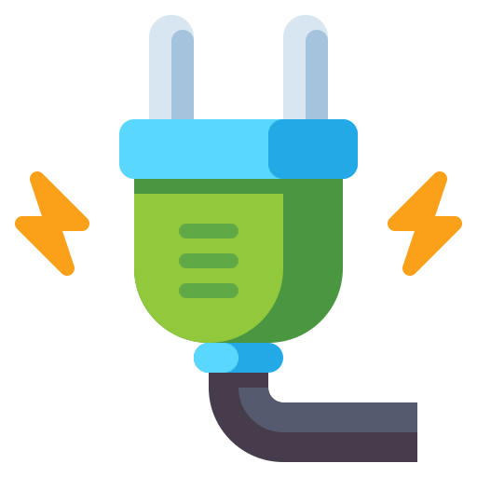
Preparing to install a heat pump water heater
Fill the tank and complete electrical connections
Filling the water tank
Fill the water tank via the cold-water inlet
Simultaneously turn on the highest hot-water faucet in the house to allow air to escape
Run the hot-water faucet until it has reached a steady stream for three minutes, then turn it off
Electrical connections
Connect the electrical supply in accordance with manufacturer instructions
Use proper wires and nuts at the electrical connection points
Turn on the power at the electrical panel, and verify voltage using a voltmeter
Start the water heater!
Notes:
Fill the tank and complete the electrical connections
Open the cold-water valve slowly at first to make sure there are no leaks. Then, fill the heat pump water heater. Meanwhile, turn on the highest hot water faucet in the house to allow air to escape as the tank is filled, and double-check the piping for leaks. Some rusty water may get pushed through, which is normal. When the hot water faucet in the house has a steady stream, the tank is full. Run the faucet for 3 minutes after a constant flow has been achieved before turning it off.
When the tank is full, connect to the electrical supply according to the manufacturer’s instructions. Use new properly sized wire nuts to connect the wires. Then, turn on the power to the heat pump water heater at the breaker. Use a voltage meter to verify proper voltage per the manufacturer’s instructions. Make sure all cover plates are properly installed.
Start the water heater
Most water heaters will go through a self-check and verify that the tank is full of water, that it has sufficient power, and that there are not any errors. This can take up to five minutes (there may be a series of clicks, and the fan may turn on and off). Congratulations! The new heat pump water heater is successfully installed, and set to provide years of reliable hot water and savings.

Slide 10
Maintain a heat pump water heater
Clean air filters
Vacuuming
Wipe with damp cloth
Rinse under water
Allow to air dry
Manually operate the temperature and pressure relief valve
Drain and flush the tank to remove sediment
Periodically check:
Plumbing for leaks
Condensation lines
Hot water line insulation
Notes:
Maintaining a heat pump water heater will ensure the unit stays efficient and has a long, reliable life. Perform preventative maintenance on water heater as directed by the manufacturer’s instructions. This may involve:
Cleaning the heat pump water heater’s air filters by vacuuming the dust and wiping them with a damp cloth, rinsing them underwater, and allowing them to air dry.
Manually operating the temperature and pressure relief valve to ensure it is working properly.
Draining and flushing the tank to remove any sediment that has built up at the manufacturer’s specified interval.
Periodically check plumbing for leaks and corrosion.
Periodically check the condensate line, and clean if necessary.
Periodically check the hot water line insulation to make sure it stays in place and in good condition.

Slide 11
HotWaterSolutionsNW.org | Do It Yourself
References

Slide 12
For additional information on available Heat Pump Water Heater products and brands, use the following website: ENERGY STAR Certified Water Heaters | EPA ENERGY STAR

