Slide 1
HPWH Load Shifting
Notes:
About the Image: Glass Lab Equipment
Glass lab equipment on a table at the regional American Chemical Society meeting
https://www.flickr.com/photos/pnnl/41280037010/in/album-72157692716565760/

Slide 2
Section 1 – Apply
What is a CTA-2045 Communication device
How to Install a CTA-2045 device onto a heat pump water heater
How to use the CTA-2045 device to control the heat pump water heater
Participating in utility demand response programs

Slide 3
What is a CTA-2045 Device
A CTA-2045 Device enables appliance such as Heat Pump Water Heaters as well as other appliances
Pool Pumps
Dryers
Electric Vehicle Chargers
HVAC Units
Packaged terminal air conditioners
Mini-split and centrally ducted heat pumps
Smart thermostats
to connect, communicate, and by controlled by local utility providers. This allows for the following qualities.
Smart grid interaction
OpenADR Alliance Capabilities

Slide 4
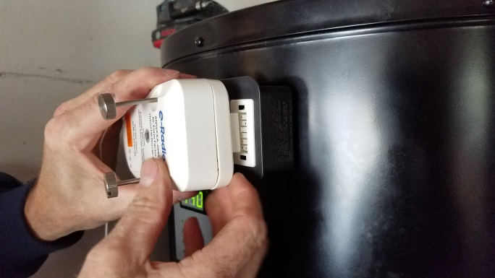
How to Install CTA-2045 onto a HPWH
Required Materials:
A HPWH with a CTA-2045 port
If the HPWH does not have a port, a CTA-2045 port adapter can also be used.
An AC or DC-powered CTA-2045 Device that is compatible
Philips and flathead screwdrivers
A computer, tablet, or smart phone

Slide 5
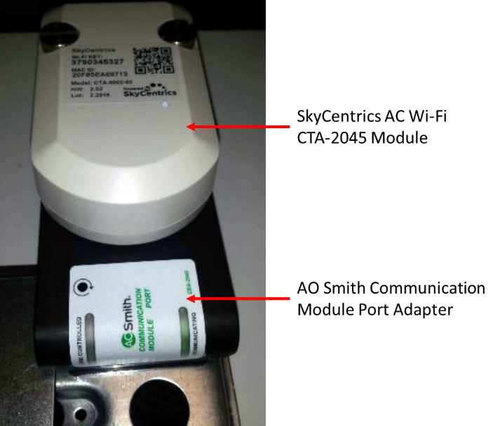
How to Install CTA-2045 onto a HPWH
Step 1: Installing the CTA-2045 Hardware onto the Heat Pump Water Heater:
Turn off electricity to the water heater.
Unscrew and remove the cover plate on the communication port.
If an adapter is needed, install and screw down the port adapter to the communication port.
Install and screw down the CTA-2045 Wi-Fi Module onto the port adapter. If an adapter was not needed, install and screw down the CTA-2045 Wi-Fi Module onto the communication port.
Turn the electricity to the water heater back on and check for a solid pink LED light on the device.
Figure 1: SkyCentrics AC CTA-2045 Wi-Fi Module installed on an AO Smith Heat Pump Water Heater. Image Reference: https://www.energy.gov/sites/default/files/2020/03/f72/bbrn-peer-022720.pdf

Slide 6
How to Install CTA-2045 onto a HPWH
Step 2: Connecting the CTA-2045 Module to the Wi-Fi Network:
Using a laptop, tablet, or smart phone, check the Wi-Fi network for the CTA-2045 device on the and connect to the device’s Wi-Fi access point . The SSID of the device’s WiFi network should match the ID of the device, as seen on its label.
Depending on the manufacturer of the CTA-2045 device, there may be a website to access or an application to download specific for products from that manufacturer.
Follow the instructions on the website or app to connect the CTA-2045 device to the Wi-Fi network in the residence.
Note: The pink light on the device should start blinking as it makes the connection and will change color from pink to blue as the connection is made.
The CTA-2045 device should be ready for use.
Note: When the setup is complete, the light on the device should now be a steady blue color instead of blinking.

Slide 7
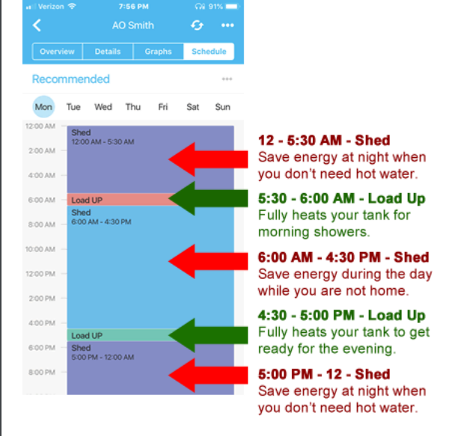
Operating the Heat Pump Water Heater Through the CTA-2045
Using associated applications for the CTA-2045 device, the user can set a schedule that sets the HPWH in different modes.
Figure 2: Example of a sample HPWH operation schedule using the SkyCentrics app for a CTA-2045 connected AO Smith HPWH. Source Link: https://www.energy.gov/sites/default/files/2020/03/f72/bbrn-peer-022720.pdf

Slide 8
Operating the Heat Pump Water Heater Through the CTA-2045
Additionally, data can be received from the CTA-2045 about the HPWH. Such as…
The HPWH’s power consumption in both Watts at that current moment and in total Watt-hours since the HPWH was turned on and connected online.
The HPWH’s current operating status:
Running
Idle
Running in a cycle mode
The HPWH’s current curtailment type, that is, any action that the appliance is undergoing that is affecting the electrical load:
None
Shed Event
Grid Emergency Event
Load Event
Autonomous Cycling
Customer Override
Error States

Slide 9
Participating In Utility Demand Programs
Incentives are offered by utility providers for participating in demand response programs. In these programs, utility providers may change the mode of operation of the HPWH in/and around peak response times to lessen the burden on the grid.
To compensate for this, utility providers offer incentives, more information on an example of this kind of program framework can be found the link below.
CPUC Provides Additional Incentives and Framework for Electric Heat Pump Water Heater Program (ca.gov)

Slide 10
References
Eustis_Session7C_HWF16_2.23.16.pdf (aceee.org)
Heat Pump Water Heaters -- What You Need to Know Right Now (energy.gov)
Microsoft PowerPoint - OADR_CTA2045_Overview Webinar (openadr.org)
2018 ACEEE Proceedings
CPUC Provides Additional Incentives and Framework for Electric Heat Pump Water Heater Program
Video Reference
AO Smith SkyCentrics CTA-2
Connecting a SkyCentrics CTA-2045 module to Wi-Fi with the SkyCentrics Mobile App - YouTube045 Hardware Installation - YouTube

Slide 11
For additional information on available Heat Pump Water Heater products and brands, use the following website: ENERGY STAR Certified Water Heaters | EPA ENERGY STAR

