Slide 1
HPWH – Decision Guidance

Slide 2
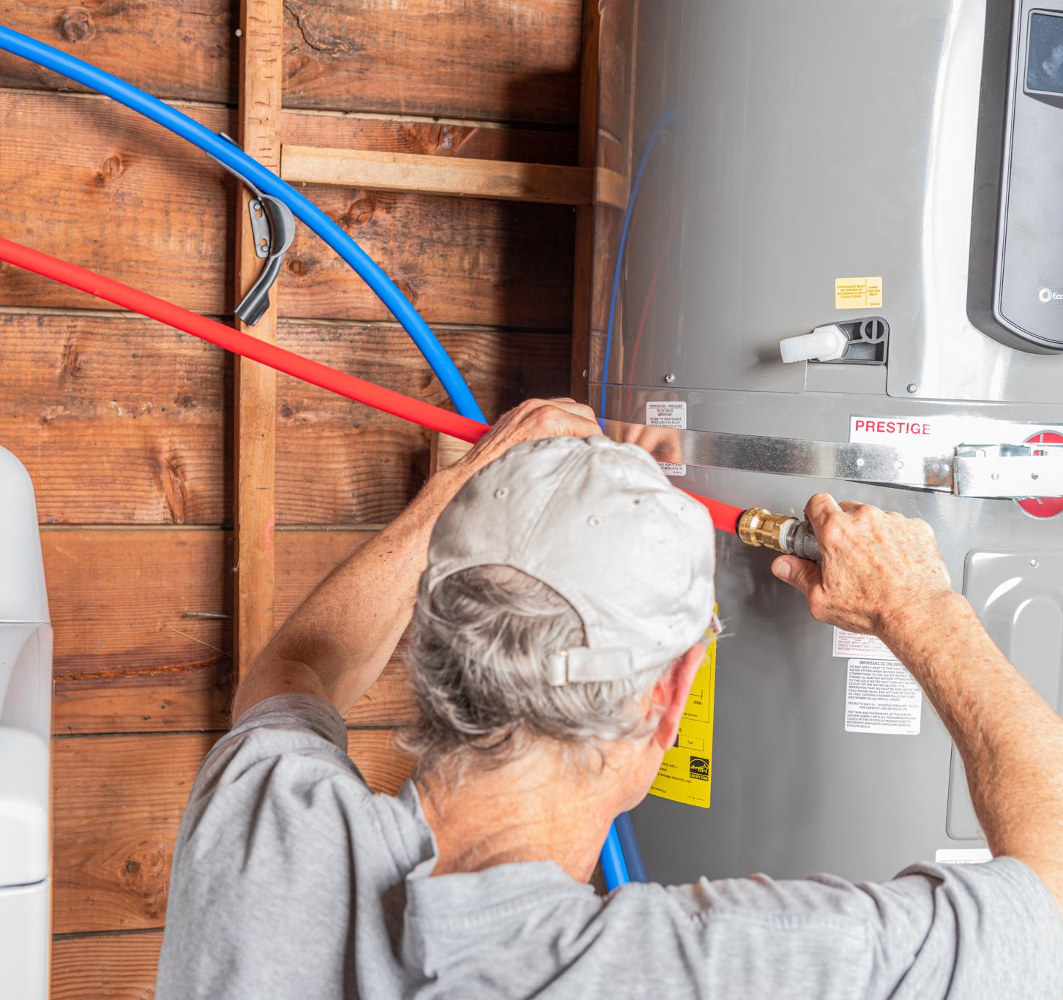
Section 1 - Remember
Installation challenges for HPWH
Current and new technologies
HotWaterSolutionsNW.org | Save Money with a Heat Pump Water Heater

Slide 3

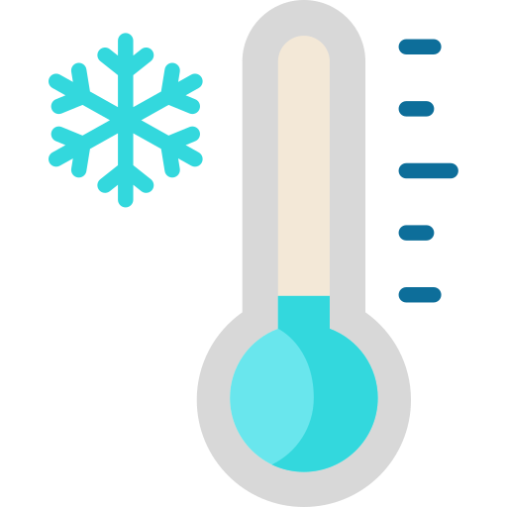


Installation Challenges
Temperature
  Space should be able to maintain a temperature range of 40º–120ºF (4.4º–49.9ºC).
Clearance
  HPWH should be installed in a space with 700-cubic feet (28.3-cubic meters) of air space around the water heater
Space Considerations
  Temperature
  Clearance
  Noise
Noise
  Sound generated tends to run between 40 dBA to 80 dBA, where the majority of HPWHs are below 55 dBA
Notes:
When installing a heat pump water heater (HPWH), there are several key challenges that should be considered before installation begins. Some of these challenges include the space required, electrical capacity, condensation, cold exhaust air, noise, and plumbing connections. Heat pump water heaters tend to be taller and wider than other water heaters with similar tank capacity. This is due to the heat pump components of the unit, usually found at the top of the water heater. In addition to this, because the heat pump requires additional space to facilitate air ventilation, the volume of space needed to install a HPWH is usually higher than other conventional water heaters of similar size. It is recommended that a HPWH should be installed in a space with 700 cubic feet (19.8 cubic meters) of air space around the water heater. For optimal efficiency, the space should be able to maintain a temperature range of at least 40ºF (4.4ºC). For spaces that do not meet these airflow requirements, see Level 2 for possible modifications to the space.

Slide 4

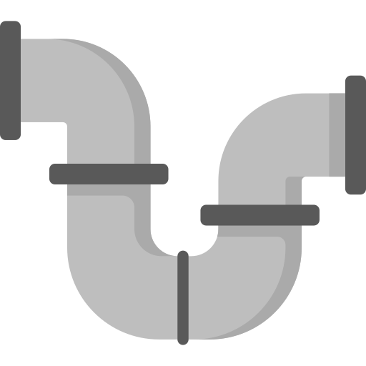

Installation Challenges
Electrical
  240 volts and 30 amps are required
Plumbing Connections
  Location of inlet and outlet may differ from old water heater
Electrical
Plumbing Connections
Condensate Drain
Condensate Drain
  Floor or sink drain should be located nearby
  Condensate pump can be used
Notes:
Electrical Service
Currently, most new homes have an electrical service of 200A. However, some older homes may have electrical service of less than 100A. Since power needs to be supplied to both the heat pump system and the backup electrical resistance rod, 240 volts and 30 amps are required for some units. This requirement can limit the installation location, and a residence’s general ability to install a HPWH. To check if a home is ready to accommodate the 240V/30A requirement at a given location, or how to modify the home’s electrical system to do so, refer to the lecture module Electrical Panels for further information. Additionally, more information on a home’s electrical capacity can be found in the level 3 section of this module, Decision Guidance for HPWH, where a step-by-step guide is provided to increase the amperage load of a residence. Keep in mind that this work should be performed by a trained electrical technician and not the homeowner. Another option is to use alternative equipment, such as a lower input rate 240V/15A HPWH or a 120V/15A HPWH that only uses a heat pump and does not contain an electrical heating element. For more information on 120V HPWH models, see Learning Objective 1.2.
Condensate Management
The creation of condensate is a standard part of HPWHs and should be addressed accordingly when installing a HPWH. To address condensation, a floor or sink drain should be located nearby. In the absence of a nearby drain, a condensate pump can be used (the condensate pump will require its own outlet connection). Additional guidance can be found in the Installation of HPWH lecture module.
Noise Management and Location
Noise created from HPWHs can be substantial and should be accounted for when choosing a location for which to install the water heater. The noise generated is a low soft humming sound, similar to the noise generated by a dishwasher or a refrigerator. The majority of HPWHs generate sound less than 55 dBA. The sound is caused by the moving fan and compressor components of the heat pump on the appliance. This source of sound is expected, and not an indicator of an issue or error. Additional, distinctive sounds not caused by the heat pump system can be an indicator of an issue. Because of the sound generated from the heat pump and the cold, dry air exhausted from the fans, it is generally recommended that the unit is installed in a remote part of the house that is adequately conditioned with sufficient space. Avoid locations near a thermostat, as the exhaust may impact HVAC operation. Usually, these requirements make them best for basements or garages.
Piping Considerations
If replacing an older water heater, it is important to take note as to the location of the inlet/outlet points on the water heater. In older water heaters, it is common for these connection points to be at or near the top of the water heater, but due to the heat pump components of a HPWH being located at the top, these inlet/outlet points are likely to be found on the side instead. Longer supply lines will need to be installed, using solid and flexible pipe connections, in order to reach the inlet/outlet points. Newer models of HPWHs may have top connections for inlet and outlet water, making them easier to install as replacements.
Hot Water Solutions: Heat Pump Water Heater Installation Best Practices

Slide 5
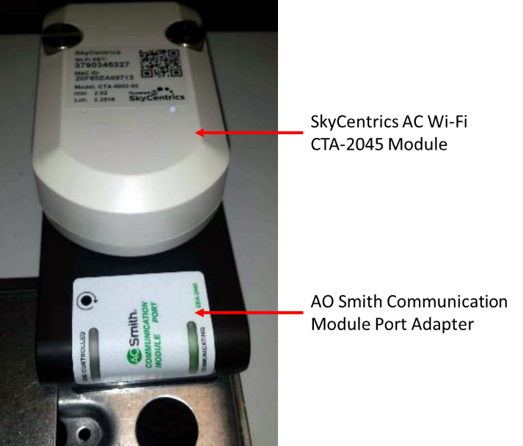

Current and New Technologies
Grid Communication
  CTA-2045 Add-on
  In-built communication capabilities
Figure 1: SkyCentrics AC CTA-2045 Wi-Fi Module installed on an AO Smith Heat Pump Water Heater. Image Reference: https://www.energy.gov/sites/default/files/2020/03/f72/bbrn-peer-022720.pdf
Grid communication
120V/15A HPWH
Cold climate HPWH (Split-Type)
Electrical Capacity Requirements
  Standard
    240-Volt, 30-Amp
  New simplified models
    120-Volt, 15-Amp
Cold climate HPWH
  Extract heat from outside the house
  Effective down to -25°F (-31°C)
Notes:
120V/15A Models
Most HPWH models require a 240-volt connection and a 30-amp circuit. Some newer models of HPWHs offer options that utilize a 120-volt connection and a 15-amp circuit instead. This change makes them more accommodating and compatible with older homes that may not have the required electrical capabilities to install a standard 240V/30A HPWH. The lower electrical requirements make them more accessible to the general public. The trade-off on these 120V/15A models is that they do not have an electrical resistance heating element to provide backup heat, as would be found in standard hybrid HPWHs. This lowers their ability to generate hot water on-demand and during non-ideal environmental conditions. The 120V models have a lower first hour rating as a result. Efforts to mitigate the lowered on-demand hot water generation include maintaining higher water temperatures while on standby.
Grid Integration
Grid integration is becoming more desirable in common household appliances, including HPWHs. Additional factors and installation requirements are also needed for grid integration, such as the installation of an American National Standards Institute (ANSI) certified device that allows for communication between appliances and utilities. An example of such a device is a CTA-2045 device. Currently, CTA-2045 devices are the standard add-on for HPWHs to gain the capability to actively interact with the grid and be adjusted in real time by utility providers. Benefits of having grid interaction include having the capability to participate in peak rebate programs administered by local utility providers. These programs offer monetary incentive for gaining control of large electrical appliances during peak power grid usage, in which they reduce the operational demand of interactive units. As this technology becomes more common, and expected as a standard feature, the means to connect to it are becoming more standardized as well. Additionally, newer models are being released with the in-built ability to be remote controlled by connecting to a pre-existing wireless network such as Wi-Fi. This development into smarter home appliances and system can facilitate opportunities to install HPWHs that can integrate with grid responses and take advantage of the benefits associated. For more information on installation requirements for CTA-2045 devices, refer to the CTA-2045 lecture module.
Cold climate HPWHs (Split-Type)
Cold conditions can have a negative impact on the efficiency of HPWHs. Environmental temperatures below zero limit the location in which HPWHs can be installed in a residence in much of the northern and midwestern United States. As advances in refrigeration technology have been made, HPWH have likewise been able to operate effectively at lower temperatures. However, the HPWH releasing cold air into the indoor airspace where it is located is still a significant issue in these colder climates. To address this shortcoming, split-type HPWHs can be used instead. With an indoor water storage tank and an outdoor compressor, these systems can extract heat from outside the house instead of from the indoor airspace. Split-type HPWHs are effective down to -25°F (-31°C), allowing for effective heat pump water heating even in colder climates in the United States. Additionally, these systems are easier to accommodate for in height constrained space due to the heat pump being separate from the tank, resulting in a shorter unit. But split-type HPWHs can also be significantly more expensive than an integrated system, and the additional cost may greater than the reduced energy cost. These factors make split-type HPWH applications a niche solution.

Slide 6
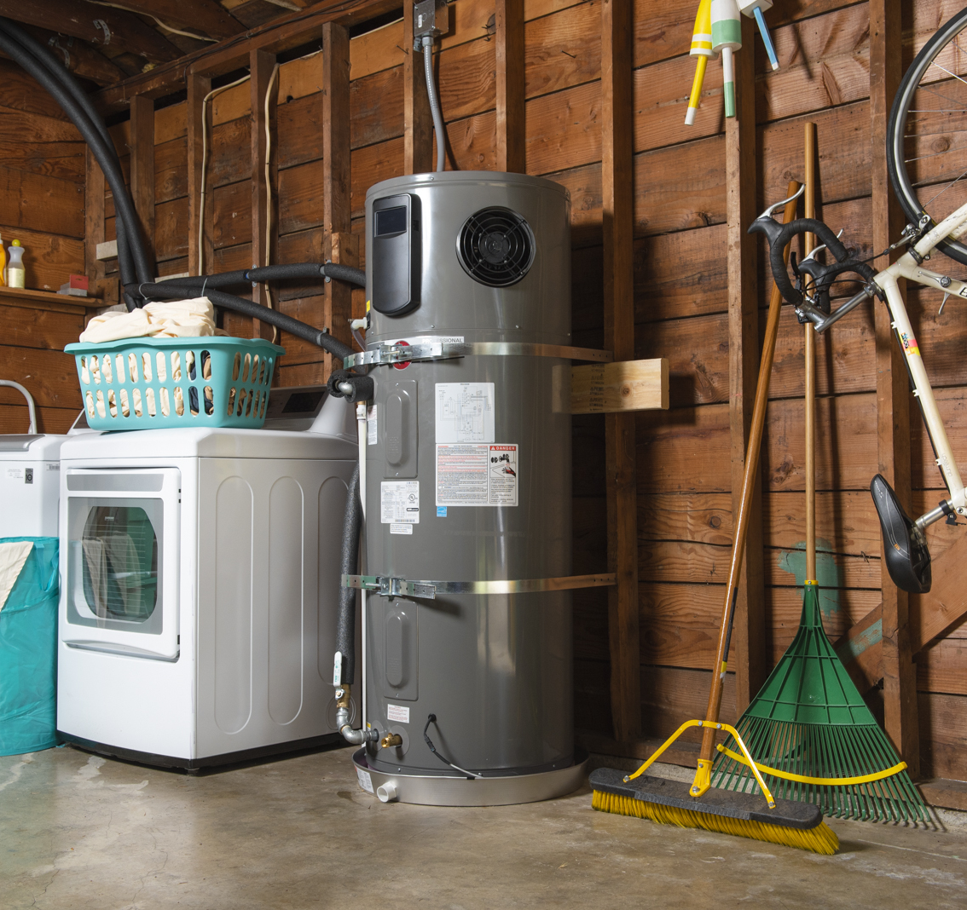
Section 2 - Understand
Where can a HPWH be installed?
HPWH Operating modes
HotWaterSolutionsNW.org | Save Money with a Heat Pump Water Heater

Slide 7



Installation locations
Requirements
  At least 700-cubic feet of volume (Approximately 9 x 10 x 8-foot room)
Examples include…
  Garage
  Basement
  Utility closet
  Laundry room
Notes:
Proper installation is essential to maximizing the energy efficiency gains of a new heat pump water heater (HPWH). Since the initial costs of a new HPWH system can be relatively high compared to a conventional water heater, it is very important to optimize the location it is installed. There are a variety of appropriate installation locations for a HPWH, which will depend on the homeowner’s availability of space, fuel type to be used, and local building codes. Other important considerations include sound concerns, whether the room is heated or insulated, local climate, and the overall size of the system. For optimal system efficiency and safety, it is therefore recommended to use a qualified contractor to evaluate and perform the installation of the HPWH.
The first step to properly install a HPWH is to identify a location with the appropriate space for the system. The location should have enough room to perform the initial installation procedures, as well as the necessary maintenance requirements specified by the manufacturer throughout the life of the system. The standard space recommendation for most HPWH systems is at least 700 cubic feet of volume, or approximately a 9 x 10 x 8-foot room. Some recent HPWH releases have shown a reduced space requirement as low as 450 cubic feet. Make sure the location meets the clearance requirements specified by the manufacturer, and that the system is easily accessible for controls and maintenance. Typical rooms in a home that meet the space requirement include a garage, basement, utility closet, or laundry room. If the room that the HPWH is in does not meet the space requirement, exhaust ducting or louvered doors can be used to overcome this issue. Louvers on their own can significantly reduce the volume of air space required for efficient operation, while exhaust ducting or a combination of ducting or louvers can remove the minimum air space requirement entirely. However, installing ductwork comes with its own cost and logistical issues, including making sure to insulate all exposed metal on any exhaust ductwork to prevent condensation from occurring. This is even more important if the home is located in a cold climate, where the installation must take into consideration the potential for freezing conditions in the room, especially in unfinished or unheated garages and basements.
Occupant health and comfort must also be accounted for when determining the right location for the HPWH. Exhaust air emitted from the HPWH can be much colder than the ambient temperature indoors, so it is important to isolate the exhaust away from highly occupied rooms, particularly if the room is being heated. Check that the air intake pathway is clear and unobstructed. Sound from the HPWH must also be considered by separating the system from occupants, especially near bedrooms, to minimize noise disturbance. If sound issues are a concern and the HPWH cannot be separated any further from occupied spaces, consult the manufacturer for options on sound mitigation, such as isolation pads, foam, or mounting strategies. Depending on the region, make sure the system is strapped down and secured in case of an earthquake or other natural disaster.

Slide 8

Operating Modes
Heat Pump – Only the heat pump is used to heat water.
Hybrid – The default setting of the heat pump water heater, which uses both the heat pump and the electric-resistance elements to heat water.
Electric – This mode only uses the electric-resistance elements to heat water.
Vacation – This mode tells the HPWH to keep the water at a low, warm temperature (usually around 50-60°F, depending on the model) for a set period of days.
Notes:
The actual energy usage of a HPWH depends on its operating mode. While the specifics of the modes vary by model, HPWHs generally have four different operating modes:
Heat Pump – Only the heat pump is used to heat water. Heat pump mode is for warmer temperatures for when the electric-resistance element is not needed to meet hot water demand.
Hybrid – The default setting of the heat pump water heater, which uses both the heat pump and the electric-resistance elements to heat water.
Electric – This mode only uses the electric-resistance elements to heat water.
Vacation – This mode tells the HPWH to keep the water at a low, warm temperature (usually around 50-60°F, depending on the model) for a set period of days.
The Heat Pump mode is the most energy-efficient operating mode, but also takes the longest time to heat up the water. The Electric mode is the fastest at heating water but uses the most energy to do so. The Hybrid mode, using both the heat pump and electric-resistance components, offers a balance between energy efficiency and speed. The Vacation mode is meant to be used during periods where the residence is unoccupied. The temperature that Vacation mode operates at ensures that the water inside the tank and connected piping does not freeze during the vacation period, which can cause damage to the piping or the HPWH itself.
The modes of the HPWHs can vary depending on the specific model. For example, as 120V HPWHs do not have the electric-resistance elements that 240V HPWHs have, 120V HPWHs are limited to heat pump and vacation modes only. Also, some HPWHs may have additional mode settings that modify how much of the heat pump and electric-resistance elements are used. For example, some hybrid modes might use the electric resistance for backup only, while others might use the heat pump and electric resistance simultaneously. For HPWHs without a Vacation mode, it is recommended to use the Heat Pump mode of operation at a low setpoint temperature (50-60°F) to prevent water freezing while minimizing energy costs during periods where the residence is planned to be unoccupied.
Furthermore, since 120V HPWHs lack an electric mode, special attention must be paid to the ambient air temperatures in the installation location. If the air temperature drops below the cutoff temperature for the compressor (generally around 40°F), the water heater will not be able to make more hot water. If the low temperatures persist for multiple hours, this may result in hot water runouts. These conditions could be found in a garage or other uninsulated location in a cold climate. However, this factor should be considered even in warmer climates where the water heater is located outdoors. Locations as warm as Climate Zone 2 may see annual lows below this temperature during a cold snap, which could leave occupants without hot water.

Slide 9
Section 3 –
Apply
Condensate and routing options
How to size HPWHs
Installation guidance
HotWaterSolutionsNW.org | Save Money with a Heat Pump Water Heater

Slide 10
Condensate Routing
Setting up condensate routing
Ensure that the water heater tank is leveled
Condensate is collected in a tray below the evaporator coil
Water is then routed to an existing drain or external location using standard PVC piping
  At least ¾ inches
  Easily reachable
Additional Considerations
Precautions must be taken if the condensate drain is at risk of freezing due to ambient conditions.
In the case that the condensate is not draining efficiently enough to prevent build up, a condensate pump can be used to increase drainage
Notes:
Condensate is formed when moisture from the ambient air is cooled at a constant pressure to the point that it forms a liquid and settles on the cooling surface. Heat pump water heaters (HPWHs) can produce condensate on the evaporator coil during their normal operation, which must be addressed. While the condensate itself is neutral and harmless, if excess moisture is allowed to build up over time it can lead to other issues, such as biological growth (e.g., mold). The condensate must therefore be properly drained to avoid build up.
The first step to setup a HPWH for proper drainage is to ensure that the water heater tank is level so the evaporator drain pan can drain the condensate efficiently. The condensate is collected in a tray below the evaporator coil, which must then be routed to an existing drain or external location using standard PVC piping. According to the International Mechanical Code (IMC), if an existing drain is used, it must be at least ¾ inches in size and larger than the drainage pipe. It should be able to be easily reached for cleaning and removing potential blockages. The homeowner can also choose to drain the condensate into a storage tank for use in irrigation or other purposes. If the HPWH is located in an uninsulated room that can drop below freezing, or if the condensate is drained outside into a cold climate, then care needs to be taken to ensure the drainage route does not freeze and cause blockage.
If the condensate from the HPWH cannot be drained effectively using gravity, a condensate pump may be required. For example, if the unit is located in the basement and the available drain is located on the ground floor, a pump can be used. If the HPWH shares a space with an air conditioner, the condensate from these two pieces of equipment can often be served by one pump.

Slide 11
How to Size a HPWH
Things to consider when sizing a HPWH
Size of tank
First hour rating
  Number of gallons of hot water the HPWH can supply per hour with a full tank of heated water
Recovery Time
  How long it takes to reheat new water in the tank
HPWH Model
  240-volt with back-up electrical heating element
  120-volt without back-up electrical heating element
Mixing Valves
  Allows to keep water at higher temperature
  Mixes cold water for lower water temperature
Proper HPWH Sizing leads to efficiency
Notes:
Proper sizing of a HPWH should ensure hot water needs are met while maximizing efficiency. Efficient operation should minimize electric resistance usage. In most systems, resistance heating turns on to meet high demand or when the air temperature is too cold for the heat pump to operate. This occurs because of the faster recovery time of resistance heating compared to heat pump operation. The recovery time of a water heater refers to how long it takes to reheat new water in the tank after the already heated water is used. If the HPWH can be sized to meet the typical high demand of a household without needing to recover hot water, this will minimize electric resistance usage. The heat pump will then be able to recover slowly until the next period of demand. Additionally, for 120V HPWHs without electric resistance backup, sizing to meet this demand will prevent hot water runouts.
To properly size a HPWH, match its first hour rating (FHR), or the number of gallons of hot water the HPWH can supply per hour with a full tank of heated water, with the peak hour demand for the household. The first hour rating will depend on the storage tank capacity and input rate of heat from the compressor.
To estimate the peak hour demand, first determine the time of day the most hot water is used in the household, and narrow it down to a single one-hour period. Next, complete the worksheet below for this one-hour peak usage time, and calculate the total of each usage during that hour. This value will be the peak hour demand for the household in gallons, and a HPWH will need a first hour rating of this amount or higher.

Slide 12
How to Size a HPWH
Table for sizing HPWH
Notes:
In addition to the above sizing guidance, a few other factors need to be considered. The first is mixing valves and the hot water setpoint. Mixing valves allow for the temperature of the water in the tank to be higher than normal, then mixed with cold water to reach a lower temperature. It increases the amount of thermal energy that can be stored in the tank, and as a result increases the amount of hot water that can be delivered before the tank runs out. There will likely be a slight decrease in efficiency due to higher standby losses (thermal losses through the tank while the hot water in the tank is not being used), though it may be offset by less use of the electric resistance elements in times of high demand. For 120V equipment, the mixing valve can be crucial to preventing hot water runouts. Once the tank is empty, the heat pump will take a while to recover the tank temperature. Increasing the effective capacity of the tank with a mixing valve will help avoid that problem.
The second factor to consider is the recovery time and the conditions that affect it. Recovery time in heat pump mode is affected by not only the inlet water temperature, but also the ambient air temperature in the space. Low inlet water temperatures and cooler air in the winter can significantly increase the recovery time. This can cause challenges in colder climates, or in outdoor installation locations. When sizing, consider all of the above guidance to ensure hot water needs are met efficiently.

Slide 13
Installation Guidance
Recirculation Pumps Application
Fixtures located farther from the water heater may take longer to provide hot water
Recirculation pumps make it so that water is always circulating through the pipe system
Recirculation pumps are used to ensure that hot water is available at any time from all fixtures
Recirculation Pumps with HPWH
Interactions between recirculation pump and HPWHs can cause issues
Water may not be cold enough as it circulates to activate heating cycle in HPWH
Water may not be hot enough as it circulates to stop recirculation
Limits possible modes of operation for the HPWH
Recirculation Pumps
Backdraft Safety
Notes:
Recirculation Pumps:
A continuously operated circulation pump, or recirculation pump, is used in water heaters to ensure that hot water is available at any time. This is more apparent with water fixtures that are located far away from a building’s water heater, as there is more water in the pipe that needs to be pumped out before hot water from the water heater can be delivered to the fixture. Recirculation pumps address this issue by continuously circulating water through a valve that diverts water from the fixture back to the water heater, where it is heated. The water is recycled this way until it reaches the desired temperature, as measured by a temperature sensor placed at the input of water flow to the water heater. When the desired temperature is reached the recirculation pump shuts off. Note that using a recirculation pump to ensure there is hot water in the water lines means that if cold water is needed instead, the cold water may be lukewarm from the heat, and could take time before the water is cold.
Recirculation pumps can be used for water systems with HPWHs as well, but an issue that has come up with this use is that the hot water being circulated can prevent the HPWH from operating correctly. If the temperature of the water coming into the HPWH is not cold enough, then the HPWH will not activate its heating cycle to heat up the tank water. This limits which modes of the HPWH can be used with the recirculation pump to be able to avoid excessive, wasteful operation. Another issue is that a continuously running recirculation pump causes energy waste. Because of this, many energy efficiency programs require that if a recirculation pump is installed it has to be tied to a push button or occupancy sensor in the bathroom to make it operate only on demand.

Slide 14
Installation Guidance
Possible Concerns
Backdraft can take place when a HPWH and as Gas Furnace share the same airspace
Backdrafting is where the products of combustion, exhaust, and flue gases aren’t vented properly, and instead escape into the indoor air space
If multiple combustion appliances and HPWHs share the same airspace the cold air released from the HPWH can depressurize the airspace and cause appliances to no longer operate safely
Solutions
Backdraft can be avoided by ensuring that there is enough airspace in the room to meet the minimum safety airspace requirements for the safe operation the HPWH and any Gas Furnaces or other combustion appliances
Louvers and openings can be used to connect to other airspaces if the current available airspace is insufficient
For additional information about combustion safety for gas-fueled appliances, see the Combustion Safety module
Recirculation Pumps
Backdraft Safety
Notes:
Backdraft Safety with HPWHs and Gas Furnaces Sharing the Same Airspace:
When using a gas furnace or other combustion appliances, there is a possibility of backdrafting, where the products of combustion, exhaust, and flue gases aren’t vented properly, and instead escape into the indoor air space. There is a minimum airspace needed for safe operation of combustion appliances, which is dependent on the type of appliance. If the room’s airspace is insufficient to operate the furnace safely, louvers and openings can be added to connect to another airspace to provide the necessary volume. When multiple combustion appliances share the same airspace, more air is needed to operate safely and avoid backdrafting.
Similar considerations must be made if HPWHs share an airspace with furnaces or other appliances that operate through combustion. HPWHs release cold air to their surroundings as a byproduct, after drawing in warm air to heat up the water in the HPWH’s tank. This temperature drop can depressurize the airspace, so if the HPWH is sharing the same air space as a combustion appliance, the decrease in pressure can cause the appliance to no longer have enough air to operate safely and backdraft as a result. Other ways this could occur is when the common vent might be oversized when it is just the gas furnace that remains, preventing the gas furnace from drafting correctly. And if the HPWH exhaust is only ducted, it can depressurize the room where the HPWH and gas furnace resides causing the gas furnace to backdraft.
For additional information about combustion safety for gas-fueled appliances, see the Combustion Safety module.

Slide 15
References
  hws-installation-best-practices-guide.pdf (hotwatersolutionsnw.org)
  ENERGY STAR Ask the Experts | Products | ENERGY STAR
  ENERGY STAR | Products | Ask the Experts (energystar.gov)
  energysaver/heat-pump-water-heaters (www.energy.gov)
  https://pge.docebosaas.com/learn/ (Pacific Gas & Electric) (Requires free registration)
  heat-pump-water-heaters-code-compliance-brief (basc.pnnl.gov)
  HPWH_SalesGuide_May2021.pdf (energystar.gov)
  high_efficiency_electric_storage_water_heaters/how_it_works (energystar.gov)
  UseAndCare.pdf (rheem.com)
  residential_heat_pump_aerotherm_re_series_iomanual_re2h50s_re2h65t_re2h80t_52169.pdf (bradfordwhite.com)
  energysaver/sizing-new-water-heater (www.energy.gov)
  hws-installation-best-practices-guide.pdf (hotwatersolutionsnw.org)
  https://www.youtube.com/watch?v=AQC_shrv8KA
  tech-bulletins/Heat+Pump+w-recirculation+1331.pdf (rheem.com)
  tech-tip-water-heater-venting-safety-2 (insider.energytrust.org)

Slide 16
For additional information on available Heat Pump Water Heater products and brands, use the following website:
ENERGY STAR Certified Water Heaters | EPA ENERGY STAR

